Slide 1

To Dip or Not To Dip: Case-based Education
This educational tool is part of the Aged Care Quality and Safety Commission’s resource bundle to improve antibiotic use for urinary tract infections in aged care services.
Version 2 (December 2023)
Notes:
Preparation
Participants should have access to
2 paper-copies of clinical pathway (without catheter) to complete in session
Be able to see paper copies of User guide to Clinical Pathway so they know it will be available for them to refer to in their clinical areas
Be able to see paper copies of the Consumer brochure “Do I need antibiotics?” so they know it will be available for them to print out from the ACQSC website and provide to consumers
Introduction and icebreaker
As participants arrive, introduce yourself and welcome them to the session.
Say urine dipstick testing can influence decision-making around diagnosis of UTI and whether antibiotics are prescribed.
Ask the group why they think antibiotic overuse and misuse is an important area to focus on in aged care?
Explain AMR organisms is a concern in aged care. Ask them to guess resistance rates fro MRSA and E.coli cefalexin resistance. The answer- MRSA aged care 26% , hospitals 13%, community13%. E.coli Keflex resistance aged care 37%, hospitals 20%, community 28% (reference AURA 2019 report)
Ask the group what they think are pros and cons of antibiotics.

Slide 2


Slide 3
Smart use of antibiotics today makes sure antibiotics work tomorrow
Antibiotics are powerful drugs that
are used to treat bacterial infections
Save lives
Reduce illness duration
Reduce illness severity
Antibiotics have side-effects and risks
Adverse side effects, such as
  Loss of appetite
  Nausea, diarrhoea, abdominal pain
  Rash
  Thrush / fungal infections
  Clostridioides difficile infection (C. diff)
Not selective: kill good bacteria,
disrupt the body’s usual microbiome
Use of antibiotics to treat conditions
that do not require antibiotics contributes
to antimicrobial resistance
Notes:
Present slide 2.
Option: Ask the group what have they heard about the global threat of AMR?

Slide 4
Antimicrobial resistance in Australia
Antimicrobial resistance
  It is a problem globally and in Australia
  It is a problem in aged care homes
  Rates of antibiotic resistant bacteria such as MRSA ('golden Staph') and E.coli
  (a common cause of UTI) are higher in aged care homes than in the community
The more antibiotics that we use (and we use a lot in aged care homes),
the faster resistance develops in bacteria
Impact of antimicrobial resistance on residents
  It causes infections that cannot be treated effectively with first-line antibiotics
  It causes infections that require stronger treatment (e.g., antibiotics with more side-effects,
  given intravenously, given in hospital) or sometimes, infections that are incurable
Notes:
Present slides 3 to 5 and invite discussion if time.

Slide 5
Why is prescribing for UTI one of the biggest
antibiotic prescribing problems in aged care?
Antibiotics for UTI overprescribed for
Asymptomatic Bacteriuria (ASB)
Conditions that are assumed to be UTI
Recurrent UTI
Antibiotics prescribed
For excessive durations
Are more broad-spectrum than required
Unnecessary harms to resident from overprescribing
Antibiotic side-effects
C. diff infection
Increased risk of developing antibiotic resistant infections
Potential risk to facility
More transmission-based precautions required for residents with multidrug resistant organisms
Multidrug resistant organism outbreaks

Slide 6
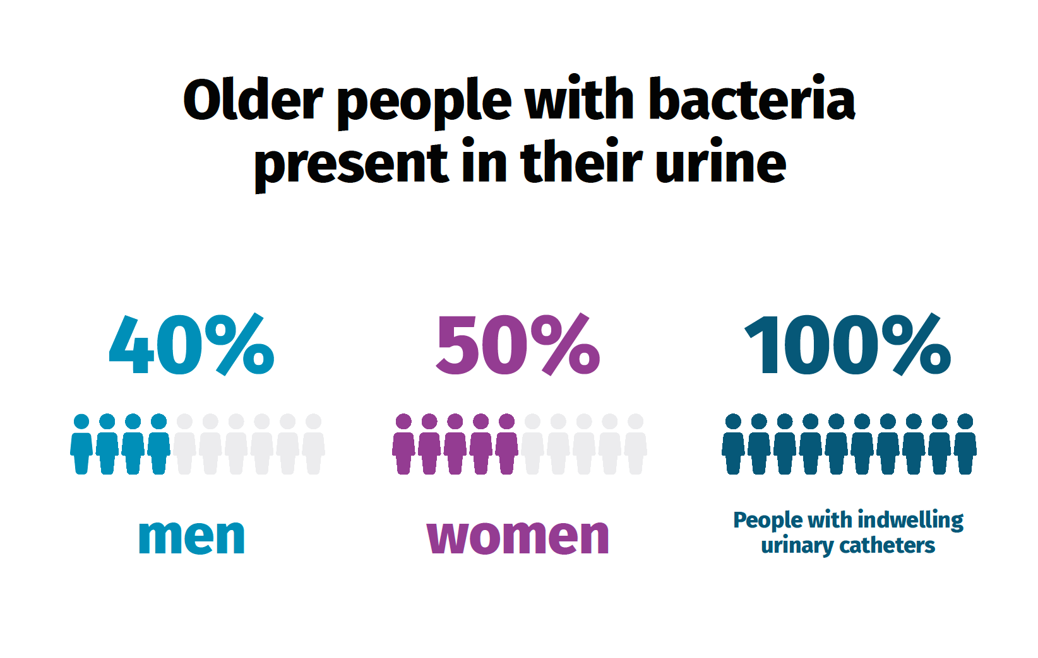
What is Asymptomatic Bacteriuria (ASB)
Harmless bacteria in urine
Antibiotic treatment is not required
Antibiotic treatment does not reduce likelihood of UTI in future
Antibiotic side-effects from treatment of ASB is preventable harm

Slide 7

To Dip or Not To Dip
Notes:
Slide 7 has embedded video link. Play the video to 00:00 to 11:14.
Video explains the background to this quality improvement activity, explains what is a UTI, what is ASB, introduces the clinical pathway

Slide 8
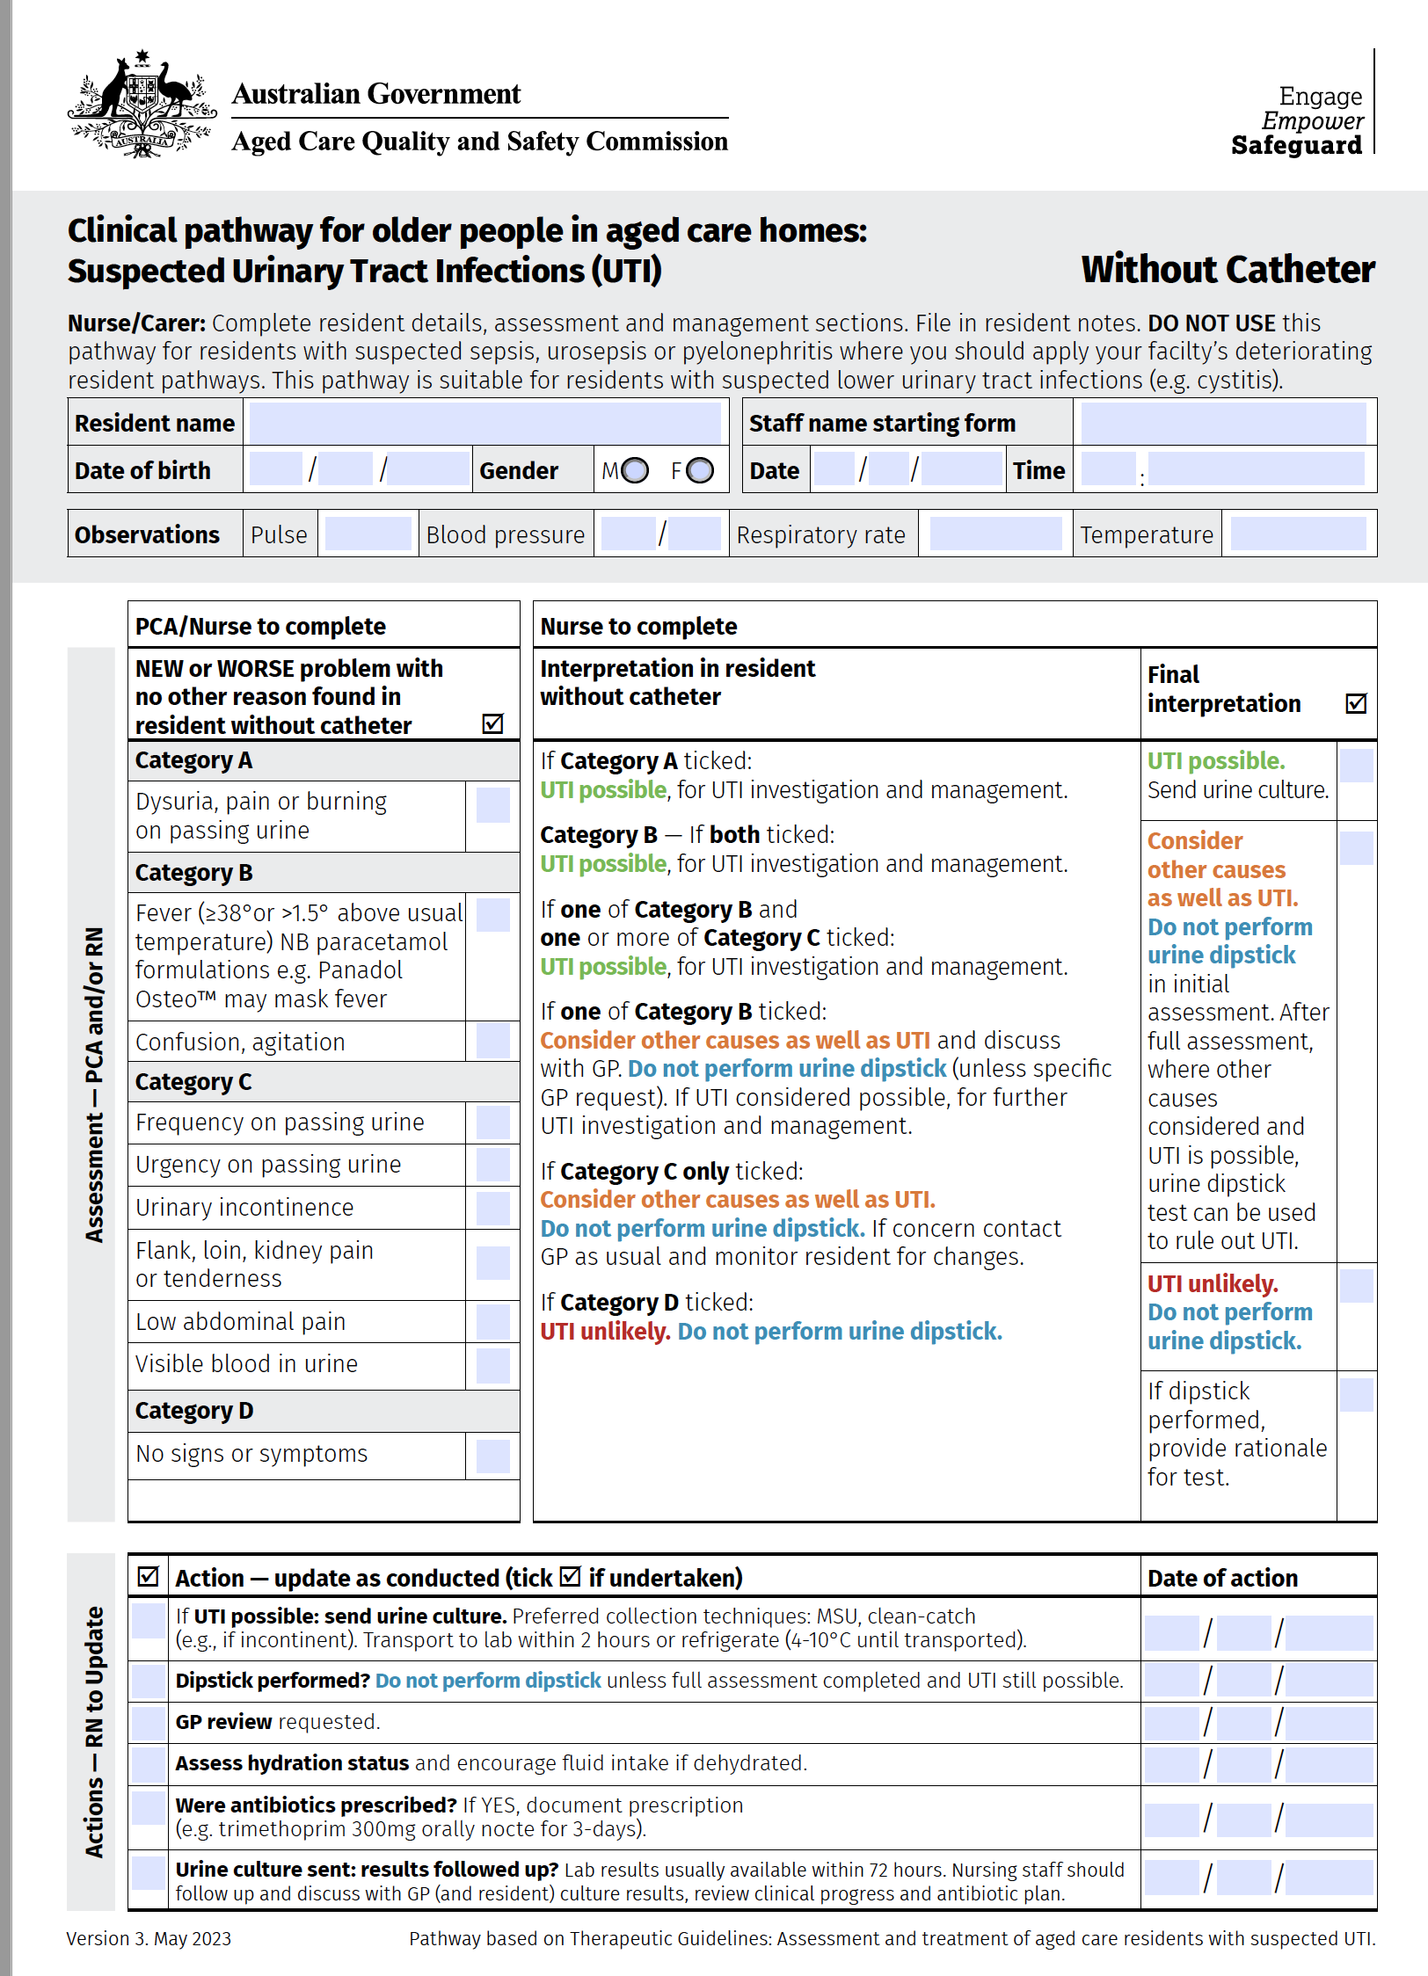
Clinical pathways are helpful…
Residents without catheter
There is also a pathway for
residents with a catheter
ACQSC Clinical Pathway is adapted from TG: Antibiotics
“Assessment and treatment of aged care facility residents with suspected UTI”
Notes:
Show clinical pathways, without catheter (this slide) and with catheter.
Emphasise that this pathway does not apply to those with serious illness, they should have separate RACF policies and procedures around that.
These are some general pointers but the point of this session is not to educate regarding sepsis or other serious medical conditions
Concern that the resident looks very unwell – this alone is enough for clinical escalation
Observations out of range BP, HR, PR, Sao2

Slide 9
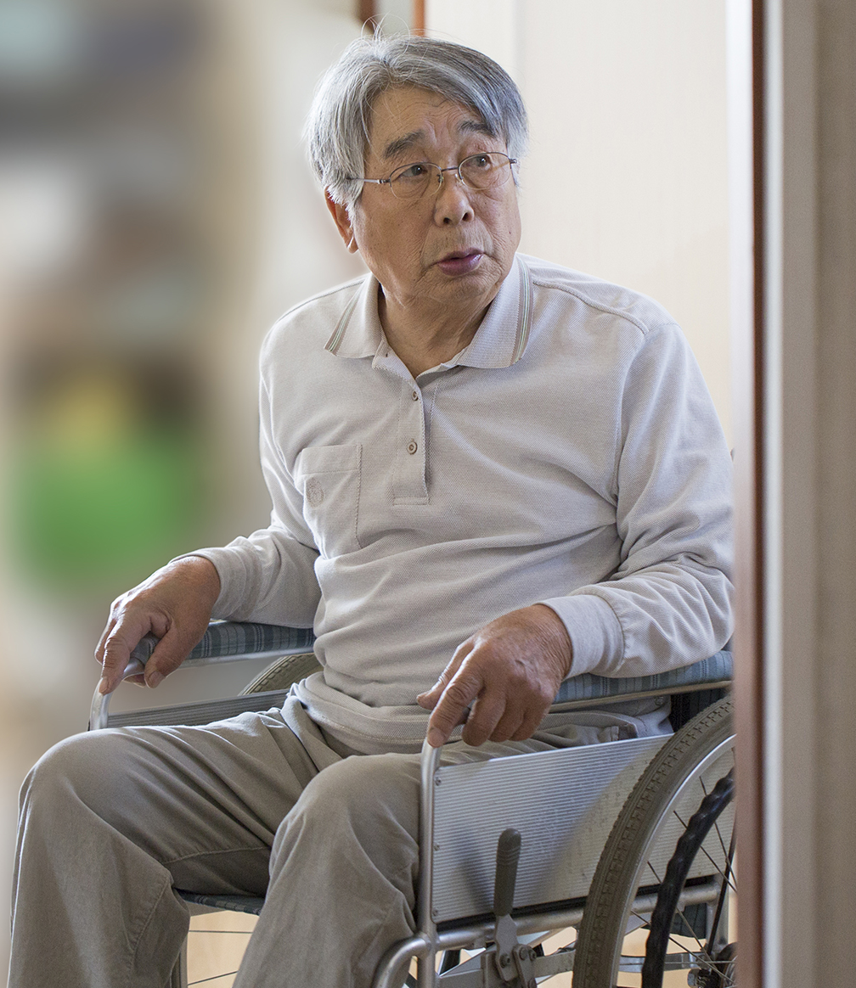
Case study 1
John Lee is an 80-year-old resident
Has had antibiotics in the past for suspected UTI
Increasing confusion over 2 days
No history of fever, temp 36.5°C
Urine: clear yellow, smells strong, not catheterised
What else should you ask about?
Notes:
If the response is urinalysis, use question prompts to draw out
-would you dip straight away?
-would you be looking for more symptoms and signs? If so, what?
-would you want to rule out other things?
-What else would you do?
The following may be offered as suitable responses
Signs of sepsis – obs out of range, BP, RR, HR, rigors, acute confusion or agitation (see alos notes Slide 10)
Signs of pyelonephritis – flank pain, urine symptoms, sepsis
UTI symptoms or signs – new or worsening…
Cystitis (Infection in Bladder) symptoms – bladder pain or pain urinating
Pyelonephritis (Infection in Kidney) symptoms – loin pain or pain over kidney(see picture)
Other Symptoms that might be UTI but might also be other conditions urine frequency, incontinence, visible blood in urine
Consider other causes
Fever or chills can be caused by infection elsewhere such as chest, skin, abdominal
New confusion can be caused by medications, infection elsewhere, neurological conditions, pain or distress
Changes in colour and smell of urine can be caused by dehydration, certain foods, continence aid change frequency, personal hygiene
Previous antibiotics and durations – if recent previous antibiotic exposure, may be at risk of resistant infection, helps doctor with choice of antibiotics
Risk factors for UTI- catheter
Hydration – strong smelling urine could be related to dehydration from illness (infectious or not infectious cause)

Slide 10
Case study #1 John Lee
80 year-old resident in an aged care home
Has had antibiotics in past
for suspected UTI
Increasing confusion over 2 days
No history of fever, temp 36.5°C
Urine: clear yellow, smells strong
  Is this serious requiring
  immediate escalation?
  Sepsis
  Pyelonephritis
  What else could it be?
  New or worse confusion can be caused by many medical, medication problems or environmental situation
  Infection at other sites
John has no features of sepsis based on observations
Possible causes of new confusion:
Infection – chest, skin, abdominal
Medication-related
Severe pain, distress
Environment
  Is this a UTI?
  Any new or worse symptoms
  that point to UTI?
  Cystitis (Infection in bladder)
  bladder pain or pain urinating
  Pyelonephritis (Infection in kidney)
    flank pain or pain over kidney (see illustration)
  Other symptoms that might be UTI
  but might also be other conditions
  urine frequency, incontinence,
  visible blood in urine
  Other useful information?
  Current or recent urinary catheter (IDC or SPC)
  Hydration status
  Recent urine culture results
  Recent or current antibiotics
Notes:
Is this serious requiring immediate escalation? - Say "Let's go through this step by step”
Response:
Signs of sepsis – observations out of range, BP, RR, HR, rigors, acute confusion or agitation
Signs of pyelonephritis – flank pain, urine symptoms, sepsis, UTI symptoms or signs – new or worsening…
Is this a UTI?
Cystitis (Infection in Bladder) symptoms – bladder pain or pain urinating
Pyelonephritis (Infection in Kidney) symptoms – loin pain or pain over kidney (see picture)
Other Symptoms that might be UTI but might also be other conditions urine frequency, incontinence, visible blood in urine
What else could it be? Consider other causes that cause similar symptoms or signs
Fever or chills can be caused by infection elsewhere such as chest, skin, abdominal
New confusion can be caused by medications, infection elsewhere, neurological conditions, pain or distress
Changes in colour and/or smell of urine can be caused by dehydration, certain foods, continence aid change frequency, personal hygiene
Other useful information
Previous antibiotics and durations – if recent previous antibiotic exposure, may be at risk of resistant infection, helps doctor with choice of antibiotics
Risk factors for UTI- catheter
Hydration – strong smelling urine could be related to dehydration from illness (infectious or not infectious cause)
Does a urine dipstick testing help? Explain that the most important thing is to clinically assess John for UTI and also other possible causes for increasing confusion. His only symptoms is increasing confusion that is new. This could be caused be non-infective causes or infective causes, of which UTI is one of the possible sites of infection but not the only one. If dipstick testing is performed as the first test, this may lead to the real diagnosis being missed.
The best approach is to perform a top to toe assessment of John, discuss with GP regarding all possibilities. Dipstick testing should not be performed by carer or nursing staff unless the GP feels that it will be useful as a rule out test for UTI. It is not useful as a rule in test as it cannot separate UTI from ASB. If acute confusion is the only symptom or sign, urine dipstick testing is not recommended as urine dipstick testing is not useful as a rule out test.
Explain that the clinical pathway explains this as well.

Slide 11
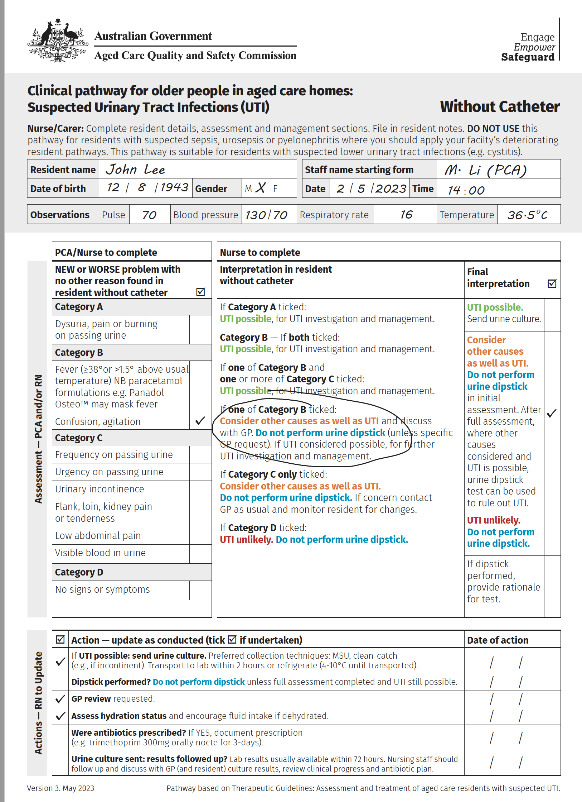
Case study #1 John Lee
Increasing confusion over 2 days
No history of fever, temp 36.5°C
Urine: clear yellow, smells strong
Notes:
Invite discussion on whether participants feel that they can use the pathway or not?
Some reasons that they may raise are
Resident with cognitive impairment
Resident with chronic incontinence
Residents don’t meet criteria in pathway and even after thorough assessment, we think infection, especially UTI is still possible
Refer nurses to read “User guide to clinical pathway”.
This provides detailed information to help respond to above.
Some points to mention:
A clinical pathway is a guide and does not replace clinical judgement.
Not all residents can be assessed according clinical pathway, but mopst can (even those with cognitive impairment).
The clinical pathway encourages
– not relying on a dipstick test result to diagnose UTI
Performing a thorough clinical assessment first to ensure nothing missed
If after this has been done, if UTI is still suspected because no other obvious reason has emerged, a urine dipstick test can be helpful in ruling out UTI, but not helpful in ruling in UTI.

Slide 12
Practice points:
Does a resident have a suspected UTI?
Look to see if resident has symptoms or signs that suggest they have a UTI
Also consider whether their symptoms
may be related to other conditions
Use the clinical pathways to help guide your decision-making
Notes:
End of Case Study 1
Show participants paper copies of accompanying “user guide to clinical pathway” that provides detailed information on urine culture and antibiotic prescribing.

Slide 13

Case study 2
Mary Brown is a 78-year-old resident
New urinary incontinence
Temperature 38°C
Antibiotics previously for suspected UTI
Is this serious requiring immediate escalation?
Is this a UTI?
What else could it be?
What are your next steps?
Does urine dipstick help?
Notes:
Seek comments using Slide 12 prompts.
Ask participants to complete blank clinical pathway using Case Study 2 information.
What requires immediate escalation?
It should be emphasised that this pathway does not apply to those with serious illness, they should have separate RACF policies and procedures around that.
These are some general pointers but the point of this session is not to educate regarding sepsis or other serious medical conditions
Concern that the resident looks very unwell – this alone is enough for clinical escalation
Observations out of range BP, HR, PR, Sao2

Slide 14
Case study #2
Mary Brown
78 year-old resident in aged care home
No confusion/delirium
New incontinence
Temp 38°C
Has had antibiotics in the past
for suspected UTI that worked
Is this a UTI?
  Incontinence is new, resident has fever
  Other information you want to know
    Are the rest of her clinical
    observations stable?
    Is she eating, drinking, vomiting?
    Does she look or feel unwell?
To exclude
Other causes of incontinence:
diuretics, urinary retention with overflow
Other causes of fever:
skin or chest infection, viral infection
Mary Brown, additional information on examination
Has no IDC
Has no other causes of symptoms identified
Other observations stable; RR, HR, BP
Eating and drinking well
Notes:
Present Slide 13sand use slide note prompts to deliver the key message: where UTI is possible a urine dipstick is unnecessary as you have already come to the conclusion using signs and symptoms.
Is this serious requiring immediate escalation?
It may be if she has observations that fulfil sepsis e.g., unstable/low BP, looks very unwell -> she may need to go to hospital. If so, she will need medical review at the very least.
See also notes Slides 8 and 13
Is this a UTI?
Possible. As she has a fever highly likely she has an infection. New incontinence suggests urine source possible. However we should check her over to make sure she has no infection elsewhere e.g., skin infection
What else could it be?
Infection highly likely, see above answer. UTI likely. Less likely infection elsewhere but still check over. Uncommonly, fever can be caused by incorrect reading of thermometer, medications, heat intolerance
What are your next steps?
In medical emergency, may need hospital care. If less urgent, medical review.
Does urine dipstick help?
Yes it can help- if positive supports your what you suspected i.e. it is a possible UTI. This is because you were already suspicious based on symptoms and signs. If Mary did not have urinary tract related symptoms or signs, a positive dipstick is because they have ASB. If the result was negative in Mary’s case, you would have to carefully look for a source of infection separate to UTI.
NB Text in bold is a very important concept to explain

Slide 15
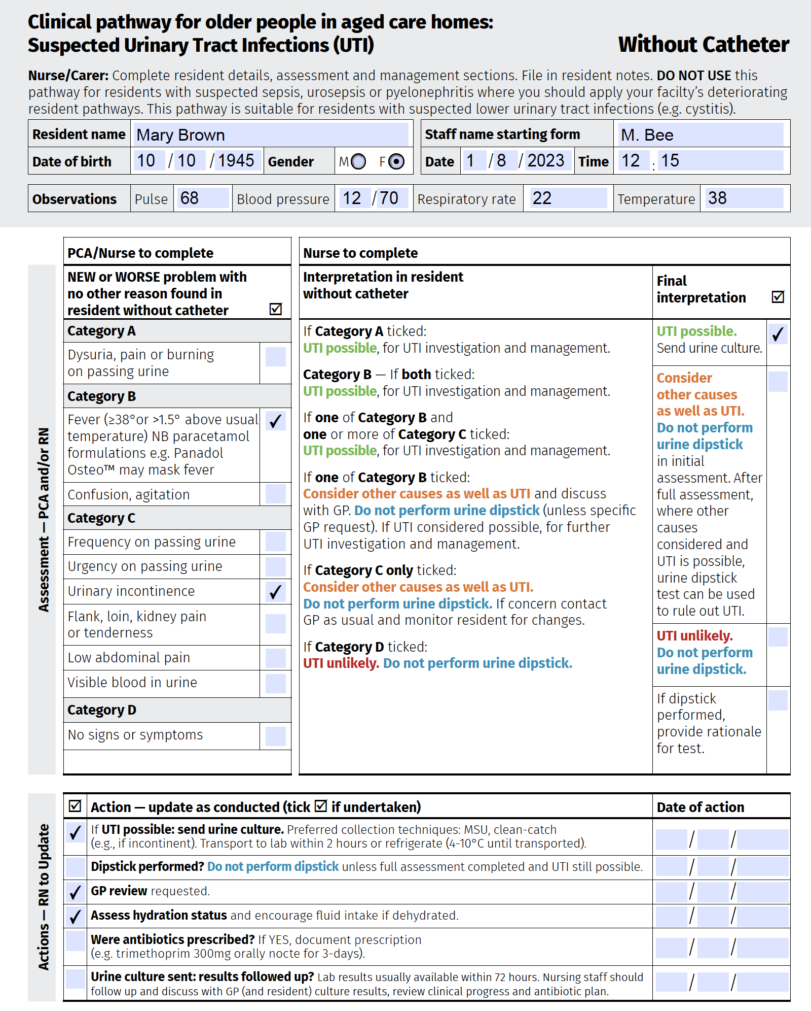
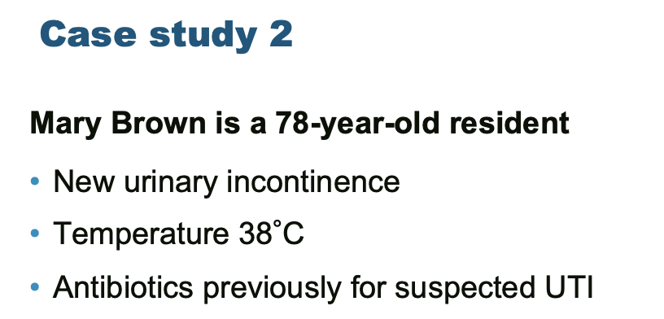
120/70

Slide 16
We notice that on Mary’s medication chart she was started on a fluid tablet last week. Could this explain her new incontinence?
We recheck temperature and it is 38°C. We feel this is most likely because of infection.
Should we perform a urine dipstick test?
A urine culture is sent off.
Notes:
Follow Slide prompts.
Ask Should we perform a urine dipstick test?
Provide answer: As we have completed a thorough clinical assessment and cannot find a reason for her fever, and she has new incontinence, a urine dipstick test can be performed.
A negative result should prompt use to look for other causes of her fever apart from UTI.
A positive result is not useful in diagnosing a UTI as it could be because of ASB or UTI.
Mary fulfils the criteria for UTI possible based on her symptoms and signs we can go ahead and send a urine culture.

Slide 17
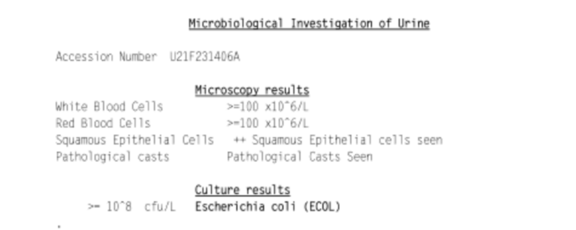
It is now a few days later
Mary’s urinary incontinence has gone away as we are reminding her regularly to go to the toilet.
Mary has now developed a sore throat and cough. It seems like a viral respiratory tract infection is the likely cause of her fever.
The urine culture result is back and has grown E. coli
Does Mary have an E. coli UTI?
Notes:
Follow Slide prompts.
Ask Does Mary have and E.coli UTI?
Provide answer: We have found other reasons for her symptoms and signs.
She does not have an E.coli UTI, she has ASB.
Key message:
Positive dipstick or urine culture may indicate ASB. It does not confirm a UTI diagnosis.
We need to check whether the symptoms or signs suggest UTI.

Slide 18
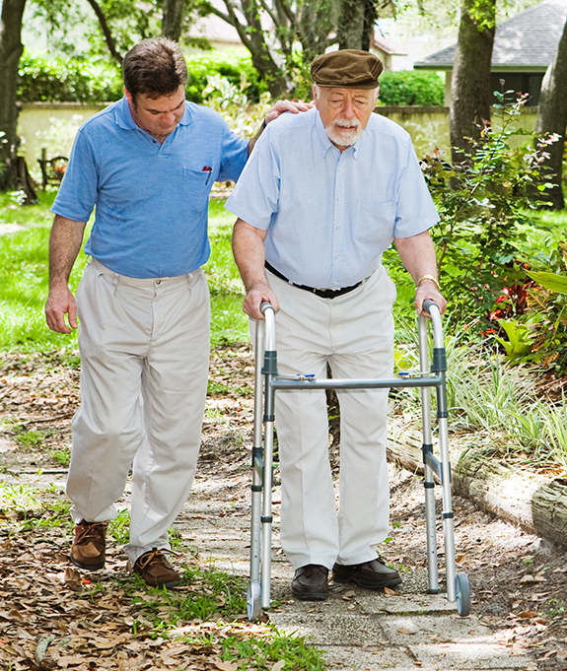
Case study 3
  Glen Edwards is a 72-year-old resident
    Stroke three years ago, cognitive impairment
  2 admissions to hospital for UTI, multiple courses of antibiotics
  C. difficile diarrhoea with recent antibiotics
Simon, his son, visits and notices Glenn is sleepier
than usual and that his urine smells.
Simon thinks this might be another UTI and wants
him started on antibiotics right away.
How do you respond to Simon’s request?
Should the GP be contacted to prescribe antibiotics?
18
Notes:
Present Case Study 3.
Seek comments using slide question prompts.

Slide 19
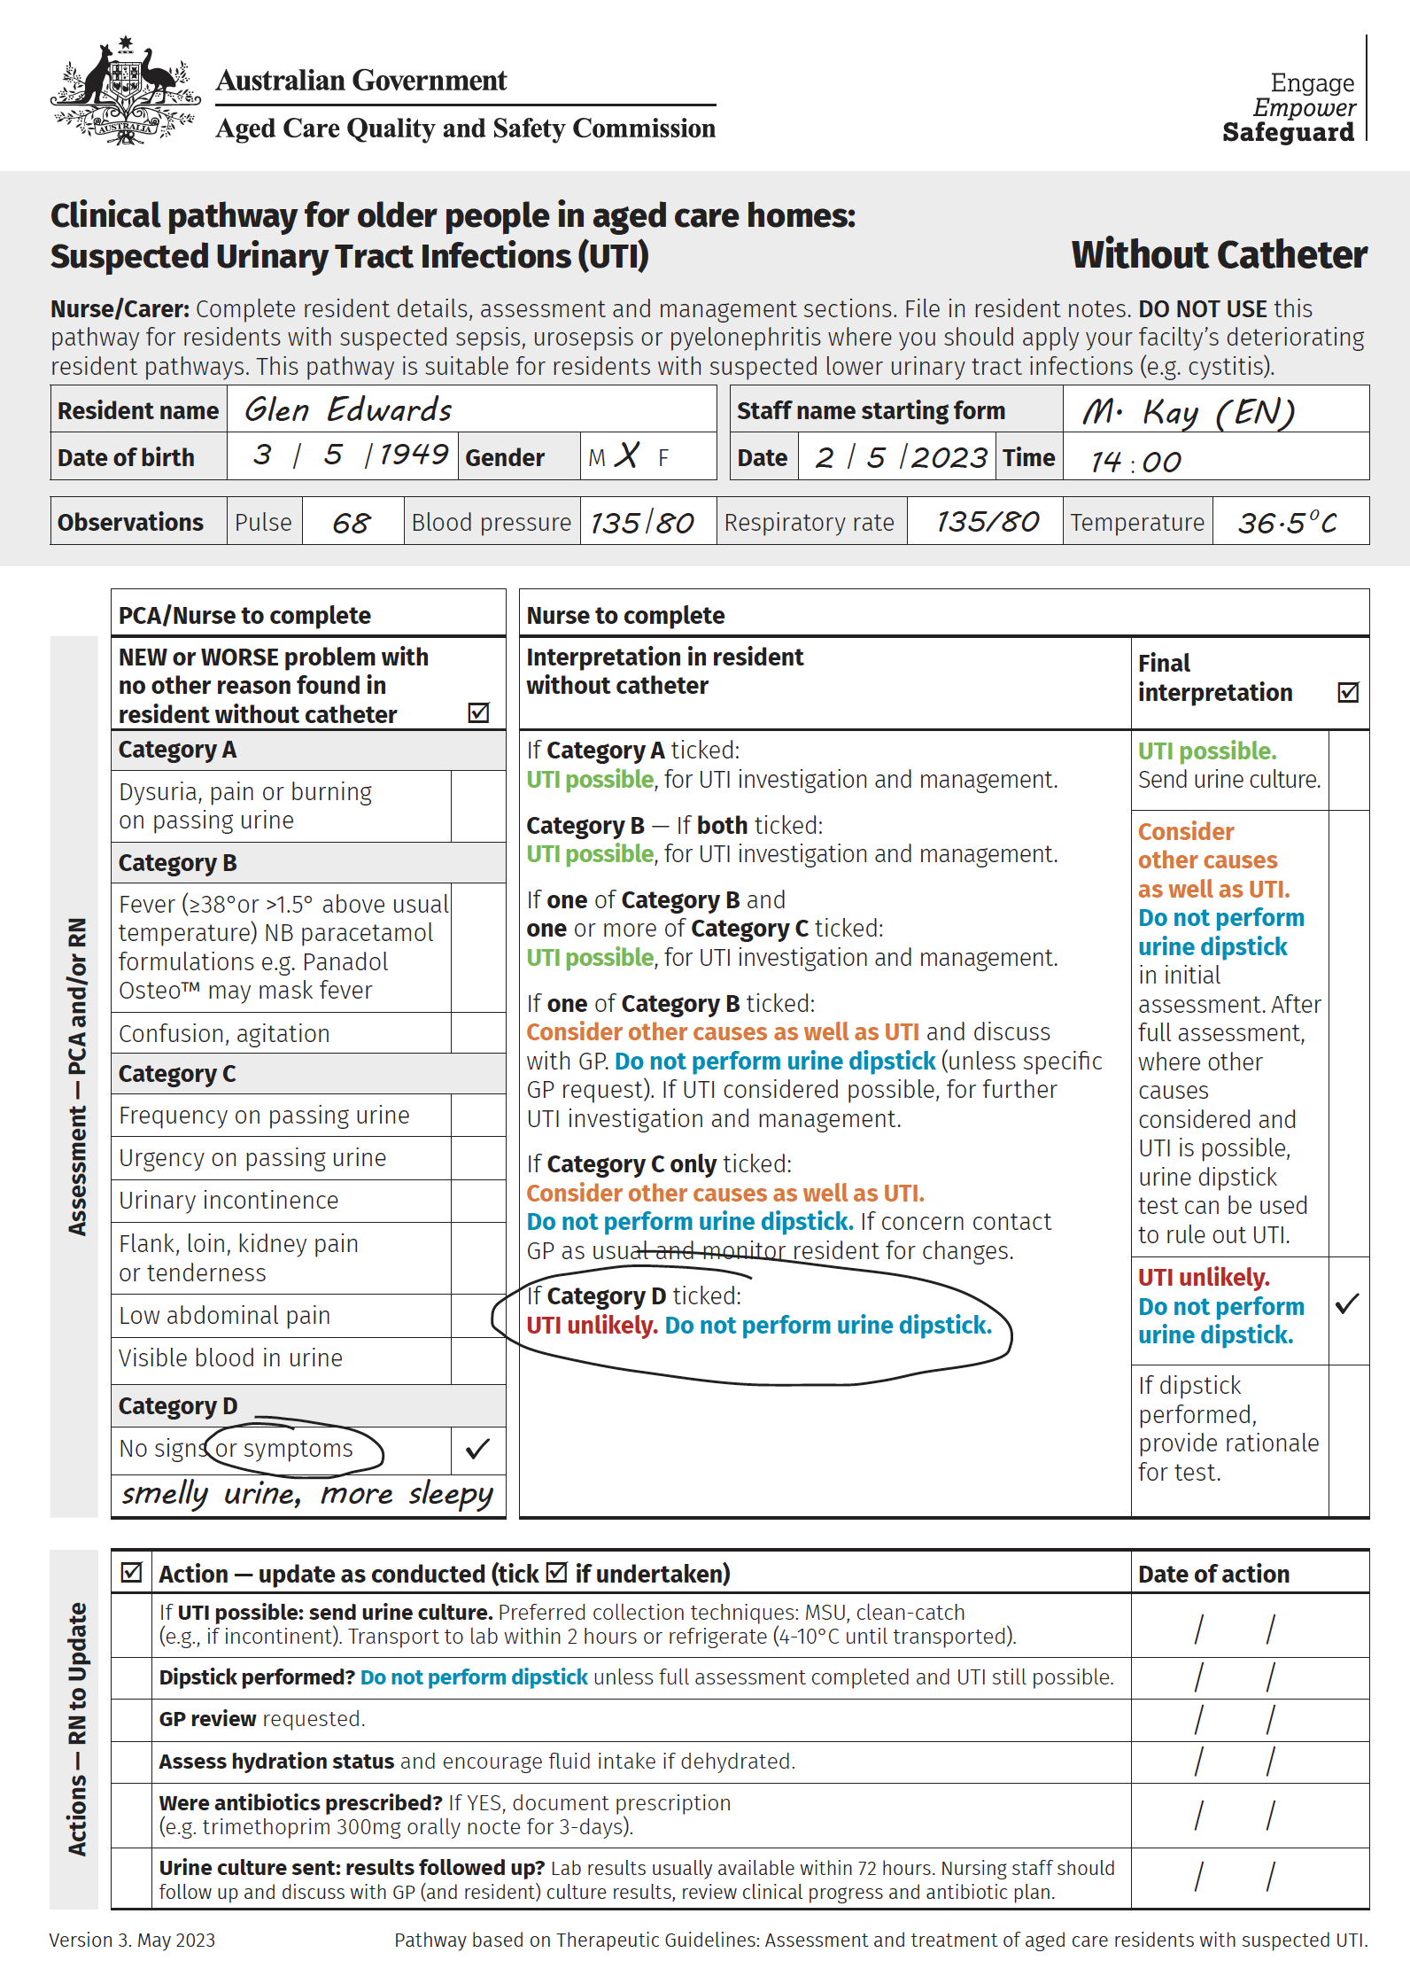
Case study 3 Glenn Edwards
Previous UTI, multiple antibiotics,
C.difficile infection related to antibiotics
New concern: sleepier than usual and smelly urine
72 year-old resident in care home
Stroke 3 years ago,
cognitively impairment
Let’s use this clinical pathway for Case 3
Glenn Edwards
Clinical assessment
Staff noticed that Glen was sleepy this
morning but did not notice this yesterday.
Glenn’s clinical observations are normal, he does
not have any pain in the abdomen or kidney area.
His appetite was fine this morning.
He is continent.
Notes:
Explain this is a situation where UTI is not the most likely diagnosis and a positive dipstick would likely be related to ASB rather than UTI.
Ask participants what they would do if speaking to Simon and responding to his concerns about his father?

Slide 20
Communication with resident and family
First, explain the Situation. Glenn’s current state, what is Simon concerned about?
Next, share some Background information about Glenn and why it can be harmful
for him to receive unnecessary antibiotics.
Provide Simon with your Assessment
of Glenn. What other factors might
be influencing his father’s health,
and what makes you think that this
might not be a UTI?
Consider providing residents and family members with information, such as the ACQSC “Do I need Antibiotics - Information for aged care residents and families, carers and representatives”
Share your alternative Recommendation for Glenn’s care. It is helpful to emphasise that you are recommending this course
of action out of your concern for Glenn’s wellbeing and that you will monitor
him closely and keep Simon updated.
Adapted from CDC resources for clinical staff managing Infections in LTCFs
Notes:
Show Slides18 and 19 to prompt discussion on having conversations with families.
Ask “is this something that you can include in your everyday practice?”

Slide 21

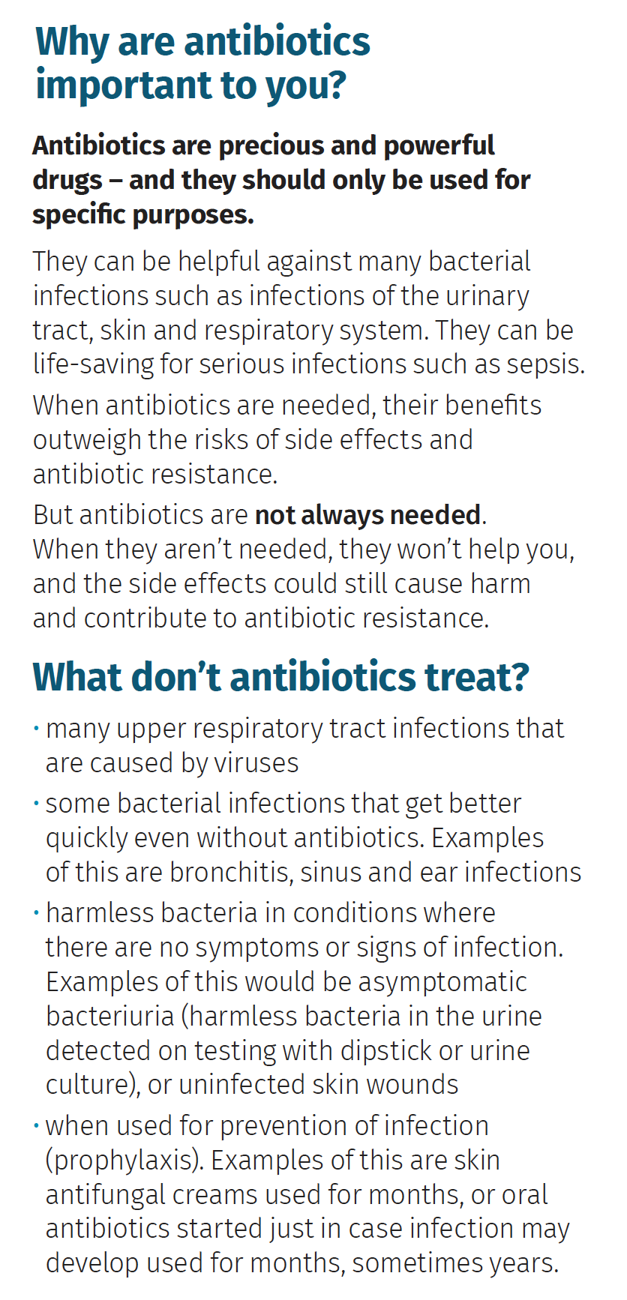
Consider What Residents
and Families are Actually Saying
Example Dialogue
Family says: “My dad always
looks like this when he has a UTI.”
We are going to watch
him closely
Let’s help him drink more fluids.
Would you be able to encourage
him to drink some extra juice?
Family says: “Let’s just give
him antibiotics just in case.”
Antibiotics won’t help
if he doesn’t have a UTI
Antibiotics could hurt
him (e.g., diarrhoea)
We don’t want to miss
the real cause
Placeholder for Do I need Antibiotics- Information for ACH Consumers and family
Educate residents and families regarding antibiotic use!
Ensure that residents’ needs for pain relief and other supportive care are met.
Adapted from CDC resources for clinical staff managing Infections in LTCFs
Notes:
Ask “is this something that you can include in your everyday practice?”

Slide 22
Practice Points: Take-home messages
Bacteria in urine is very common. This may not mean an infection is present.
Positive results from a dipstick test or urine culture may indicate ASB. It does not confirm a UTI diagnosis.
We need to check whether the symptoms or signs suggest UTI.
Smelly, dark or cloudy urine or falls are not symptoms or signs of UTI.
We need to look for other causes.
In residents who are unwell, the first step is a thorough clinical assessment and to discuss your findings with the GP.
Come to a decision together whether to perform a dipstick test. Remember, a positive dipstick test result could be due to ASB or UTI. A negative result suggests we should keep an open mind about non-UTI causes.

Slide 23
What is the harm in dipstick testing?
It is difficult to ignore a positive result
The real diagnosis may be missed
Antibiotics may be unnecessarily prescribed.

Slide 24
Thank you for your participation today.
Further questions or comments?
All these resources are available on Aged Care
Quality and Safety Commission website
https://www.agedcarequality.gov.au/providers/better-use-medication/antimicrobial-stewardship
Acknowledgements:
To Dip or Not to Dip resources adapted from NHS To Dip or Not to Dip campaign,
Dr Amelia Joseph, Elizabeth Beech
Notes:
Wrap up
Ask them
-what they thought of the session?
-any questions or comments about any of the content discussed today?
- will this change their practice around urinalysis?
-to Identify one practice they can take and try on the floor
Thank group for their time and participation.
Mention again all these resources are available on ACQSC website. Remind participants that they can watch the full video after this session (only 16 minutes, on Youtube. Look for ACQSC and “To dip or not to dip video”.

