Slide 1

Your rights in aged care

Slide 2

Introduction
This presentation supports aged care providers and workers yarn with older mob and their families about aged care. It covers:
explaining aged care options
planning your home care
planning your residential care
speaking up.
In the spirit of reconciliation, the Aged Care Quality and Safety Commission acknowledges the Traditional Custodians of Country and Island homes throughout Australia and their connections to land, water and community.
We pay our respect to their Elders, past, present and emerging and extend that respect to all Aboriginal and Torres Strait Islander people.
Please know there may be images of, or images that look like people who have passed into the Dreaming.
Artwork by Chern’ee Sutton - proud Kalkadoon woman.

Slide 3

Explaining aged care options

Slide 4
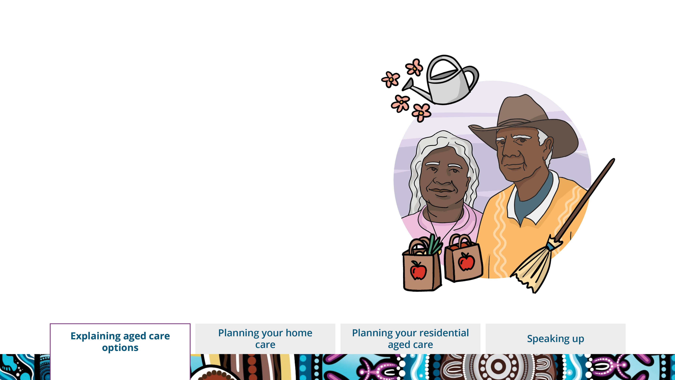
Explaining aged care options
Are you aged 50 or over?
Need help:
• with everyday jobs
• looking after yourself
• getting around?
You may be able to get aged care.
Notes:
Explaining aged care options. Aged care is available for mob that are 50 and over.
If you need help with everyday things like cleaning, cooking, showering, shopping and getting out and about, you might be eligible for aged care.

Slide 5
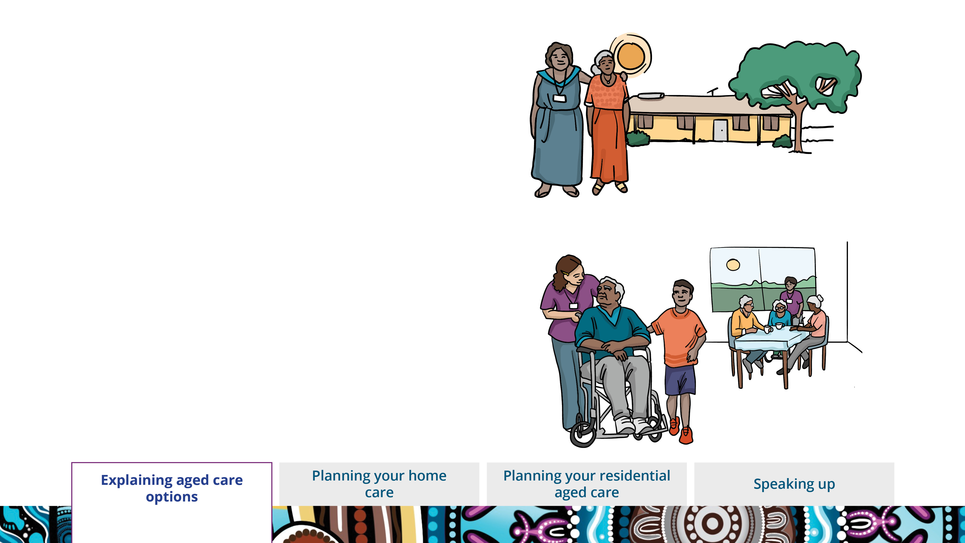
You can get aged care in your own home.
Some people might live in an aged care home.
Notes:
You can get aged care in your own home.
We have people that can help you and your family there.
Some people can live in an aged care home if they need more support.

Slide 6
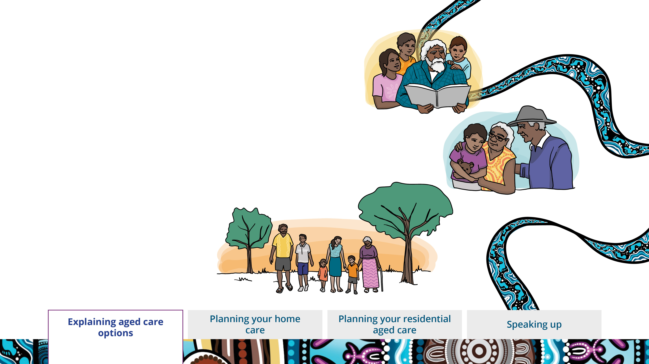
You have rights.
Your connection to family, community and Country must be respected.
It’s your aged care, your way.
Notes:
It doesn’t matter what aged care you get – there’s one thing that’s the same.
You have the right to good, safe aged care.
You have the right to make choices about your aged care.
Your connection to your family, community and Country must be respected.

Slide 7
Planning your home care

Slide 8
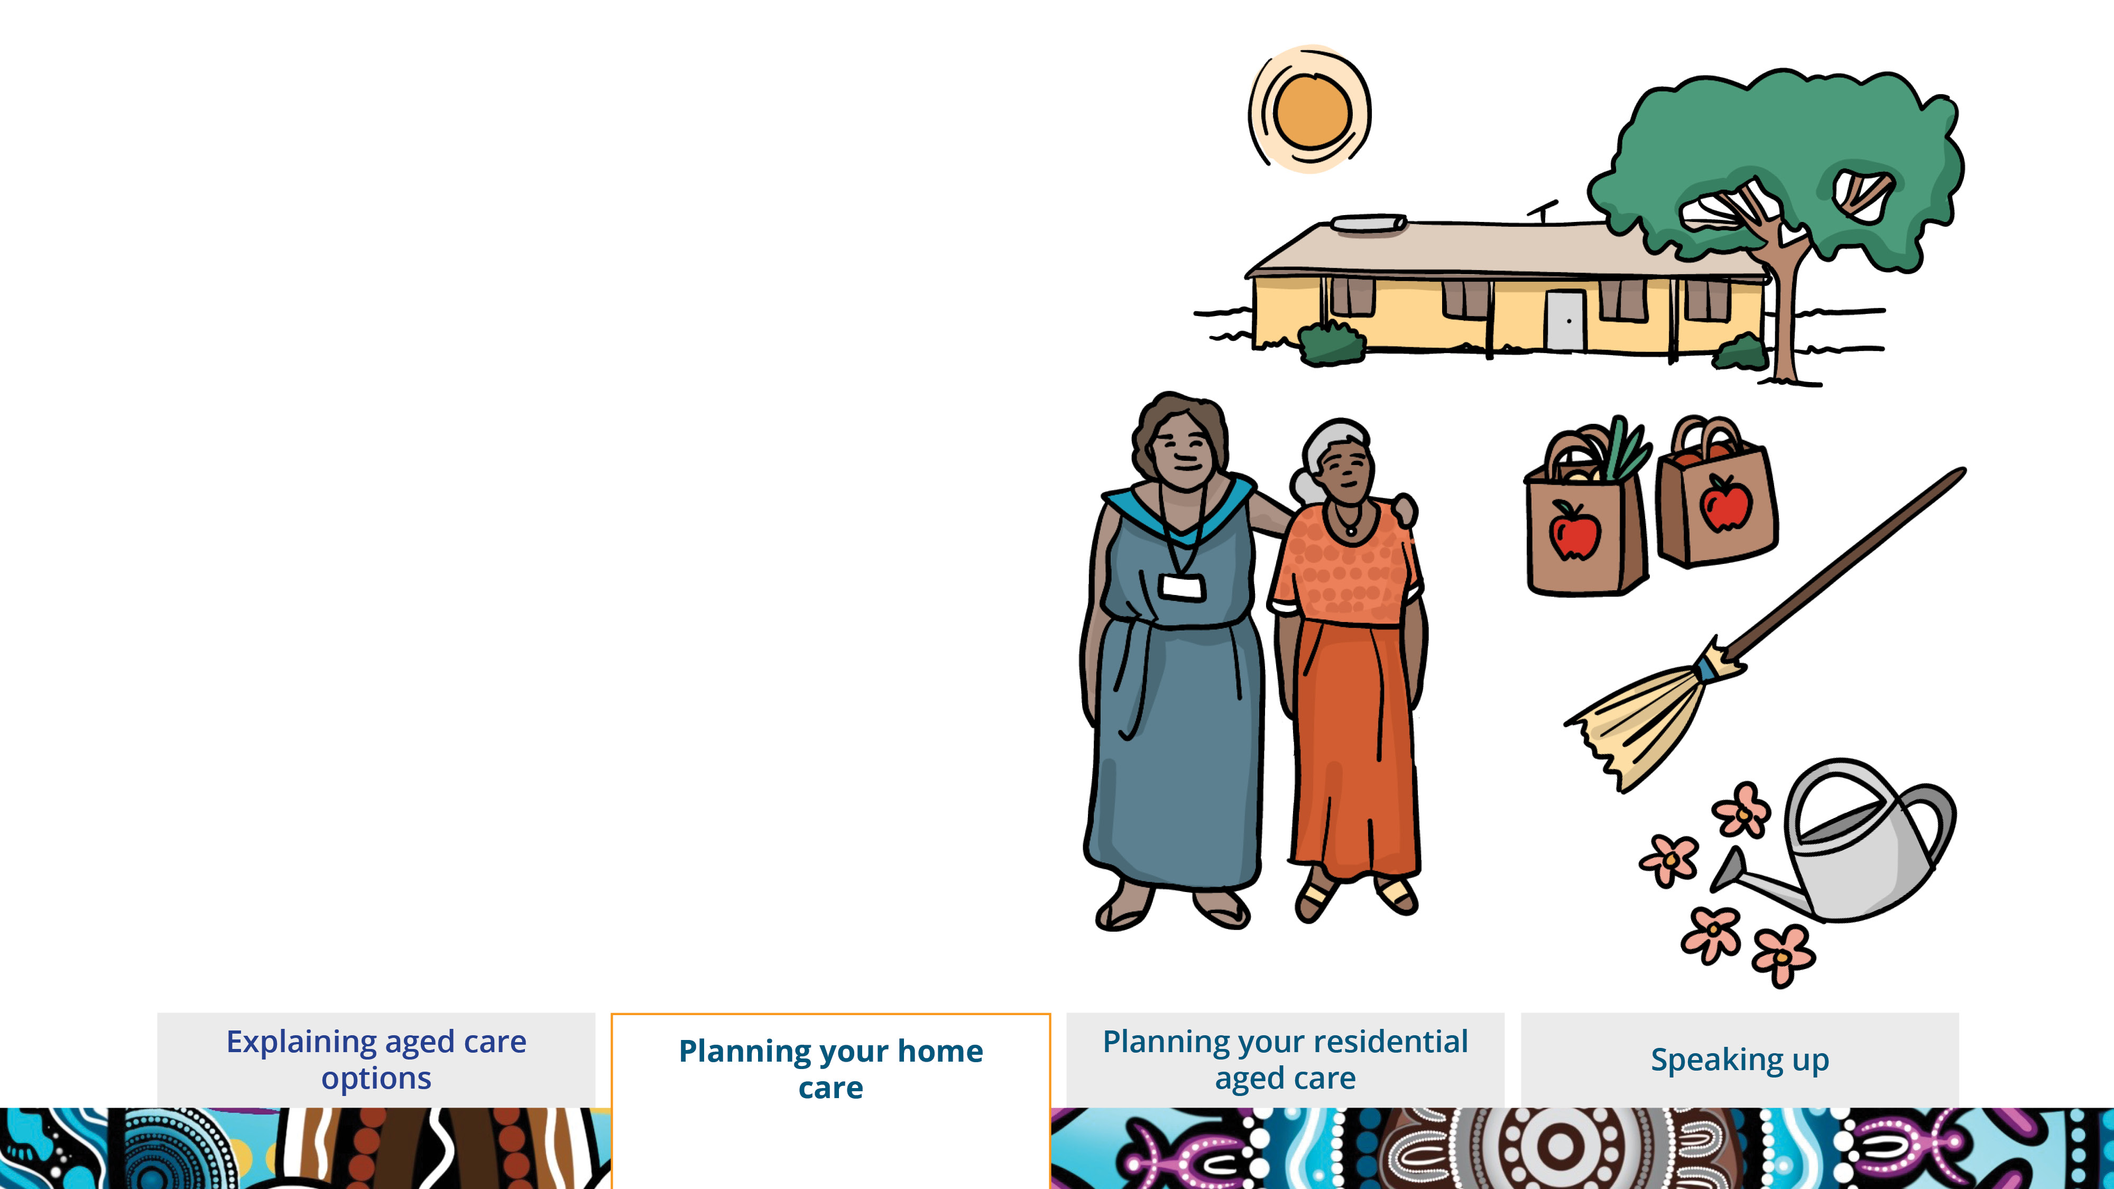
Planning your home care
You might need a little bit or a lot of help at home for things like:
getting around
shopping
cleaning
gardening.
Notes:
Planning your home care.
Home care is getting aged care help while you live at home.
It can be for things like:
getting to appointments
help with going to the toilet or showering
getting groceries or going shopping
cleaning, gardening or other jobs at home.

Slide 9
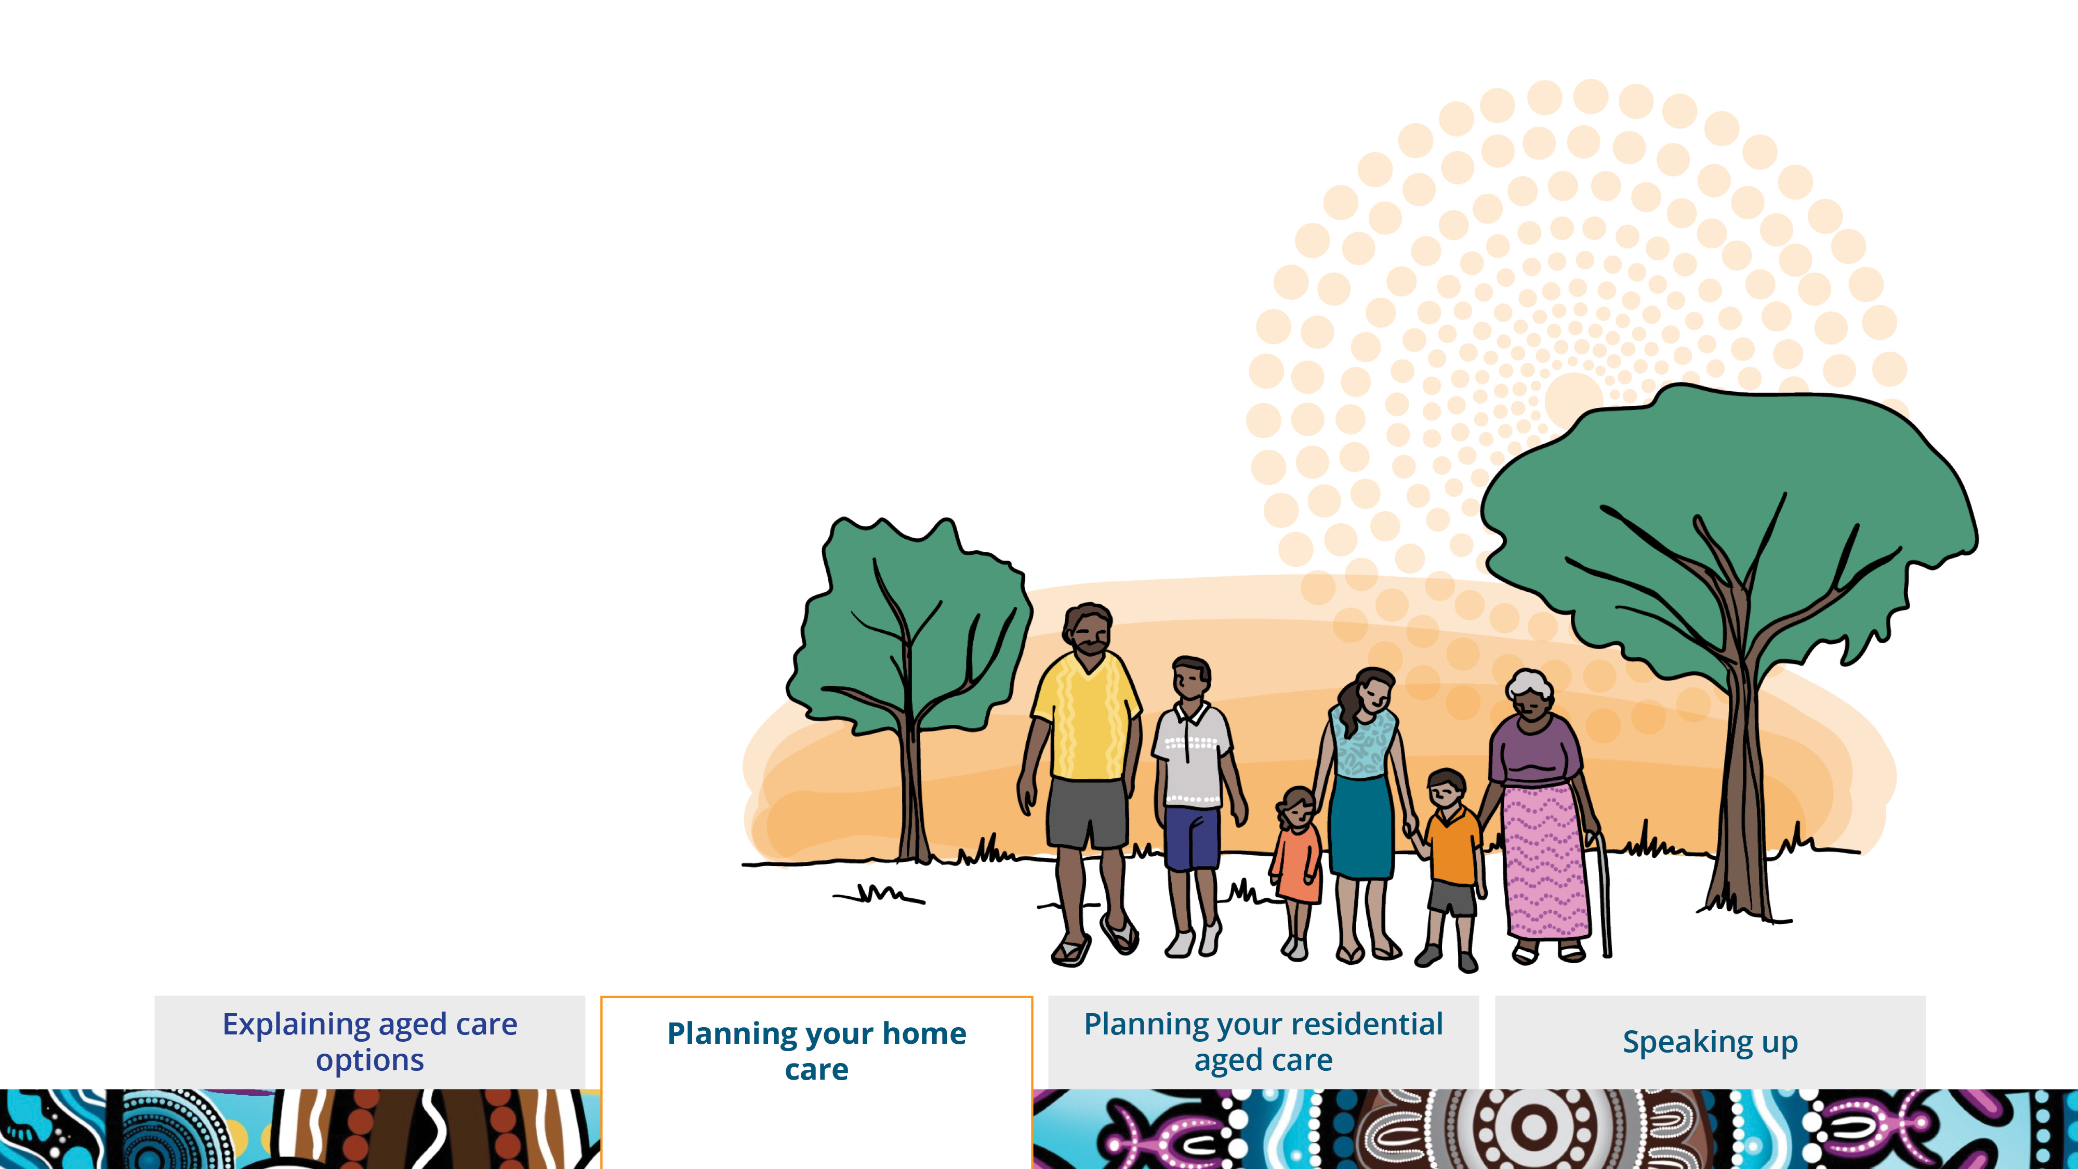
Your family can be part of your care if you want them to be.
Let us know who you want there when we yarn with you about your care.
Notes:
Let us know if there are important people or family you want involved in your care.
We can make sure they are updated about your care and include them when we yarn with you about your care.

Slide 10
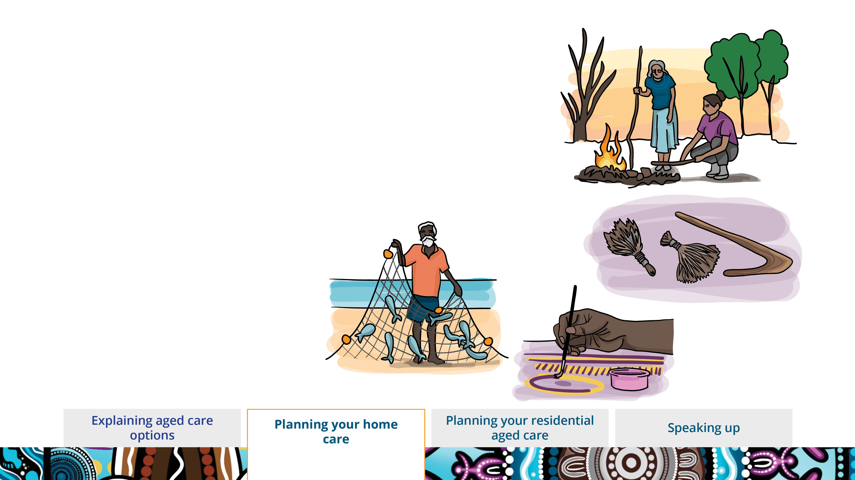
Tell us what is important to you and your culture.
We can help you stay connected to your community and Country.
Notes:
Let us know about things that are important to you and your culture that we can help with.
Like taking you to special places or ceremonies.
Or helping you do things that are important to you, like painting or fishing.

Slide 11
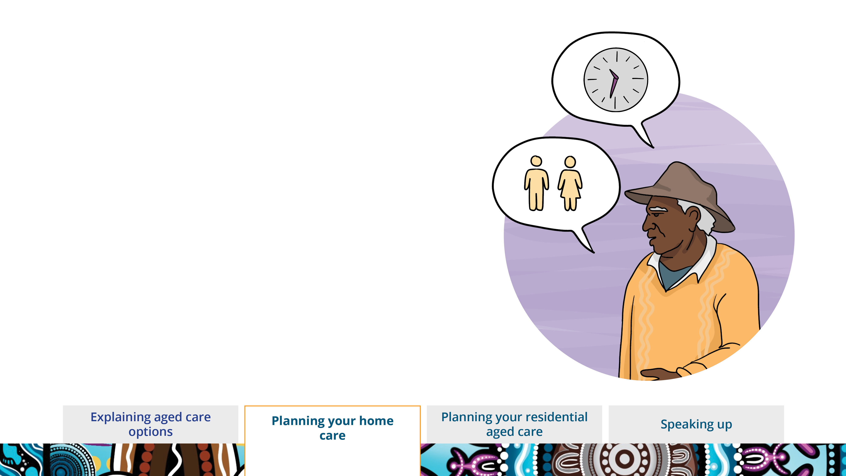
Tell us what you want in your aged care.
Tell us who you’d like to look after you – like if you want a man or a woman to help you.
Tell us when you want your aged care help.
Notes:
Tell us what you’d like for your aged care help.
Like if you want a man or woman to help you.
Or if there are certain times or days that you want help.

Slide 12
Planning your residential aged care

Slide 13
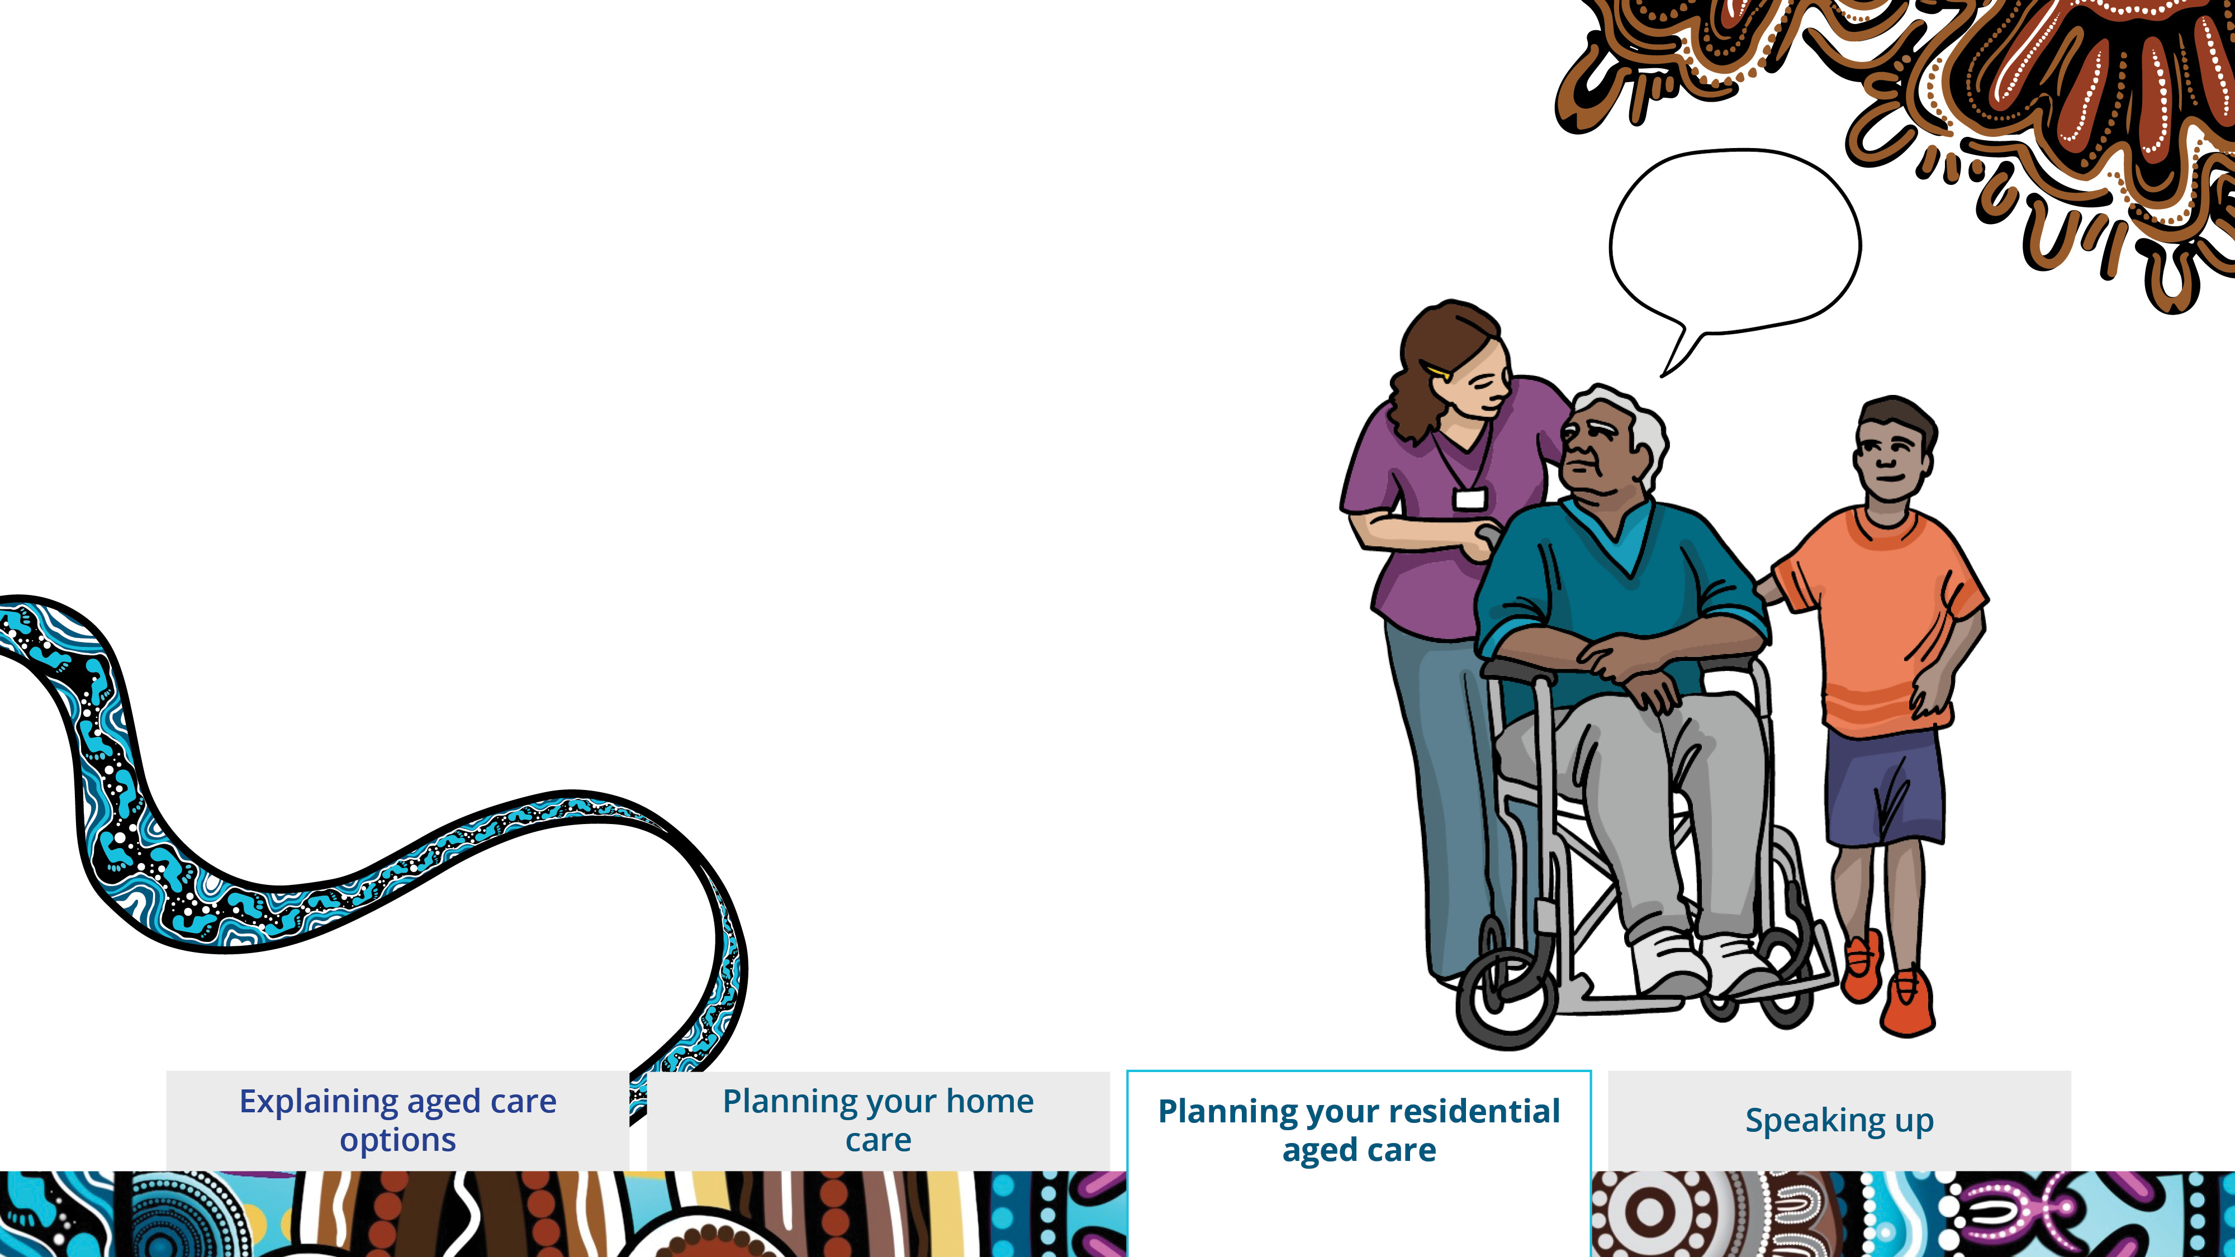
Planning your residential aged care
We want you to feel at home here.
Tell us what will help you feel
comfortable here.
Notes:
Planning your residential aged care
We know being away from home can be hard.
We want to help you feel at home here.
Let us know what will help you feel at home and connected to family, community and Country.

Slide 14
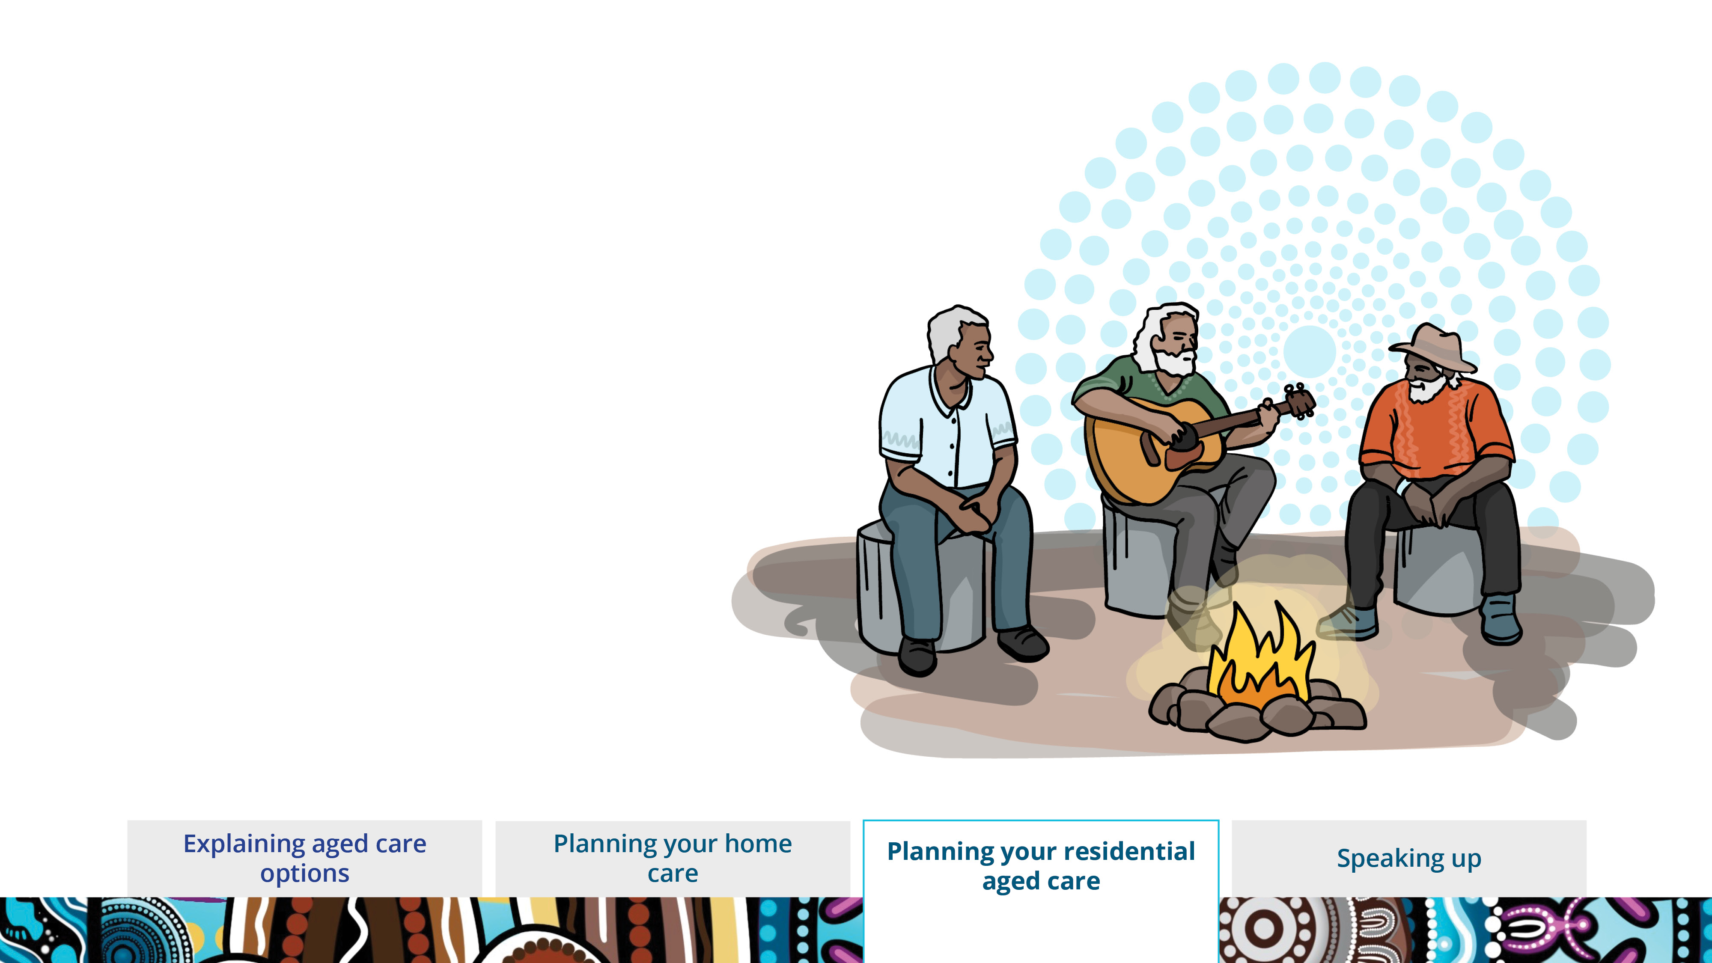
We know a small piece of home can make a big difference.
Tell us what’s important to you and your culture.
Notes:
We like to learn about your culture. Tell us what’s important to you.
Let us know if there are things that you like to do.
This could be listening to music, sitting outside or painting.

Slide 15
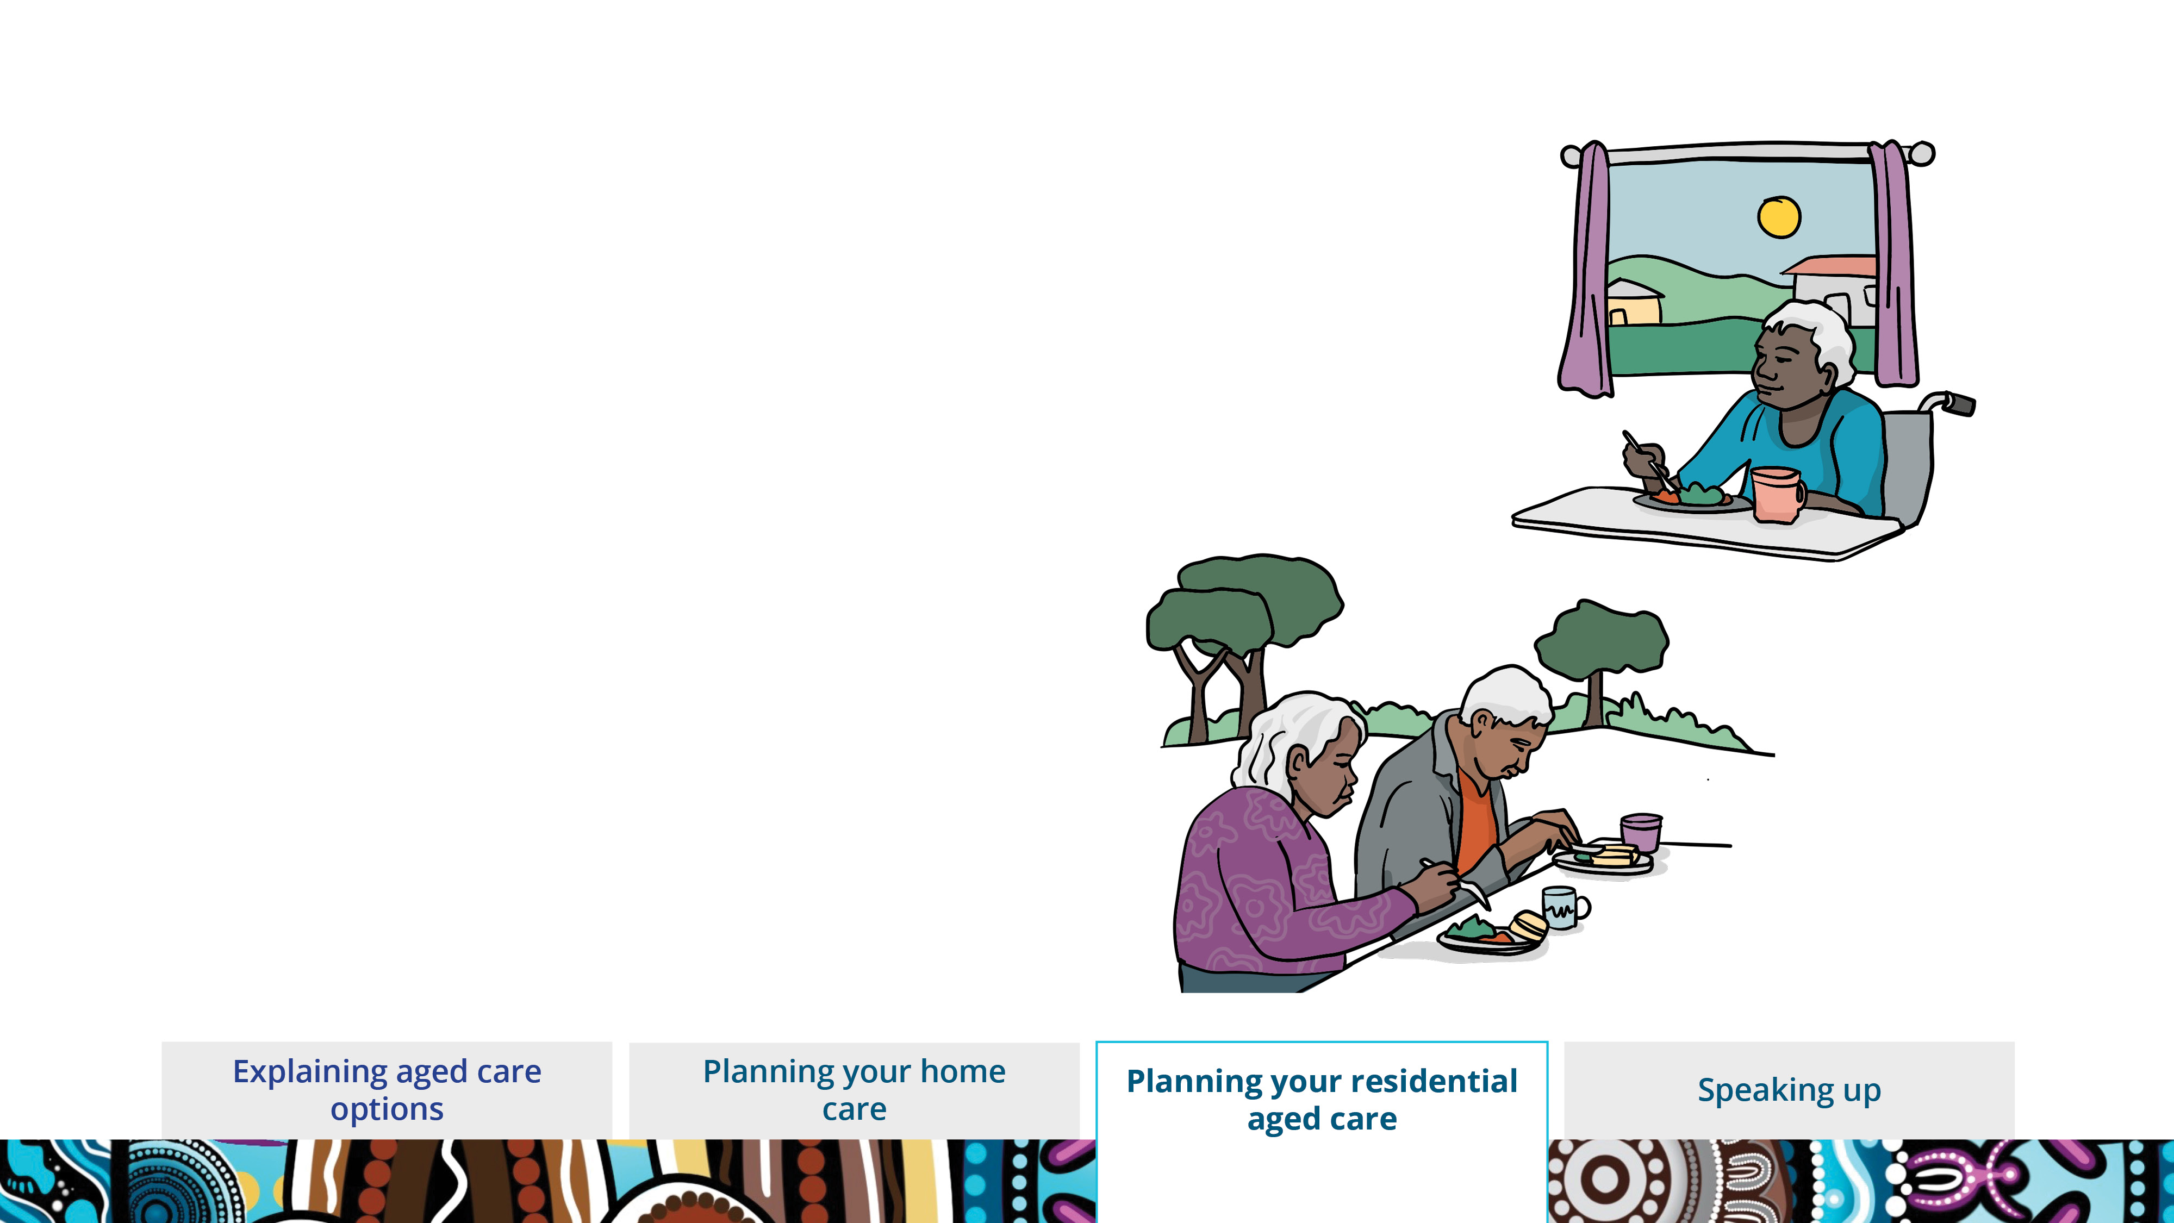
Tell us what food and drinks you like.
Let us know what you don’t like.
Tell us where and how you like to eat and drink.
Notes:
We want to make sure you’re enjoying good food.
Let us know what you like to eat and drink.
And what you don’t like.
Tell us if there are things you like about where you eat – like sitting outside, by the fire or with a group of people.

Slide 16
Speaking up

Slide 17
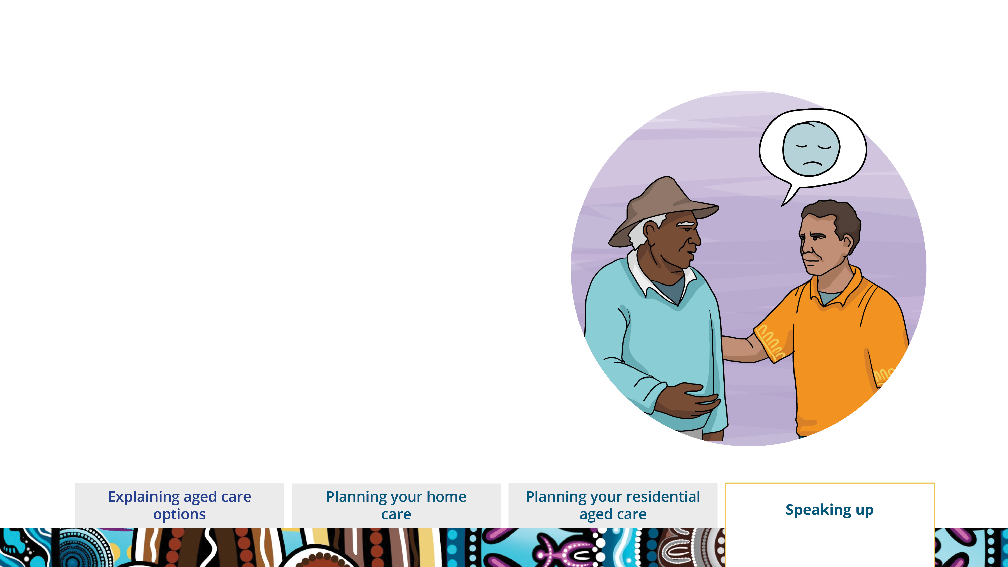
Speaking up
It’s OK to tell someone if you are unhappy.
It’s your right.
If there is a problem, we can help to fix it.
Notes:
Speaking up
We want you to have the best care for you.
If you are worried or unhappy about the way you’re being looked after it’s important to speak up.
This is your right. We want you to let us know if you’re unhappy.
Usually, the problem can be fixed quickly with no fuss.

Slide 18
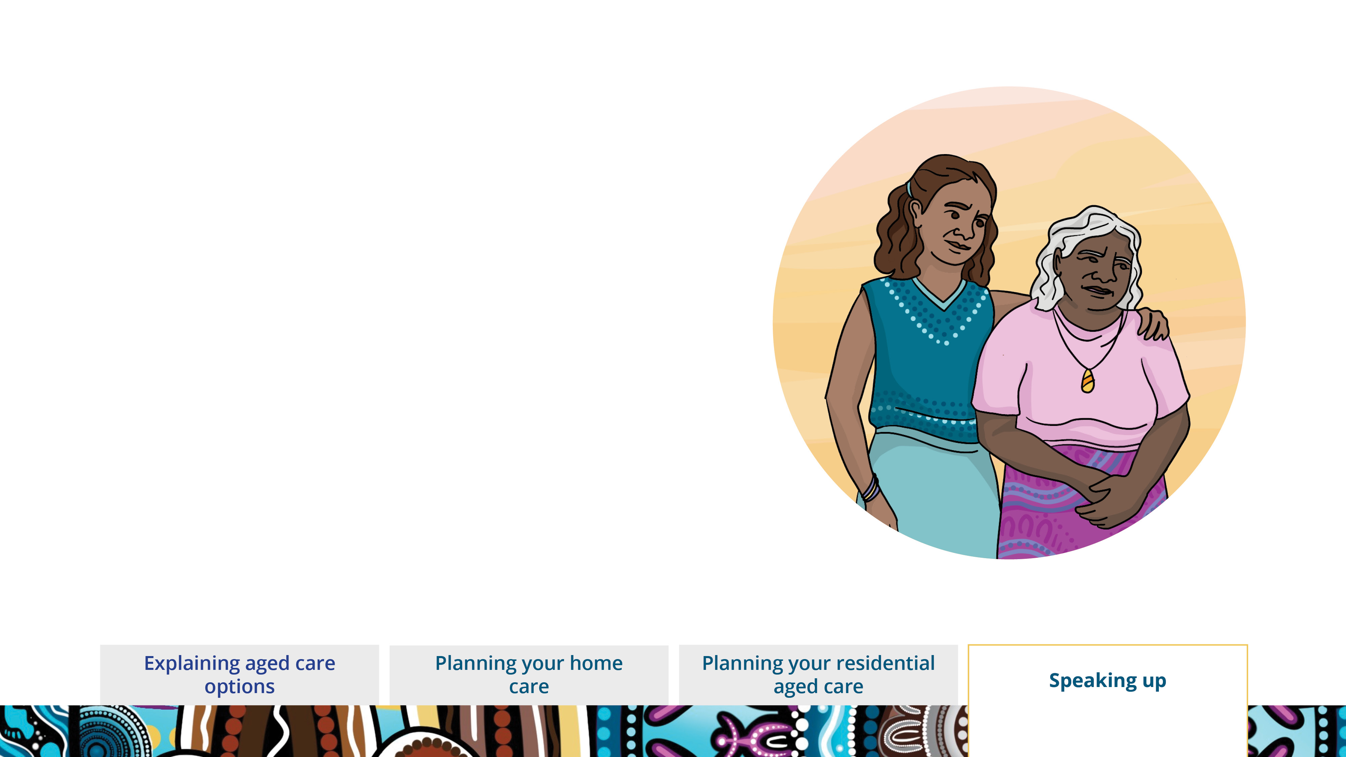
You can tell us or your family.
You can ask an advocate to speak up for you.
An advocate can help you understand your aged care.
Advocates are free.
You can contact your Aboriginal Health Service or the Older Person’s Advocacy Network for more information about getting an advocate.
Your family, friends or anyone you want to speak up for you can be an advocate too.
Notes:
You or your family can have a yarn with us about what you want and how we can help you.
It’s our job to make sure you’re getting cared for in a way that is right for you.
You can also ask an advocate to speak up for you.
An advocate is someone who can help you in different ways.
It doesn’t cost anything to ask an advocate to help.
They can help you understand things like your aged care services, your fees or your rights.
You can ask them to speak up for you to help manage your aged care.
An advocate can also be a family member, a friend or anyone you want to speak up for you.

Slide 19
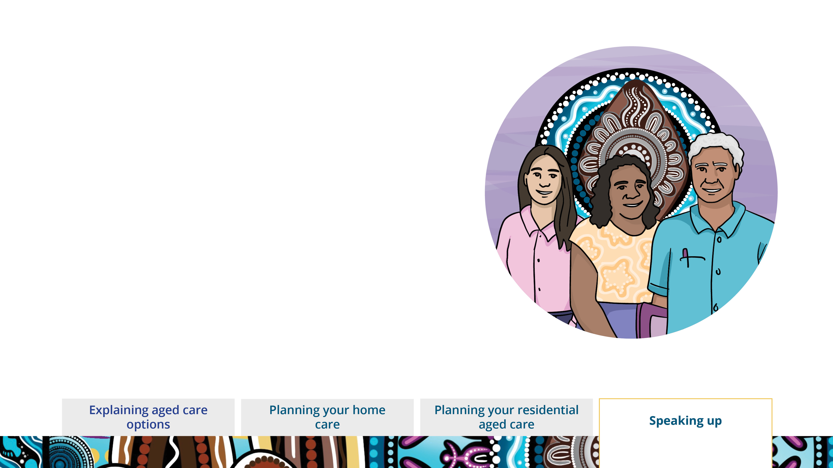
You or your family can talk to the Aged Care Quality and Safety Commission too.
It’s the Commission’s job to make sure you get good, culturally appropriate and safe aged care.
Notes:
You or your family can also contact the Aged Care Quality and Safety Commission.
It’s their job to make sure that everyone is getting quality and safe aged care.

Slide 20
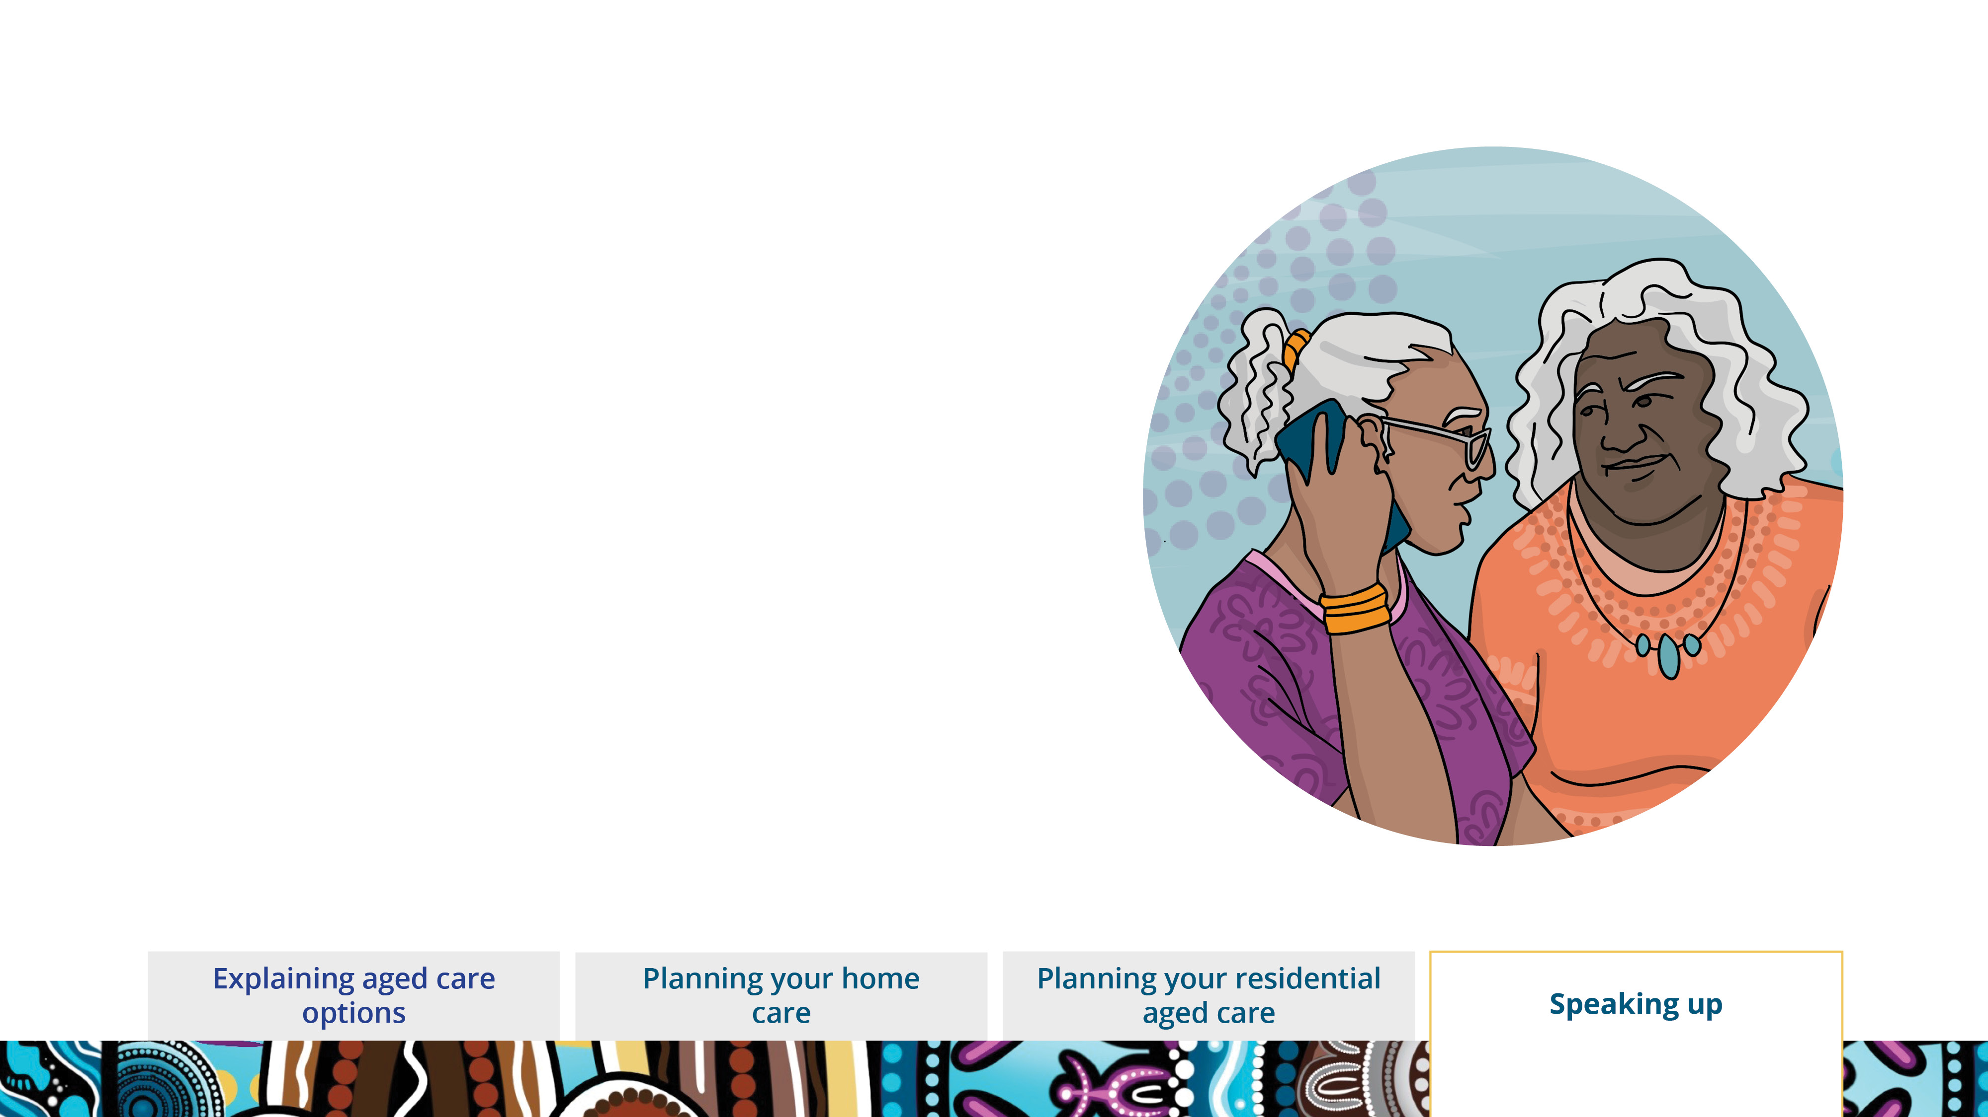
You can talk to the Commission for free.
It is private.
You don’t have to tell them your name.
Notes:
Talking to the Commission is free and private.
You don’t have to give your name if you don’t want to.

Slide 21
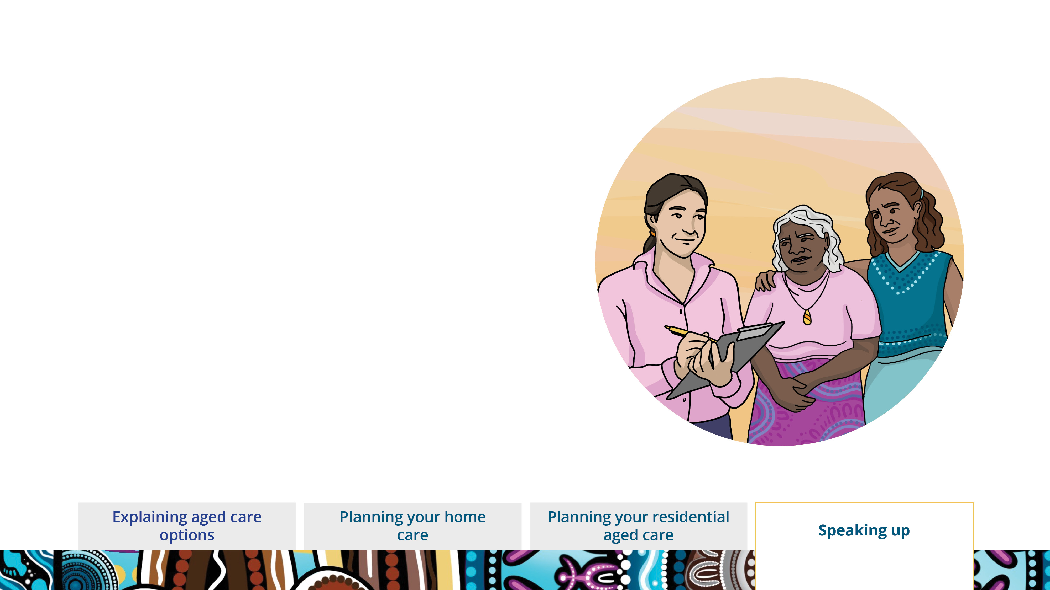

They will help you and your family with the problem.
Call 1800 951 822
Email info@agedcarequality.gov.au
Visit agedcarequality.gov.au/FirstNations
Notes:
When you contact the Commission, they will ask you some questions about what you want changed about your aged care.
They will be able to give you some advice and help solve the problem with you and your family.

