Slide 1

Food, nutrition and dining: a reflection on practice
A training resource for aged care providers and their workforce
Notes:
Welcome learners
Audience
Residential aged care provider L&D staff and managers for use with their workforce
Purpose
Downloadable presentation L&D staff can use to promote discussion and educate their staff to support and improve the food, nutrition and dining experience of residents in their care.
Learning objectives
Promote discussion and reflection between staff about how they can support and improve the food, nutrition and dining experience of their consumers
Identify the FND resources available from the Commission

Slide 2

Agenda
Why is Food, Nutrition and Dining important?
How is this relevant to our organisation?
The dining experience
Supporting residents with swallowing difficulties
Supporting oral health
Resident food and drink choices ’
Food, nutrition, dining and dementia

Slide 3
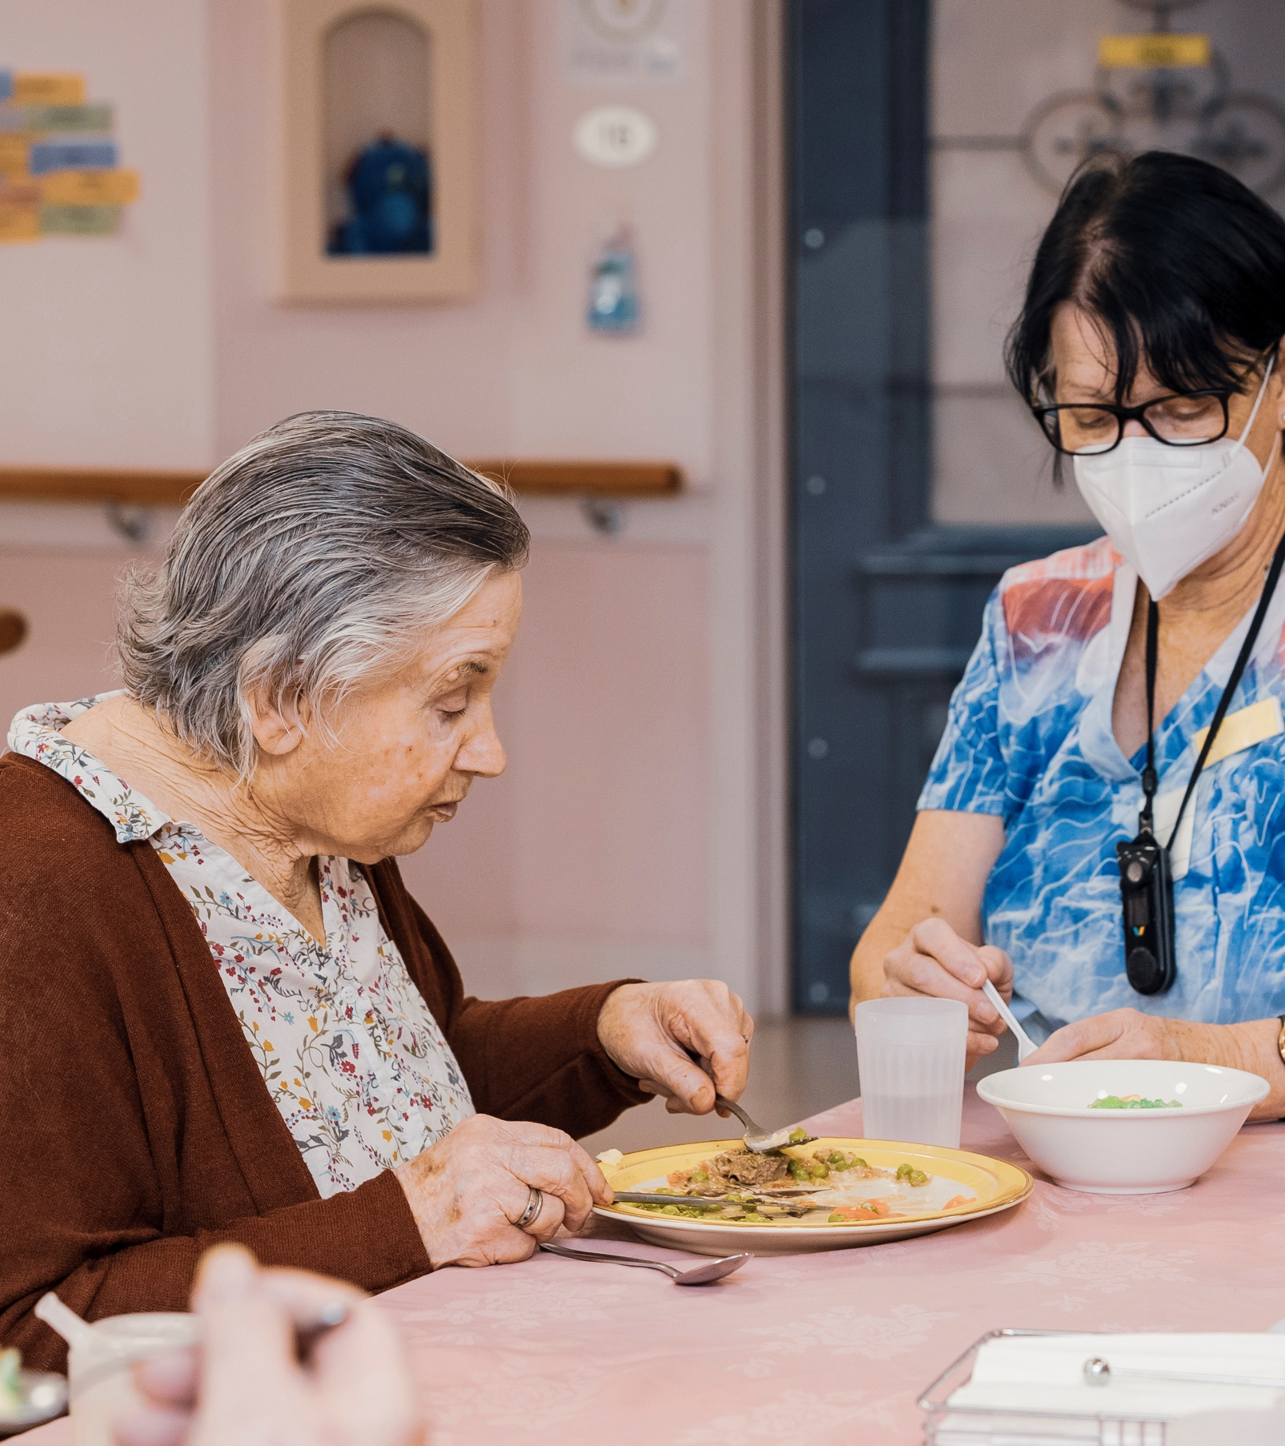
Food, nutrition and dining: why is it important?
Health and social outcomes
Legislation and quality standards
Notes:
Manage a discussion:
Impact on health and social outcomes
Residents who enjoy their dining experience are more likely to eat and drink well, reducing the risk of malnutrition, dehydration and unplanned weight loss.
An enjoyable dining experience is important for residents regardless of what, where, how and when they eat.
Legislation and quality standards
Getting the dining experience right helps us meet the Aged Care Quality Standards.
Getting it right is clearly important for a number of quality standards including, nutrition, care, environment, clinical care, governance

Slide 4





Commission’s food, nutrition and dining campaign
4 key priority areas
Resources to learn about:
Why is food, nutrition and dining important?
How to identify issues and act early?
How to empower residents?
Notes:
Explore the Commission's Food, Nutrition and Dining webpages for providers, workers and older people.
Resources, videos, modules, webinars and case studies aimed to:
help us understand why food, nutrition and dining is so important to the health, wellbeing and quality of life of our residents
help us understand how nutrition impacts on many quality indicators, and is a major contributor to resident quality of life
build provider and worker capability to identify and act early on areas that impact eating, nutrition, drinking and hydration
empower residents to know what they can expect from their food and dining experience and influence changes where needed
help us meet the needs of people who cannot easily communicate their needs and wishes.
Explore the Commission’s Food, Nutrition and Dining resources (provider) webpage: https://www.agedcarequality.gov.au/providers/food-nutrition-dining/food-nutrition-dining-resources-providers

Slide 5
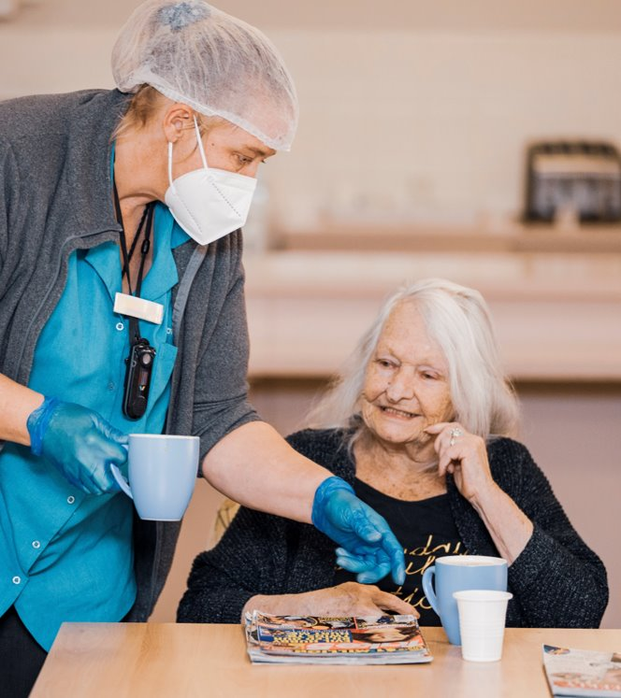
Food, nutrition and dining and us
How this fits with our values and policies at [insert organisation name].
Notes:
[Note to L&D staff member to insert information about how and why food, nutrition and dining is important and fits with your organisation’s values, mission, purpose, policies, processes and procedures.]
Discussion about how it impacts many quality indicators and also then the star ratings and provider reputation
(for example weight loss, pressure injury, falls, consumer experience, quality of life, Activities of Daily Living (ADL), hospitalisation)

Slide 6
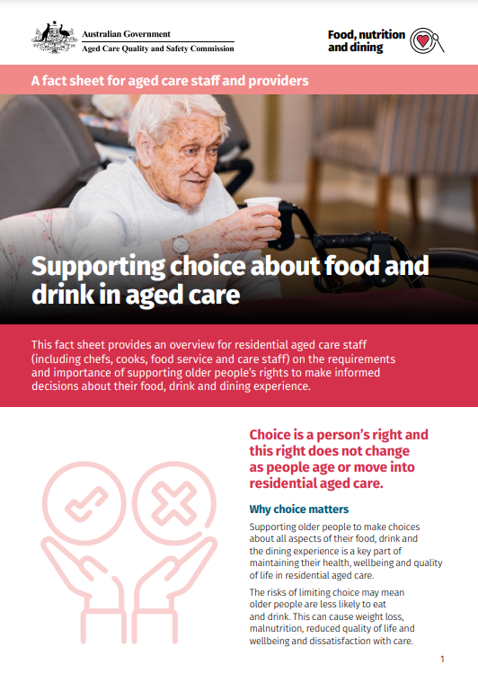
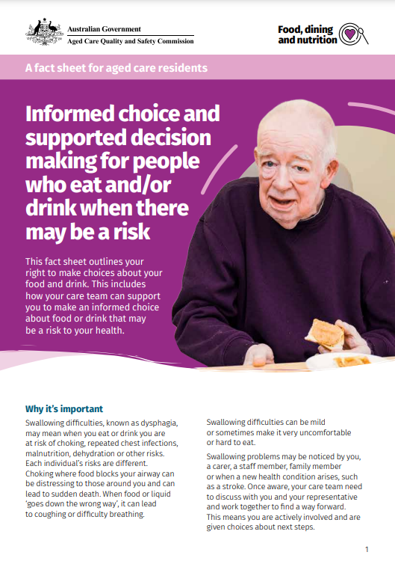

Resident food and drink choices
Notes:
Select each resource to open and explore with your team.
For more information refer to:
Providing food and dining choice - aged care staff poster: https://www.agedcarequality.gov.au/resource-library/providing-food-and-dining-choice-aged-care-staff-poster
Food and drink in your aged care – supporting informed choice and risk – aged care staff poster: https://www.agedcarequality.gov.au/resource-library/food-and-drink-your-aged-care-supporting-informed-choice-and-risk-staff-poster
Dining and consumer choice webinar: https://www.youtube.com/watch?v=XSgiQ8DSm3E

Slide 7
Resident food and drink choices
Reflective discussion
[Please insert selection of chosen discussion questions relevant to your staff]
Notes:
Questions for workers involved in resident care:
How do we make sure a person’s choices are included in meal planning, delivery, and the mealtime experience?
Do resident care plans include individual choices around eating and drinking?
How closely do our policies and processes follow this factsheet?
Do we have the right supports in place to provide residents with all the information they need to make informed choices about eating and drinking (for example dietitian and speech pathology services)?
How can we support resident choice when it comes to food, nutrition and dining?
If a resident expresses their likes or dislikes to us informally, how can we make sure this information is recorded and communicated?
How do we understand the choices and preferences of those residents who have difficulty communicating?
What other ideas, innovations, inspirations do we have and who can we tell?

Slide 8

The dining experience
Introductory video
Notes:
The ‘dining experience’ includes: dining space, ambience, noise, decor, layout, tableware and setting, crockery and cutlery, support, interactions with staff and social and cultural meaning.
Further resource links:
Getting the dining experience right staff fact sheet: https://www.agedcarequality.gov.au/resources/getting-the-dining-experience-right-aged-care-staff-fact-sheet
Know, Observe, Support, Act poster: https://www.agedcarequality.gov.au/resource-library/know-observe-support-act-poster
Dining essentials - 8 facts you need to know about the residents you care for poster: https://www.agedcarequality.gov.au/resource-library/8-facts-you-need-know-about-each-resident-poster
Getting the dining experience right poster: https://www.agedcarequality.gov.au/resources/getting-the-dining-experience-right-poster
Dining and consumer choice webinar: https://www.youtube.com/watch?v=XSgiQ8DSm3E
A case study in food, dining and nutrition webinar: https://www.youtube.com/watch?v=kYv5J0U0UZ4

Slide 9
The dining experience
Reflective discussion
[Please insert selection of chosen discussion questions relevant to your staff]
Notes:
Questions for workers involved in resident care:
What do we do well when it comes to the dining experience of those in our care?
How could we improve the dining experience for each resident?
How can we further support our residents to connect, interact and engage during mealtimes?
What do we do if someone has not eaten their food?
How do we make sure residents have the right utensils and equipment to support them to eat independently? Are receiving the help they need?
How do we make sure there is enough staff available to provide this help?
How do we make sure residents are getting the correct meals?
How do we know if a resident is drinking enough?
How do we know if a person living with dementia doesn’t like a meal or a food? What do we do about this to make sure they get something else next time?
How do we make sure that clinical tasks are not part of the dining experience?
How do we communicate and respond if a resident is not eating or drinking part or all of their meal?
What other ideas, innovations, inspirations do we have and who can we tell?

Slide 10

Supporting swallowing difficulties
Introductory video
Notes:
Further resource links: Supporting safe and enjoyable mealtimes for people with swallowing difficulties aged care staff factsheet: https://www.agedcarequality.gov.au/resource-library/workers-supporting-safe-and-enjoyable-mealtimes-people-swallowing-difficulties Nutrition and texture modified food and drinks aged care staff factsheet: https://www.agedcarequality.gov.au/resource-library/workers-nutrition-and-texture-modified-food-and-drink Informed choice and supported decision making for people who plan to Eat and Drink with Acknowledged Risk factsheet: https://www.agedcarequality.gov.au/resource-library/informed-choice-and-supported-decision-making-people-who-eat-andor-drink-when-there-may-be-risk Swallowing, texture-modified diets and nutrition webinar: https://www.youtube.com/watch?v=6_q3KTrb2Io

Slide 11
Supporting swallowing difficulties
Reflective questions
[Please insert selection of chosen discussion questions relevant to your staff]
Notes:
Questions for workers involved in resident care:
How do you recognise if a resident might be having difficulty eating, drinking or swallowing?
If a resident is choking, what are the immediate steps you would take to respond?
If a resident is coughing while eating and drinking what steps would you take to respond? Who do you refer them to and how?
How do the speech pathologist and dietitian support residents with eating, drinking and swallowing impairments?
What strategies are in place to make sure residents who have difficulty swallowing are supported to safely eat and drink?
What happens when the resident doesn't want to follow the speech pathologist’s advice? Do we understand eating and drinking with acknowledged risk (EDAR)?
How closely do our processes follow the process described in the video?
- recognise and act
- refer to support
- implement mealtime support plan
- review
How do we monitor that residents are getting the hydration and nutrition that’s in their care plan?
How do we make sure that texture modified diets and fluids are the correct consistency for consumers?
How can we support residents’ choice when it comes to eating and drinking?
What other ideas, innovations, inspirations do we have and who can we tell?

Slide 12

Supporting oral health
Introductory video
Notes:
Further resource links:
Supporting daily oral health care in residential aged care staff fact sheet: https://www.agedcarequality.gov.au/resource-library/supporting-daily-oral-health-care-residential-aged-care-staff-fact-sheet
KNOW, LOOK, ACT – Oral Pain aged care staff poster: https://www.agedcarequality.gov.au/resource-library/know-look-act-oral-pain-aged-care-staff-poster
Oral and dental health and its impact on eating and nutrition webinar: https://www.youtube.com/watch?v=i0glSkNrfq8

Slide 13
Supporting oral health
Reflective discussion
[Please insert selection of chosen discussion questions relevant to your staff]
Notes:
Questions for workers involved in resident care:
What plan do we have in place to support daily oral health care of each resident?
How do we encourage and support a resident to independently manage their oral and dental care?
How do we monitor and make sure residents are receiving oral health care as it is included in their care plan?
How do we make sure dentures are appropriately fitted and worn?
How do we make sure dentures are clean and don’t get lost?
Do we have the right supports in place?
How do you recognise if a resident has an oral health care issue (for example experiencing pain and discomfort)? If someone has a sore mouth, what do we do?
Do the care plans reflect the oral health care plan and needs of each resident?
What do we do if the resident refuses to receive oral health care?
What other ideas, innovations, inspirations do we have and who can we tell?

Slide 14
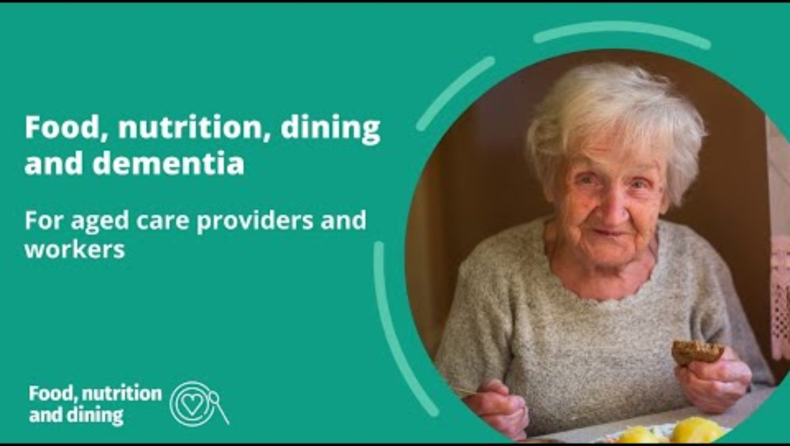
Food, nutrition, dining and dementia
Introductory video
Notes:
Further resource links:
Supporting people living with dementia for aged care providers and workers fact sheet: https://www.agedcarequality.gov.au/resource-library/supporting-dining-experience-people-living-dementia-providers-and-workers-guide
Supporting people living with dementia to eat and drink well webinar: https://www.youtube.com/watch?v=doVTwQeSlhA&t=7s

Slide 15
Food, nutrition, dining and dementia
Reflective questions
[Please insert selection of chosen discussion questions relevant to your staff]
Notes:
Questions for workers involved in resident care:
What aspects of our dining experience have proven successful for people living with dementia? (Dining experience includes: dining space, ambience, sound, décor, layout, tableware and settings, crockery and cutlery, support and assistance, interactions with staff, and social and cultural significance.)
How could we improve the dining experience for people living with dementia?
How can we make sure that the person living with dementia is supported to make choices about what they eat and drink and how they dine? For example, using the My food and dining preferences form, using menus with pictures or involving the person, their family, friends and other representatives in menu planning.
How can we recognise loss of appetite and changes in taste and smell in people living with dementia? For example, refusing food, overusing condiments, requests for extreme temperatures).
How do we recognise if a person living with dementia might be experiencing difficulty eating, drinking or swallowing? For example, avoiding certain foods because they are hard to chew or swallow, closing lips, turning head away or pushing person’s hand away, or agitation or distress during mealtimes.
What do we do if someone is not eating and drinking as much as they used to or having difficulty swallowing?
How can we support people living with dementia to look after their oral health?
How can we recognise dental or oral health problems in people living with dementia?

Slide 16

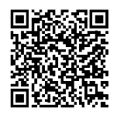
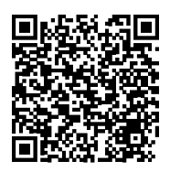
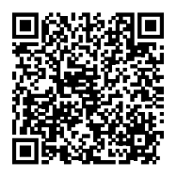
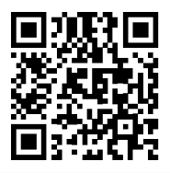


More information
Providers’ webpage
Older people’s webpage
Check out the Commission’s resources for:
Providers
Workers
Older people
Workers’ webpage
Alis online modules
Log into Alis (the Aged Care Learning Information Solution) for interactive online learning
learning.agedcarequality.gov.au
Notes:
Explore the Commission’s Food, Nutrition and Dining resources for:
Providers: https://www.agedcarequality.gov.au/providers/food-nutrition-dining/food-nutrition-dining-resources-providers
Workers: https://www.agedcarequality.gov.au/workers/food-nutrition-and-dining-resources-workers
Older People: https://www.agedcarequality.gov.au/older-australians/health-wellbeing/food-and-nutrition
Find more learning content on the Commission's aged care learning information system – Alis
Visit https://learning.agedcarequality.gov.au/

Slide 17

The Commission is here to support you
Speak up if you have any concerns about the experiences of residents in your care.
Notes:
It’s important to speak up if you have any concerns about the experiences of residents in your care.
The Commission’s Food, Nutrition and Dining Hotline 1800 844 044, is open Monday to Friday, 9am and 5pm AEST.
To speak with experts about how to improve your service’s food, nutrition and dining experience for the people in your care,

