Slide 1
How to use this resource
This resource is designed for use within your aged care organisation and is available for non-commercial use only. Our resources are updated periodically, so please make sure you have the latest version before you deliver a session.
This resource is customisable. It is divided into sections, giving you the option to cover all information or select the sections you want to focus on. It includes some optional activities you may wish to use, and we encourage you to contextualise it to your organisation.
If you need any support using this resource or if you have feedback or questions about any educational materials available from the Commission, please email us at education@agedcarequality.gov.au.

Slide 2
Release of information
The information contained in this presentation is current at the time of release. It is the responsibility of the user to ensure any information added to this document prior to and during training delivery is accurate.
Following release, it is your responsibility to ensure information you deliver is up-to-date. We recommend that you regularly check the Aged Care Quality and Safety Commission and Department of Health, Disability and Ageing websites for new information.
UNCONTROLLED ONCE RELEASED.
Version: 1.2
Notes:
The information contained in this presentation is current at the time of release. It is the responsibility of the provider to make sure any information added to this document prior to and during training delivery is accurate.
Following release, it is the provider’s responsibility to ensure information delivered is up-to-date. It is recommended to regularly check the Aged Care Quality and Safety Commission and Department of Health, Disability and Ageing websites for new information
It is uncontrolled once released.

Slide 3
Investing in your reportable incident capability
Incident management and the
Serious Incident Response Scheme
Date: [Insert delivery date]

Slide 4
Presentation sections
Section 1: An overview of incident management Slides 5-10
Section 3: Reporting obligations of the SIRS Slides 14-25
Section 2: An overview of incident management and the SIRS Slides 11-13
Section 5: Activity – Identifying SIRS reportable incidents Slides 37-42
Section 6: SIRS notifications (includes activity) Slides 42-45
Section 4: The 8 SIRS reportable incident types Slides 26-36
Section 7: Key reflections and additional resources Slides 46-50
Notes:
This presentation is broken into 7 sections. If you wish to only cover certain sections, this slide indicates what slide each section will start on.

Slide 5
An overview of incident management
Notes:
Please note: the following slides do not cover every aspect of incident management systems (IMS) in detail. If you are interested in more detailed information or training materials, there is further guidance available on the Aged Care Quality and Safety Commission (Commission) website. See slide 49 for suggested resource links.

Slide 6



Incident management and reportable incident obligations
The Aged Care Act 2024 and Aged Care Rules 2025 set out conditions for providers to:
have an effective and documented IMS
use data from our IMS to drive continuous improvement
report certain incidents to the Commission.
6
Notes:
Before looking at our reportable incident responsibilities, it is helpful to briefly talk about incident management systems (IMS) and our IMS responsibilities.
The Aged Care Act 2025 (the Act) and the Aged Care Rules 2025 (the Rules) set out conditions for providers to:​​
have an effective incident management system (IMS) in place
use data from the IMS to drive continuous improvement
report certain incidents to the Commission.​
We know that incident management is something that providers do in the day-to-day management of their business. Having good incident management processes and practices in place will ensure:
our organisation provides safe and quality aged care services for older people
we’re in the best possible position to meet our SIRS reportable incident obligations.
It's important to remember that:
Legislation requires us to have an incident management system (IMS).
Our incident management system and practices must be used to manage and document ALL incidents and near misses.
Our IMS is the critical tool to meet our reporting requirements and ensure we improve our processes, so that we effectively manage current incidents and prevent future incidents.

Slide 7
Incident Management Systems (IMS)
What is it?
A set of:
policies and processes
What does it look like?
standard operating procedures
tools and systems
training and organisational culture for managing incidents.
What is it used for?
Must be suited to the context of the care services you provide
Determined by providers
To prevent or identify, respond to and manage any incidents or near misses that occur at your organisation or during the delivery of care services to older people.
Must align with legislative requirements.
Notes:
The table on screen summarises the different aspects of incident management systems: what they are, what they are for, and the format they take. ​
​What is it?
An IMS includes policies, processes, and procedures that workers can use to prevent and manage incidents; the tools and systems used to document information about incidents and find solutions; and the training and culture relied on to continuously improve our services.
What is it for?
It helps to prevent incidents or to identify, respond to and manage any incidents or near misses that occur at our organisation and while we are delivering care services to older people. Remember that our IMS should capture all incidents which take place at our organisation, including those which are not SIRS reportable.
What does it look like?
It must be suited to the context of the care we provide, and it could be anything from a spreadsheet to complex risk management software, depending on the size and complexity of the organisation. For a full description of what must be recorded, see s164-25 of the Aged Care Rules 2025.
For our IMS to be effective, we will need to ensure all staff are trained on how to use it and that it is regularly reviewed, with your leadership and governance team involved in the process.

Slide 8
Legislative responsibilities for an IMS
The Aged Care Act 2024
- Section 164
The Aged Care Rules 2025
- Chapter 4, Part 10, Division 1
The Aged Care Quality Standards
- Standard 2
Notes:
As providers, we have legislative responsibilities to have an effective IMS in place.
The Aged Care Act 2024 (Section 164) includes requirements for incident management in aged care, which include to:
implement and maintain an incident management system
manage, and take reasonable steps to prevent incidents
not victimise or discriminate against anyone for reporting an incident
keep and retain the details recorded in relation to an incident in written or electronic form for 7 years starting on the day the record in made or received.
Also, the Aged Care Rules 2025 Chapter 4, Part 10, Division 1 specify that a registered provider must take reasonable steps to ensure that they have appropriate processes for receiving and considering information about incidents and risks and respond in a timely way.
Providers in registration categories 4, 5, and 6, must also meet the relevant strengthened Aged Care Quality Standards that apply to the services they deliver.
Outcome 2.5 Incident Management within Standard 2: The Organisation, states that providers must use an incident management system to safeguard individuals and acknowledge, respond to, effectively manage and learn from incidents.
Additionally, as outlined under the Aged Care Rules, Chapter 4, Section 164-15 providers must ensure their incident management system facilitates the open disclosure and resolution of incidents between individuals and the provider.
Under the new legislation, there have been changes introduced to reportable incidents through the Serious Incident Response Scheme (SIRS). You can view guidance on these changes by accessing the quick guide: Reportable incidents and SIRS - A quick guide to changes from 1 Nov 2025 on the Commission’s website.
Resource link: https://www.agedcarequality.gov.au/resource-library/reportable-incidents-and-sirs-quick-guide-changes-1-nov-2025

Slide 9
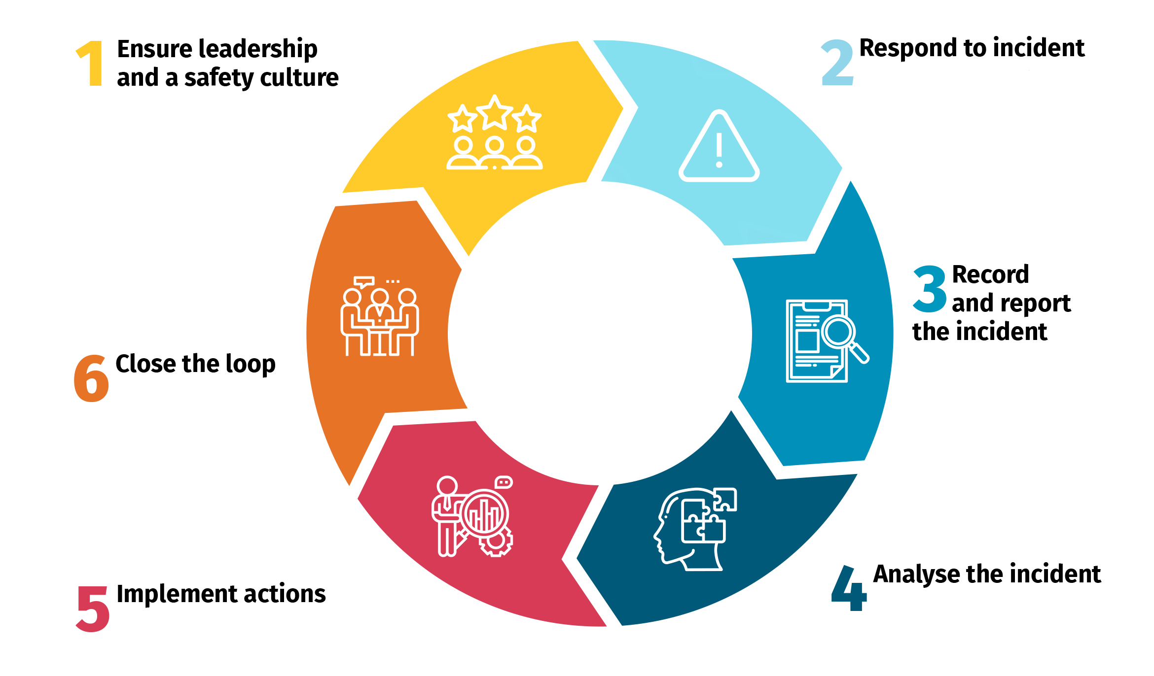
Elements of an effective IMS
Notes:
The image on screen shows 6 essential elements of an effective IMS.
This is a comprehensive approach to preventing, managing and learning from incidents. To be effective, an incident management system:
requires leadership commitment and an organisational culture that values openness, accountability and continuous improvement in quality and safety
must exist within a clear governance framework
should include comprehensive policies and procedures relating to incidents and near misses, and their management
should include a mechanism that enables incidents to be easily recorded, safely and securely stored, and easily accessed
must be well understood and used by workers, as well as older people, and their families and representatives
must enable us to respond to incidents including to:
identify and respond to an incident, and immediately supporting those affected
report the incident, make necessary notifications and record the incident appropriately
review, analyse and, if necessary, investigate how and why it happened
implement changes to reduce the risk of recurrence and to make aged care safer and
support us to continuously improve, share learnings and analyse trends and should regularly be reviewed.

Slide 10
Incident management and SIRS reporting
Ensure the wellbeing of all involved and take appropriate immediate action
2
Follow your organisation’s IMS – you need to record ALL incidents in your IMS
3
Determine if it is a SIRS reportable incident
4
Identify the incident or near miss
1
If reportable, consider the priority level and reporting obligations
5
Notes:
There are some basic steps that need to be followed when an incident occurs at our organisation. Aged care workers (workers) must be familiar with these steps because everyone has a role to play in managing and reporting SIRS reportable incidents. We need to make sure that all workers are aware of the role they play, what their responsibilities are and that they follow our IMS policies and procedures.
As an example, frontline workers might be involved in identifying the incident or near miss and ensuring the wellbeing of all involved by taking appropriate actions. They might also be responsible for documenting and escalating the incident or near miss. Clinical workers or management might be the ones who investigate, direct, or implement appropriate actions taken as required. They will also need to determine if the incident is a SIRS reportable incident and, if so, the priority level, making sure the Commission is notified within the appropriate time frames.
We also need to be aware of other reporting obligations, for example report to the police or the Australian Health Practitioner Regulation Agency (AHPRA).
We must do something about every incident, but not every incident is SIRS reportable.

Slide 11
An overview of reportable incident obligations and the Serious Incident Response Scheme (SIRS)
Notes:
This section looks at reportable incident obligations and the Serious Incident Response Scheme (SIRS).

Slide 12
Reportable incidents and the Serious Incident Response Scheme (SIRS)
What is the SIRS?
The SIRS is an initiative that aims to reduce
Why report to the SIRS?
strengthening aged care systems to reduce the risk of abuse and neglect
making sure people receiving aged care have the support they need.
enabling providers to review incident information to drive improvements in quality and safety
abuse and neglect amongst older people
accessing aged care services. It provides the
opportunity to improve safeguarding and trust
in aged care through:
Reporting SIRS reportable incidents promotes
study what happens when things go wrong
listen to people affected by an incident
build provider skills so they can better respond to serious incidents
reduce the likelihood of preventable incidents reoccurring and make changes to stop it happening again.
the protection and managing of risks that
affect older people accessing care services. The
SIRS gives providers guidance to:
Notes:
The table on screen summarises the purpose of the SIRS.
​The SIRS is an initiative that aims to reduce abuse and neglect amongst older people accessing aged care services. It provides the opportunity to improve safeguarding and trust in aged care through:
• strengthening aged care systems to reduce the risk of abuse and neglect
• enabling providers to review incident information to drive improvements in quality and safety
• making sure people receiving aged care have the support they need.
Reporting SIRS reportable incidents promotes the protection and managing of risks that affect older people accessing care services. The SIRS gives providers guidance to:
• study what happens when things go wrong
• listen to people affected by an incident
• build provider skills so they can better respond to serious incidents
• reduce the likelihood of preventable incidents reoccurring and make changes to stop it happening again.

Slide 13

About the SIRS
Three major components under the Act:
eight reportable incident types
reporting priority (timeframes)
response and improvements.
13
Notes:
The Act sets out our obligations to manage and take reasonable action to prevent incidents. This focuses on the safety, health, wellbeing, and quality of life for older people.
​
​​There are 3 major components of the SIRS that must be implemented under the Act. These include: ​​
​eight reportable incident types
reporting priority (timeframes)​
response and improvements.

Slide 14
Reporting obligations of the SIRS
Notes:
This next section will look at important terminology we need to understand to assist us with:
our reporting obligations
what SIRS reportable incidents are
the 8 types of reportable incidents
what makes a SIRS reportable incident a Priority 1 or 2 incident.

Slide 15

What is a SIRS reportable incident?
An incident is something that happens, which causes or has the potential to cause intentional or unintentional harm to an older person in your care.
It is SIRS reportable under the Act if it:
is one of the 8 SIRS reportable incident types
has occurred, or is alleged or suspected to have occurred, while providing care and services to an individual.
15
Notes:
The next few slides look at what a SIRS reportable incident is.
Firstly, an incident is something that happens, which causes or has the potential to cause intentional or unintentional harm to an older person in our care.
As mentioned previously, all incidents that occur need to be managed in our IMS. Some incidents will only need to be managed in our IMS, but there are 8 types of incidents (more on that later), which are considered reportable incidents in the serious incident response scheme, that we are required to report to the Commission.
What is a SIRS reportable incident?
As defined by the Aged Care Act 2024, an incident is reportable if it:
is one of the 8 reportable incident types
has occurred, is alleged to have occurred, or is suspected of having occurred, in connection with the delivery of funded aged care services to an individual by a registered provider.
Even if the incident caused no actual harm, it still needs to be reported. This is to account for situations where an incident occurred, and that incident could reasonably be expected to cause harm or discomfort.
For example, a care worker supports an older person with limited mobility to the toilet but then leaves them on the toilet unattended for a long period of time. When they return, the person seems unaffected – they are not physically harmed, and they do not express their distress in any obvious way. However, it is reasonable to consider that they might have been uncomfortable and/or concerned about being left unaided and that this incident could have caused harm to them.
Let’s take a closer look at some important phrases in the definition for a reportable incident.

Slide 16
What is a SIRS reportable incident?
An incident that occurs whilst delivering, or in connection with the delivery, of care and services. This includes incidents that:
occur while care services are being delivered (e.g. when staff take an older person to appointments or support them to participate in activities)
occur because of a failure to deliver appropriate care services
occur while staff are undertaking duties as part of their roles (e.g. failure to document and escalate a pressure injury)
may not have occurred while care services were being delivered but are connected because the harm (or risk of harm) arose from the way care services were delivered.
Notes:
For something to be a SIRS reportable incident, it must be an older person in our care who is impacted.
The legislation highlights that an incident is reportable where it takes place while we are providing care services, or in connection with the delivery of funded aged care services to an individual by a registered provider. This includes any incidents that:
occur while care services are being delivered (for example, when staff take an individual to appointments or support them to participate in activities)
occur because of a failure to deliver appropriate care services
occur while workers are undertaking duties as part of their roles ​(e.g. failure to document and escalate a pressure injury)
​may not have occurred while care services were being delivered but are connected because the harm (or potential harm) arose from the delivery of care services.
We need to consider the concerns or complaints raised by the older person, their family and supporters, workers or other people, to determine if they fit into one of the 8 categories of SIRS reportable incidents. Taking this step will enable us to meet our obligations for incidents which are alleged or suspected to have occurred.

Slide 17
SIRS reportable incidents
You must report to the Commission about all SIRS reportable incidents that:
are suspected or alleged, even if you can’t confirm the incident
are under investigation (e.g. internal or police investigation)
involve an older person in your care who doesn’t want to report the incident
involve older people, including those with cognitive impairment or reduced capacity.
The following incidents are not SIRS reportable incidents, but should be recorded in your IMS:
where harm has been caused to a worker, an older person’s family, supporters, visitors or another person who is not a care recipient
where an older person makes an informed decision to refuse care services
where an older person is not following a recommended course of action.
Notes:
We must report all SIRS reportable incidents to the Aged Care Quality and Safety Commission (the Commission), including incidents that:
are suspected or alleged, even if we can’t confirm the incident
are under investigation (e.g. internal or police investigation)
involve older people in our care who don’t want to report the incident
involve older people in our care, including those with cognitive impairment or reduced capacity.
The following incidents are not SIRS reportable incidents, but should be recorded in our IMS:
where harm has been caused to a worker, an older person’s family, supporters, visitors or another person who is not a care recipient for example, an older person’s spouse trips over the vacuum cleaner left in the lounge by a worker
where an older person makes an informed decision to refuse care services
where an older person is not following a recommended course of action.

Slide 18

What is a near miss?
A near miss is when an incident, event or oversight occurs that does not result in harm but had the potential to cause harm to an individual in your care.
Near misses must be captured and recorded in your IMS.
18
Notes:
A near miss is an important term to consider.
A near miss is when an incident, event or oversight occurs that does not result in harm but had the potential to cause harm to an individual in our care. Near misses must be captured and recorded in our IMS.
Examples of near misses include things like:
poor lighting that results in a worker tripping and almost falling over an extension cord, or
equipment left in a blind spot in a corridor that could have resulted in a collision involving an older person or their family members or a worker, or
a stack of boxes in a day respite centre falling over, where no one was injured.
Being proactive about reporting near misses is an opportunity for our organisation to build a safety culture and assess and learn from events so that we can understand risks and prevent incidents from occurring. All workers should be supported to recognise and report near misses and be part of the learning and quality improvements that come out of near misses or close calls.

Slide 19
Priority 1 and Priority 2 reportable incidents
Priority 1 and Priority 2 reportable incidents
Priority 1: | Priority 2: | Non-reportable incidents
A physical or psychological injury or discomfort that needs medical or psychological treatment to resolve | All other SIRS reportable incidents that are not a Priority 1 | Incidents that do not meet the definition of a SIRS reportable incident type
Unlawful sexual contact or inappropriate sexual conduct inflicted on an older person in your care | Must be reported to the Commission within 30 days of becoming aware of the incident | Need to be recorded and managed in your organisation’s IMS
Unexpected death of an older person in your care | Need to be recorded and managed in your organisation’s IMS
Unexplained absence of an older person in your care
If you believe an incident involves crime or ongoing danger where there are reasonable grounds to report to the police
Must be reported to the Commission within 24 hours of becoming aware of the incident
Need to be recorded and managed in your organisation’s IMS
Notes:
When SIRS reportable incidents occur, we need to determine if they are a Priority 1 or a Priority 2 reportable incident. This determines how long we have to complete our reporting. ​
A Priority 1 SIRS reportable incident is any reportable incident:
that has caused an older person physical or psychological injury or discomfort that needs medical or psychological treatment to resolve​
where there are reasonable grounds to report the incident to the police
involving unlawful sexual contact or inappropriate sexual conduct inflicted on an older person​
involving unexpected death of an older person resulting from care services delivered (or a failure to be delivered) by the provider, ​
involving unexplained absence of the older person during the delivery of aged care services where there are reasonable grounds to call the police.​
​
All Priority 1 incidents must be reported to the Commission within 24 hours of the provider becoming aware of the incident. We must also provide any information not available at that time to the Commission within the following 5 days.
Incidents that are unlawful or considered to involve crime (for example, the incident would be considered a criminal offence under Commonwealth, State or Territory laws) must also be reported to police within 24 hours of the provider becoming aware of the incident. In some instances, we may need to make further notifications to others depending on the nature of the incident, so you also need to be aware of your reporting requirements and obligations to other agencies such as the Australian Health Practitioner Regulation Agency (AHPRA).​
​
Priority 2 SIRS reportable incidents are all SIRS reportable incidents that don’t meet the criteria for a Priority 1 reportable incident, including any incident, allegation or suspicion that could reasonably have been expected to have caused harm to an older person receiving aged care services. These incidents must be reported to the Commission within 30 calendar days of becoming aware of the incident. ​
We must also notify the Commission of any significant new information about a reported incident as soon as reasonably practical after becoming aware of the information.

Slide 20
Key concepts for Priority 1 and 2 SIRS reportable incidents
Reporting to police
Older people with cognitive impairment or reduced capacity
Medical treatment or psychological treatment
Notes:
The next few slides, will unpack the following key concepts:
Reporting to police
Older people with cognitive impairment or reduced capacity
Medical treatment or psychological treatment

Slide 21
Reporting to police
Providers must report any incident of a criminal nature to the police within 24 hours of becoming aware of it. There is no discretion not to report.
Incidents of criminal nature can be actual, suspected or alleged where the incident would be considered a criminal offence under Commonwealth, State or Territory laws.
Reasonable grounds: includes incidents that would be considered a criminal offence, where you believe an incident may involve a criminal offence, or, where there is an immediate or ongoing risk to the safety of an individual or others.
Notes:
You must report incidents of a criminal nature to police – whether they be actual, suspected or alleged (i.e. the incident would be considered a criminal offence under Commonwealth, State or Territory laws).
You also need to report the incident if there are reasonable grounds (i.e. you have reason to believe an incident may involve a criminal offence, or, where there is an immediate or ongoing risk to the safety of an individual or others). Each state and territory describe criminal offences differently but broadly these include homicide, physical assault, sexual offences, and stealing/theft or fraud.
A couple of things that are important to note:
We don’t need permission from the affected older person and/or their family or representative to report the incident. However, police may not start an investigation until they have received a complaint from that person or their representative.
In some circumstances, police may not investigate as they have their own processes and thresholds for commencing and conducting investigations. It is important to note that police decisions, do not impact our obligations.
If we report a SIRS reportable incident to police it automatically becomes a Priority 1, even if the police decide not to take any action.

Slide 22


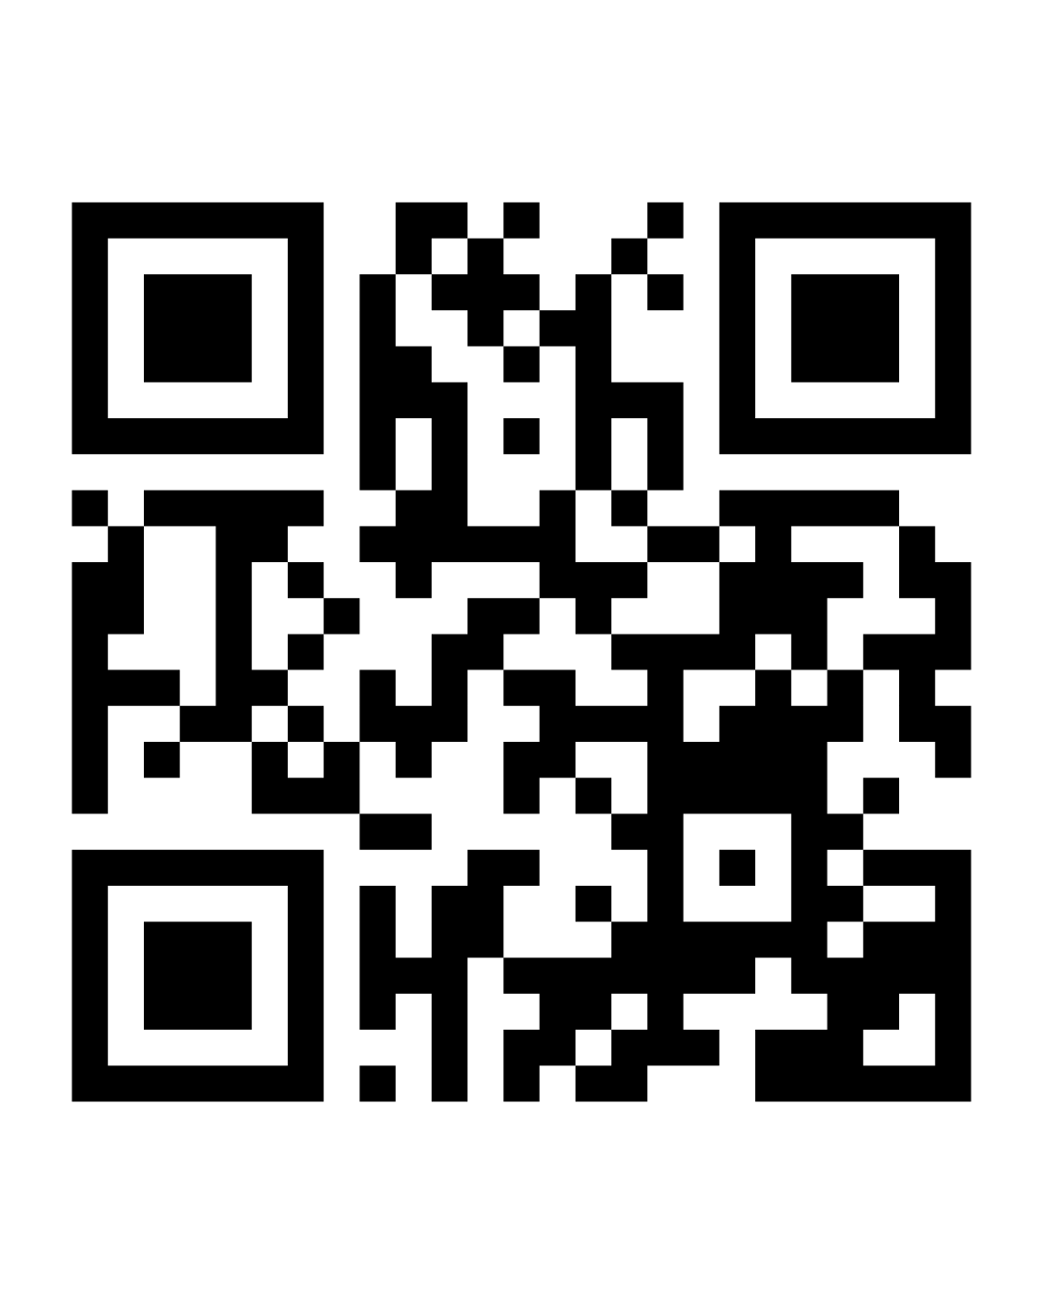
Mandatory reporting to police
Removes the burden from the impacted older person who may have concerns about reporting
Enables the police and Commission to identify emerging incident trends
Provides an opportunity to take a trauma-informed approach to support the older person after an incident
Aged Care Advocacy Line – 1800 700 600
8am – 8pm Mon – Fri | 10am – 4pm Sat
This number will connect you with the aged care advocacy organisation in your state or territory.
Notes:
Mandatory reporting removes the burden from the impacted person who may be worried about reprisal (from the offender or other person), fear the process, or hesitate to involve the alleged offender. It also enables the police and the Commission to identify emerging trends which may be impacting upon others.
While providers must report to the police, the impacted older person's choice (and, where relevant, their representative's choice) to engage further with police, must be respected.
We are expected to take a trauma-informed approach to supporting the older person which can include working with police to identify and offer appropriate support services to the older person. If you are unsure about available support services, consider starting with the Older Persons Advocacy Network (OPAN).

Slide 23
Older person with cognitive impairment
SIRS reportable incidents involving older people you provide care and services to must be reported - regardless of whether that person has an assessed cognitive impairment or reduced capacity.
Notes:
The second concept is older people with cognitive impairment or reduced capacity. There are no exemptions from reporting incidents relating to older people with an assessed cognitive or mental impairment. For example, if a worker witnesses a person with a diagnosis of dementia using unreasonable force on another older person in our care, this must be reported.
An incident may cause an older person with cognitive impairment or reduced capacity harm. Where the impairment directly affects their ability to recognise or communicate physical or psychological injury or discomfort, we must not consider the impairment as preventing the older person from being caused harm.

Slide 24
Medical treatment or psychological treatment
May include any medical or psychological treatment provided by a medical practitioner, nurse practitioner, registered nurse, psychologist or social worker.
Notes:
The third concept is Medical treatment or psychological treatment.
This includes any medical or psychological treatment used to cure a disease or condition, or to treat and resolve physical or psychological injury or discomfort, regardless of whether:
the impact on the older person is temporary or permanent AND
the type of treatment is provided to the older person at the organisation or elsewhere.
Physical or psychological injury or discomfort includes a range of issues such as:
a person’s distress requiring support or counselling
cuts, abrasions, burns, fractures or other physical injury to an older person requiring assessment and/or treatment by a nurse, doctor or allied health professional
bruising, including large individual bruises or a number of small bruises that require medical treatment to resolve
head or brain injuries which might be indicated by concussion or loss of consciousness
injury or impairment requiring the older person’s attendance at or admission to a hospital
the death of an older person.
Some examples of medical or psychological treatment include:
using an ice pack
elevating a limb
escalation to a medical officer for review
the need for a person to be offered specific emotional support resulting from the incident (step above routine emotional support offered post incident)
the need for an older person to be involved in a counselling session.
If any medical or psychological treatment is used to treat a SIRS reportable incident, the incident automatically becomes a Priority 1, regardless of the extent of the injury or discomfort, or the amount or type of treatment provided.

Slide 25
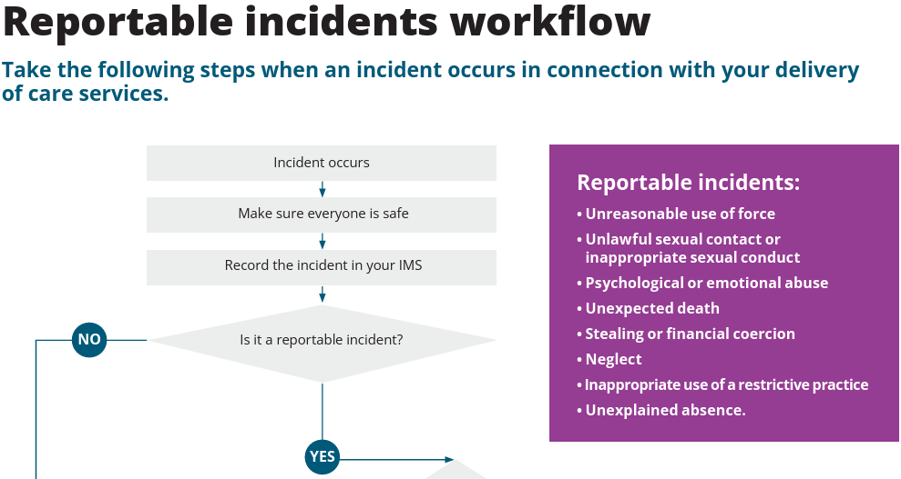

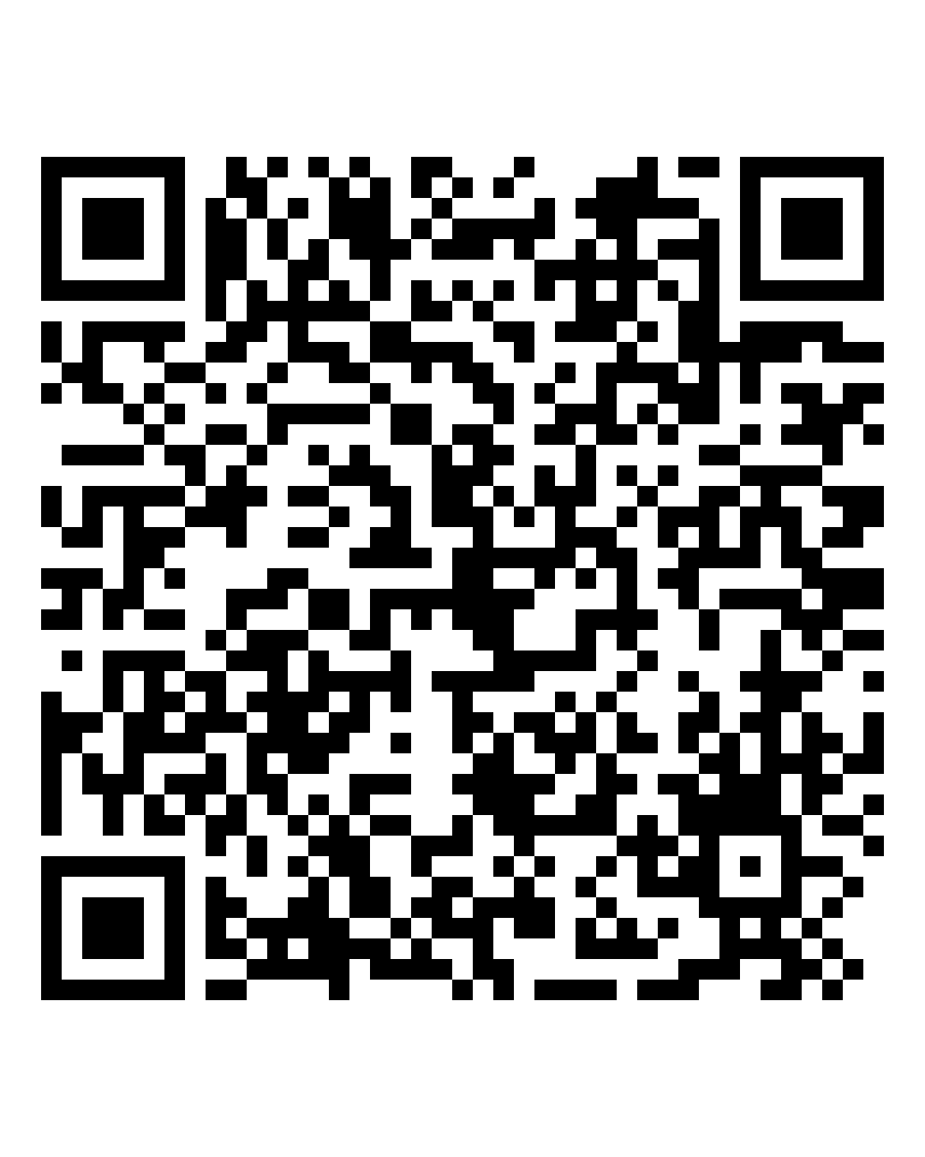
Reportable incidents workflow
www.agedcarequality.gov.au/resource-library/sirs-reportable-incidents-workflow
Notes:
A useful resource is the SIRS reportable incidents workflow, which is accessible via the Commission’s website. It walks you through some questions to help determine what to do if an incident is reportable – would it be a Priority 1 or 2?

Slide 26



The 8 SIRS reportable incident types
26
Notes:
This next section looks at the 8 SIRS reportable incident types.

Slide 27
The 8 SIRS reportable incident types
Unreasonable use of force
Unlawful sexual contact or inappropriate sexual conduct
Unexpected death
Psychological or emotional abuse
Stealing or financial coercion
Neglect
Inappropriate use of restrictive practices
Unexplained absence
Notes:
The 8 reportable incident types under the SIRS are:
Unreasonable use of force
Unlawful sexual contact or inappropriate sexual contact
Psychological or emotional abuse
Unexpected death
Stealing or financial coercion
Neglect
Inappropriate use of restrictive practices
Unexplained absence.

Slide 28
Unreasonable use of force
Includes:
unwarranted or unjustified physical conduct towards an older person that ranges from the use of deliberate and violent physical contact that has caused harm or has the potential to cause harm
hitting, punching, pushing, shoving, kicking or rough handling
repeated minor incidents of non-consensual physical contact that may have an impact over time.
Applies to incidents between workers and older people, as well as incidents which take place between two or more individuals.
Does not include physical contact with a lawful justification e.g. pushing an individual out of the way of an oncoming car.
Notes:
The first reportable incident we will look at is unreasonable use of force.
Unreasonable use of force is behaviour with an older person that includes actions like:
the use of unnecessary physical force
a deliberate and violent physical attack. In some cases, this could be between workers and an older person, or
shoving, pushing, hitting, punching, kicking or rough handling of an older person
repeated minor incidents of non-consensual physical contact that have an impact on a person over time.
If you push an older person out of harm’s way this is not considered unreasonable use of force. For example, pushing an older person out of the way of an oncoming car that would otherwise hit them or out of the way of a falling item to avoid death or serious injury to them.
It also does not include gently touching the person while providing care, to attract the person's attention, to guide the person, or to comfort the person when they are distressed.

Slide 29
Unlawful sexual contact or inappropriate sexual conduct
Always Priority 1, must be reported to the Commission within 24 hours.
Includes:
any sexual behaviour that is an offence under State, Territory or Commonwealth law
sexual contact or conduct where an older person is unable to consent
any conduct or contact of a sexual nature inflicted on the older person by a worker, or a person who provides care services while that person is providing such services (e.g. volunteers on duty).
engaging in conduct with the intention of making it easier to procure the older person to engage in sexual contact or conduct.
Does not include:
consensual sexual relations between older people, including between an older person and their partner who does not receive care services
consensual acts of affection or gestures of comfort.
Only the older person can give or withdraw consent. Their family or representatives cannot give consent or deny their sexual freedom if the person has capacity to decide.
Notes:
There are two broad types of unlawful sexual contact or inappropriate sexual conduct:
1) ANY sexual contact or conduct between a worker (or volunteer on duty) and an older person, REGARDLESS OF CONSENT, while delivering aged care services, or
2) Sexual contact or conduct towards an older person by any person WITHOUT CONSENT.
All incidents of unlawful sexual contact or inappropriate sexual conduct are Priority 1 reportable incidents and must be reported to the Commission within 24 hours of becoming aware of the incident. Incidents that are unlawful or considered to be of a criminal nature (for example sexual assault) must also be reported to police within 24 hours of becoming aware of the incident.
What is not reportable: consensual sexual relations between 2 older people receiving care services, or between an older person and their partner or a person who is not a receiving care services from our organisation.
Remember that consent can be withdrawn at any time, and you should be aware that while the person may have consented to the conduct previously, it does not mean that they consent to the same conduct in the future.
Also not included are actions of comfort, such as a worker rubbing a person’s back or patting a person on the knee, where these acts are consensual and align with the person’s personal preferences. You need to understand whether older person thinks the gesture to be comforting.
It is important to note that the SIRS notification requirements are designed to protect vulnerable people, not to restrict their sexual freedoms. Older people have the right to make choices about their personal and social life, including the right to sexual freedom and to give and receive affection. Only the person themselves can give consent. Their family/representatives cannot give consent on behalf of them.
Any individual who lacks the capacity to consent to an activity at the time the incident happens cannot consent.
You need to be familiar with assessing capacity and have existing systems and processes in place to support you to determine a person’s capacity to make informed decisions and provide consent.
It is acknowledged that individuals can have decision-making capacity for some matters and not others and that capacity can fluctuate; however, it is expected that we are trained and equipped to manage issues of consent and determine a person’s ability to make decisions.

Slide 30
Psychological or emotional abuse
Includes:
conduct that has caused (or could have caused) an older person psychological or emotional distress
yelling, demeaning, name calling, humiliating, unreasonably ignoring an older person, making threatening gestures, or refusing a person access to care as punishment
disparaging an older person’s gender, sexual orientation, sexual identity, cultural identity or religious identity.
Does not include raised voices to get the attention of an older person with hearing difficulties, minor disagreements between older people, or making reasonable requests such as encouraging a person to eat their meal.
Notes:
Psychological or emotional abuse includes behaviour that has caused, or that could have caused, an older person psychological or emotional distress.
For example, taunting, bullying, harassing or intimidating, humiliating, demeaning or an unreasonable refusal to interact with an older person or acknowledge their presence. It also includes unreasonable restriction of the person’s ability to engage socially or otherwise interact with people.
This category includes incidents that:
are a single event (such as a someone yelling at the older person) OR
are part of a pattern of abuse. While the behaviour may not cause significant harm or suffering to the older person every time, the repetitiveness of that behaviour over time increases and intensifies the level of harm to that person.
Workers may witness others interacting with an older person in a way they consider inappropriate or disrespectful. Examples include making disparaging comments about the older person’s gender, sexual orientation, or cultural or religious identity or constantly criticising an older person.
Other examples of psychological or emotional abuse include repetitive actions such as flicks, taps and bumps to an older person (where the action itself is not considered unreasonable use of force, but the repetitiveness of the action causes psychological or emotional anguish, pain or distress). These incidents are SIRS reportable because there was intent or potential to cause psychological or emotional distress or discomfort.
This category does not include: raised voices to get the attention of an older person with hearing difficulties, minor disagreements between two older people you provide care services to (e.g. at a day respite centre) or making reasonable requests such as encouraging a person to eat their meal.

Slide 31
Unexpected death
Always Priority 1, must be reported to the Commission within 24 hours.
Includes where a death is the result of care services delivered by the provider or a failure of the provider to deliver care services.
A death may occur immediately or sometime after a mistake, a failure or incident occurred. Where the death could be related to a mistake, failure or incident, you must notify the Commission.
Does not include an older person dying of an illness or disease that was appropriately assessed, monitored and managed; or dying of unrelated illness after being involved in an incident.
Notes:
In the Act, the expression ‘unexpected death of the individual’ includes death in circumstances where:
the individual was accessing funded aged care services in an approved residential care home of a registered provider, and reasonable steps were not taken by the registered provider to prevent the death; or
the death was a result of:
i) funded aged care services delivered by the registered provider; or
ii) a failure of the registered provider to deliver funded aged care services
We must notify the Commission of any incidents of unexpected death where:
aged care workers at our organisation made a mistake resulting in death
our organisation did not deliver care services in line with a person’s assessed care needs, resulting in death
our organisation provided care services that were poorly managed or not in line with best practice, resulting in death.
All reportable unexpected deaths must be reported as a Priority 1 reportable incident to the Commission within 24 hours of becoming aware.
Keep in mind that a SIRS reportable unexpected death may occur immediately or sometime after the care services were delivered or failed to be delivered.
We may not be able to establish whether the death is related to the provider’s action or inaction until a Coroner has assessed the death. The Commission understands this process can take some time, which means we may not be able to provide all the required details at the time of reporting the incident to the Commission. Any time you reasonably suspect that a death may be related to the care services we delivered or failed to deliver, we must report it to the Commission. We are then expected to notify the Commission as significant new information becomes available.
We are not required to notify the Commission of an older person’s unexpected death if the cause was unrelated to either the care services that we delivered or failed to deliver. We are also not required to report all deaths where the cause of the death is yet to be confirmed. Providers should only report those where there are reasonable grounds to believe that the death may have occurred because of the our action or inaction.
Example of what is not a SIRS reportable unexpected death include an older person dying of an illness or disease that was appropriately assessed, monitored and managed; or dying of unrelated illness after being involved in an incident.

Slide 32
Stealing or financial coercion
Stealing from an older person by a worker.
Includes conduct by a worker that is:
financially coercive towards an older person
deceptive about an older person’s financial affairs.
Also includes conduct by a worker that unreasonably controls an older person’s finances.
Does not include an older person, with cognitive capacity, willingly offering to buy a worker a coffee on an outing, or a gift to thank them.
Does not include an older person complaining to a worker about feeling financially pressured by their family.
Notes:
The SIRS reportable incident of stealing or financial coercion includes:
Stealing from an older person by a worker of the registered provider.
Conduct by a staff member of the provider that:
is coercive or deceptive in relation to the older person’s financial affairs, or
unreasonably controls the financial affairs of the older person.
This incident type includes any items belonging to an older person in our care, such as money, valuables, personal effects, and medication. There is no financial value threshold applied to this incident type. Therefore, an allegation of the theft of $5 is reportable, along with an allegation of the theft of $5000 diamond earrings.
Where an older person’s money or valuables go missing without explanation, you should try to help them to locate the item(s). If the item(s) can’t be found, and there is still a suspicion that a worker is responsible (for example the older person has told you that a worker is responsible), we should report the incident to the Commission. If the item is subsequently located, we should provide an update to the Commission.
Note that reportable incidents of stealing or financial coercion which are notifiable under the SIRS are limited to the actions of an aged care worker of the provider, against an older person receiving care services.
Examples of what is not stealing or financial coercion:
where an older person or their family gives a worker a gift to thank them for their services and support
where items go missing but are found to have been misplaced
where an older person complains to a worker that they feel financially pressured by their family.
There may be circumstances where workers are out with an older person (for example, accompanying them to an appointment) and the older person offers to purchase the worker a coffee or lunch. While this should be discouraged, and our organisation may have policies and procedures or a code of conduct that prevents this, this is not the type of incident that would qualify as a reportable incident for SIRS notification purposes and must be recorded in our IMS.
However, if you witness (or receive an allegation/hold a suspicion about) a worker specifically asking for even items of low value such as a cup of coffee, this should be reported.

Slide 33
Neglect
Neglect can be a single incident, or it can be ongoing, repeated failures by the service to meet a person’s physical or psychological needs.
Includes:
a breach of duty of care to an individual by a provider or worker
a gross breach of professional standards in providing care to an individual.
It may include depriving a person of basic necessities, withholding personal care, or regular late or missed administration of medications.
Does not include incidents resulting from an informed choice made by the individual.
Notes:
Neglect is a circumstance in which a registered provider, aged care worker or responsible person of the provider has:
delivered an aged care service to the individual that exposes them to the risk of serious injury or illness,
delivered a grossly inadequate aged care service to the individual,
been reckless or intentionally negligent in delivering an aged care service to the individual, or
caused or contributed to
i) a significant failure to deliver an aged care service to the individual; or
ii) a systematic pattern of conduct.
SIRS reportable incidents of neglect include an action, or a failure to act, by the provider or worker towards an older person that has resulted in or contributed to (or could have resulted in) harm and/or discomfort, injury, poor health outcomes, emotional distress or the death of an older person. It can be a single incident where, for example, a worker fails to fulfil a duty, resulting in actual harm to an older person or where there is the potential for harm to an older person. Neglect can also be ongoing, repeated failures by a provider to meet a person’s physical or psychological needs.
Some examples of neglect may include depriving a person of basic necessities, withholding personal care, or regular late or missed administration of medications.
Neglect does not include:
a one-off incident of late or missed administration of medications where there is no significant harm and/or discomfort caused to the person
rapid weight loss because of a diagnosis/disease, where all reasonable efforts are made to ensure the older person is receiving adequate nutrition
where an older person chooses not to receive care services in line with their assessed care need.
Older people have the right to live their lives according to their own choices and preferences, even if their choices involve risk. This is called dignity of risk. Providers supporting older people to make informed choices about their care that involve risk management is not considered neglect and is not a reportable incident. Rather, it is an important concept of rights-based, person-centred care.
However, incidents that are not SIRS reportable incidents of neglect should still be recorded and managed in our IMS.

Slide 34
Inappropriate use of restrictive practices
Restrictive practice is any practice or intervention that has the effect of restricting the rights or freedom of movement of an older person.
Inappropriate use of restrictive practice includes any use of a restrictive practice that is not consistent with the requirements in the Aged Care Act (2024) or Aged Care Rules 2025.
Does not include where a provider uses a restrictive practice on an older person that is consistent with the person’s documented care and services plan, is used while providing care in a home or community setting and it’s recorded as soon as possible following the use of the restrictive practice.
Notes:
Restrictive practices include any practice or intervention that has the effect of restricting the rights or freedom of movement of an older person. Whether the use of a restrictive practice is a SIRS reportable incident, depends on the circumstances in which it is used and whether these are consistent with requirements as described in the Aged Care Rules 2025.
General examples of restrictive practices include:
installing bed rails that make it difficult for a person to get out of bed
placing a table or something in front of a person to limit their ability to move
locking a person’s door so they can’t exit a certain room or their home
moving a mobility aid like a walker out of reach
any drug that is used to control, sedate, or restrict the movement or behaviour of a person.
The Aged Care Rules 2025 set out that the use of a restrictive practice is not a reportable incident where a provider uses the restrictive practice in line with the person’s documented care and services plan, uses the restrictive practice in the course of providing aged care in a home or community setting, and records the use of the restrictive practice as soon as possible following the use.

Slide 35
Unexplained absence – home and community care
Unexplained absence is where an older person goes missing in the course of the delivery of care services and there are reasonable grounds to report that absence to police.
This incident type is intended to only capture situations where a provider has the older person in their physical care immediately prior to the absence.
You are not required to notify the Commission of incidents where a worker arrives for a scheduled visit and the older person is not present or where the person leaves their home while, for example, home maintenance services are being delivered (and there are no reasonable grounds to contact the police).
All SIRS reportable incidents of unexplained absence are Priority 1 and must be reported to the Commission within 24 hours of becoming aware.
Notes:
Where an older person goes missing in the course of delivering care services and there are reasonable grounds to report that absence to police, this is a SIRS reportable incident.
This definition is intended to capture situations where a provider has the older person in their physical care immediately prior to their absence. For example:
A worker has taken an older person to the shops, and the older person has gone missing during the outing
An older person goes missing while a worker is delivering care services in the older person’s home, and there is reason for concern (e.g. they could be harmed if they were wandering alone)
Anytime an older person goes missing in the course of delivering care services and there are reasonable grounds to report to the police.
This definition does not require you to notify the Commission of incidents where a worker arrives for a scheduled visit and the older person is not present or where they leave their home while, for example, home maintenance services are being delivered (and there are no reasonable grounds to contact the police).
However, if an older person is not present when care services have been scheduled and there is reason for concern (or no reasonable explanation for their absence or an inability to contact them), workers have a duty of care to try and make sure the older person is safe. Workers would be responsible for alerting the provider to the older person’s unexpected absence, and the provider would be expected to follow this up (as per existing procedures agreed with each person). All unexplained absences of an older person receiving care services in a home or community setting should be recorded in our IMS and their care and services plan so that behaviours (including wandering patterns in community settings) can be understood and appropriately managed.
We are expected to report a missing older person to the police within 24 hours if there are reasonable grounds to do so, so an appropriate response and actions can be taken to locate the person.
If initially there are no grounds to report to police, but those grounds later become apparent, then we have 24 hours from the time of becoming aware of those reasonable grounds, to report to police.
All SIRS reportable incidents of unexplained absence are Priority 1 reportable incidents for the purposes of notifying the Commission.

Slide 36
Unexplained absence – Residential care home
For an older person accessing services in a residential care home, unexplained absence is the absence of an older person from the home in circumstances where there are reasonable grounds to report the absence to police.
Always Priority 1 and must be reported to the Commission within 24 hours of becoming aware.
We must notify the Commission when:
an older person is absent from your service
you are not aware of any reason for the absence
there are reasonable grounds to contact the police.
We do not need to notify the Commission if an older person returns to our residential care home before we became aware they were missing unless the police are aware of the absence or were involved in returning the individual. However, the incident may be reportable under another SIRS incident type.
Notes:
For an older person accessing services in a residential care home, unexplained absence is the absence of an older person from the home in circumstances where there are reasonable grounds to report the absence to police.
It is always a Priority 1 SIRS reportable incident, and the Commission must be notified within 24 hours of the provider becoming aware.
We must notify the Commission when:
an older person is absent from the residential care home
we are not aware of any reason for the absence
there are reasonable grounds to contact the police.
We do not need to notify the Commission if an older person returns to the residential care home before we became aware they were missing, unless the police are aware of the absence or were involved in returning the older person.
However, we should consider whether the incident meets the definition of another reportable incident category. For example, if an older person with cognitive impairment left the residential care home due to a breach of duty of care, has returned before we became aware that they were missing; this should be reported as neglect.
All unexplained absences of an older person should be recorded in our IMS, and their care and services plan reviewed, so that their behaviours or wandering patterns can be understood and appropriately managed.

Slide 37
Activity – Identifying SIRS reportable incidents
Notes:
This next section includes an optional activity on identifying SIRS reportable incidents.

Slide 38

Activity - Assessing an incident
Consider the criteria for determining whether an incident is a SIRS reportable incident or not, and whether a reportable incident is a Priority 1 or Priority 2.
Focus on the process for making your determination.
You will need to:
Select examples of incidents that have occurred at your organisation for discussion.
Look at relevant sections of the guidance material provided on the Commission website to determine whether it aligns with one of the SIRS reportable incident types.
Note down and discuss the criteria you used in your determination.
Notes:
Optional activity instructions: (do not present this content)
This is an activity you may wish to complete with your staff.
To complete the activity, you need to select an incident and then take a look at the guidance material on the Commission website (link below the notes on this slide) to determine whether it meets the threshold for SIRS reporting. Where it is reportable, determine whether it is a Priority 1 or Priority 2 incident. If you don’t have an example from your organisation in mind, you can use one of the example scenarios provided on the next two slides. You could also use an example of a non-reportable incident (which still needs to be documented in your IMS) to show your team the difference and reiterate their responsibilities for broader incident management and reporting.
The purpose of this activity is:
to identify and analyse whether an incident would be SIRS reportable
recognise the criteria you need to consider
if it is SIRS reportable, determine if it is a Priority 1 or 2 and justify reasoning.
Instructions
Select examples of incidents that have occurred at your organisation. You may want to include an incident that is not reportable under the SIRS to show your staff how it’s different. You can also use the example on the next slide if you don’t have an example from your service.
Refer to the relevant sections of the SIRS guidance found on the Commission’s website.
Note down and discuss the process and criteria you used in making your conclusion.
SIRS guidance resources on the Commission’s website: https://www.agedcarequality.gov.au/providers/serious-incident-response-scheme/sirs-provider-resources

Slide 39
Activity example – Neglect (Home and community care)
Ada’s Support at Home service delivery includes assistance with hygiene and toileting.
The aged care worker does not arrive for the scheduled visit, resulting in Ada’s continence aids not being changed. Ada was emotionally distressed as a result.
The service offers Ada counselling with a social worker.
Would this be a SIRS reportable incident?
Why? Consider the criteria.
If it is SIRS reportable, is it Priority 1 or Priority 2?
Why? Consider the criteria for each.
Notes:
You may wish to use this scenario as an example prior to doing the activity on the previous slide using your own scenarios. The purpose is to work through the scenario and answer the questions using the SIRS guideline resources.
Refer to the scenario on the slide.
Would this be a SIRS reportable incident? Why? Consider the criteria.
Answer: This is a reportable incident of neglect as it has caused psychological harm to the Ada (and may result in poor health outcomes due to hygiene issues). It is a breach of the duty of care owed by the provider, and worker, to Ada.
The older person’s reaction can help determine whether this incident is SIRS reportable.
If it is SIRS reportable, is it Priority 1 or Priority 2? Why? Consider the criteria for each.
Answer: This is a Priority 1 notification as the incident caused Ada physical or psychological injury or discomfort that required medical or psychological treatment to resolve. In this scenario, Ada was distressed and offered counselling provided by a social worker.

Slide 40
Activity example – Neglect (Residential care home)
When aged care worker, Jenny, went to John to assist him to shower, John was still in bed and asked Jenny to come back in an hour.
At lunchtime, Jenny saw John still wearing his pyjamas and realised she forgot to go back to him. As Jenny was working a short shift, she told John that he would have to wait until tomorrow. John is highly distressed by this.
The provider offers John counselling.
Would this be a SIRS reportable incident?
Why? Consider the criteria.
If it is SIRS reportable, is it Priority 1 or Priority 2?
Why? Consider the criteria for each.
Notes:
You may wish to use this scenario as an example prior to doing the activity on the previous slide using your own scenarios. The purpose is to work through the scenario and answer the questions using the SIRS guideline resources.
Refer to the scenario on the slide.
Would this be a SIRS reportable incident? Why? Consider the criteria.
Answer: This is a SIRS reportable incident of neglect as it has caused psychological harm to John (and may result in poor health outcomes due to hygiene issues). It is a breach of the duty of care owed by the provider, and worker, to John.
The older person’s reaction can help determine whether this incident is SIRS reportable.
If it is SIRS reportable, is it Priority 1 or Priority 2? Why? Consider the criteria for each.
Answer: This is a Priority 1 notification as the incident caused John physical or psychological injury or discomfort that required medical or psychological treatment to resolve. John was highly distressed and the provider offered counselling from a social worker.

Slide 41
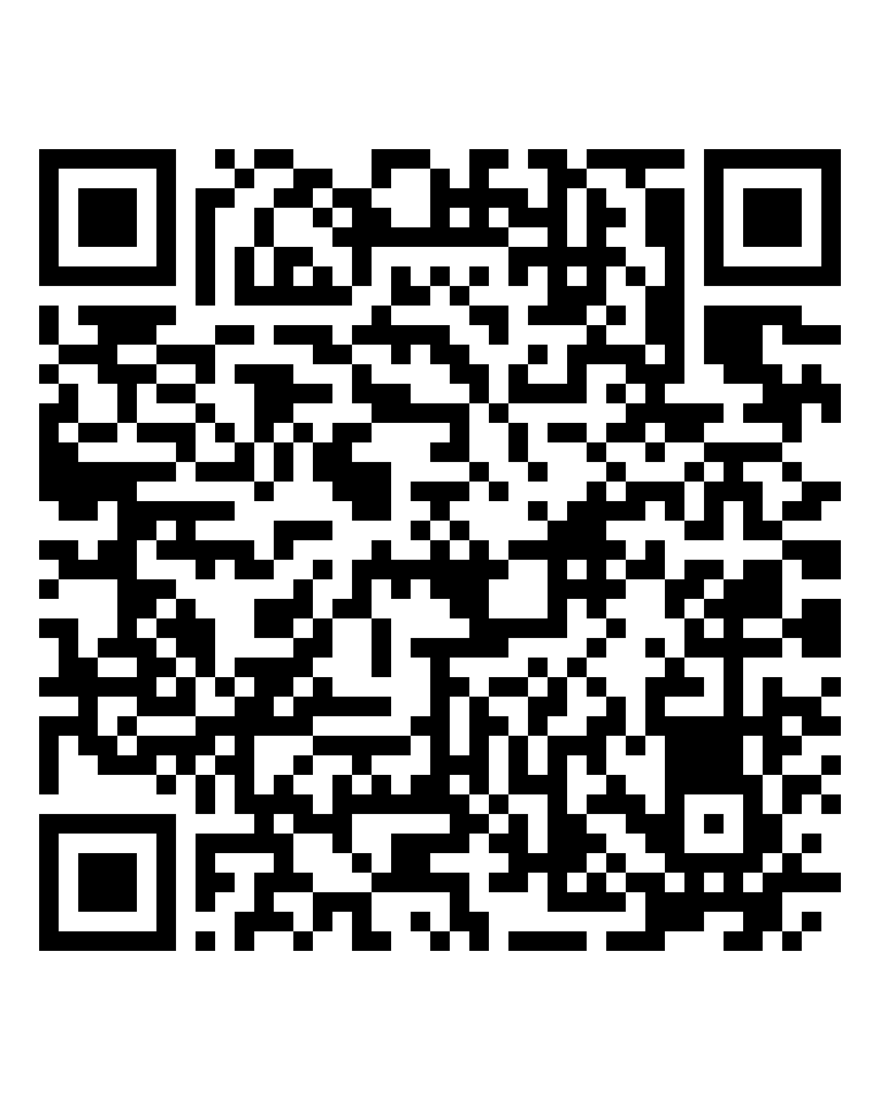
SIRS decision support tool
Use the SIRS decision support tool to help you work out what incidents you need to report to us and when.
www.agedcarequality.gov.au/resource-library/serious-incident-response-scheme-decision-support-tool
Notes:
You can use the SIRS Decision Support Tool to help you work out what incidents you need to report to the Commission and when.
If you’re unsure whether an incident is SIRS reportable, you can use the Commission’s decision support tool to help guide you. It’s available on the Commission’s website.
The information contained in the tool is intended to provide you with general guidance to help you decide whether an incident should be notified to the Commission and if it is reportable if this would be a Priority 1 or 2.
Note that it is a guide only and it’s still your responsibility to make your own assessment about the notification of a SIRS reportable incident and to be aware of your legislative requirements.
Resource: https://www.agedcarequality.gov.au/resource-library/serious-incident-response-scheme-decision-support-tool

Slide 42
SIRS notifications

Slide 43
Features of a clear SIRS notification
To make a clear notification to the Commission, you need to include:
what happened
when the incident happened
where the incident happened
who was involved, including the older person affected and workers involved with the incident
what actions were taken after the incident
what caused the incident (if known)
what changes the provider will make because of the incident (if known).
Notes:
A clear and quality SIRS incident notification requires us to do more than just provide information from our organisation’s IMS. It is important that the person making the notification is familiar with what happened and has applied a problem-solving approach. Our notification needs to show that we understand the causes and risks and show a good understanding of how to respond to the incident or what steps will be taken to minimise risk of recurrence for the incident.
It’s easier to make a clear notification to the Commission if you have all the information you need. To make a clear notification you need more than the details from the progress notes about the incident, or text from our incident management system. You need to include in your notification:
what happened
when the incident happened
where the incident happened
who was involved, including the older person affected and workers involved with the incident
what actions were taken after the incident
what caused the incident (if known)
what changes the provider will make because of the incident (if known).
If you find more information after submitting your notification, you should update the Commission.

Slide 44
The Commission’s response to SIRS notifications
Holistically consider SIRS notifications​
Apply ongoing risk assessment and management​
Use a range of actions and tools​
Engage with providers ​
Provide education on the SIRS
Notes:
When it comes to the SIRS and SIRS notifications, the central role of the Commission is to quickly understand whether older people are at immediate risk. The Commission will determine whether any actions need to be taken to better understand or mitigate that risk. The Commission does this by:
Holistically consider SIRS notifications with a focus on understanding:
the incident, including why or how it happened and the impact on the person/s involved
the risk to the older person and to other people
the adequacy of the steps taken by the provider to understand the risk and to mitigate the risk (both immediately and in a sustained way)
any other factors that may influence the Commission’s confidence in the provider to manage the risk and reduce the risk of reoccurrence.
Apply ongoing risk assessment and management
From the moment the Commission receives a notification, the Commission will assess risk, with a focus on understanding the risks to, and impacts on, the individual/s.
Use a range of actions and tools
The Commission has access to a suite of tools to effectively regulate, assimilate and analyse information, understand sources of risk, and to draw conclusions about the likelihood of events and consequences.
Engage with providers
The matters on which the Commission will engage with providers (and the outcomes sought) will differ from case to case; but the Commission’s engagement with providers will be purposeful, respectful, timely and clear.

Slide 45
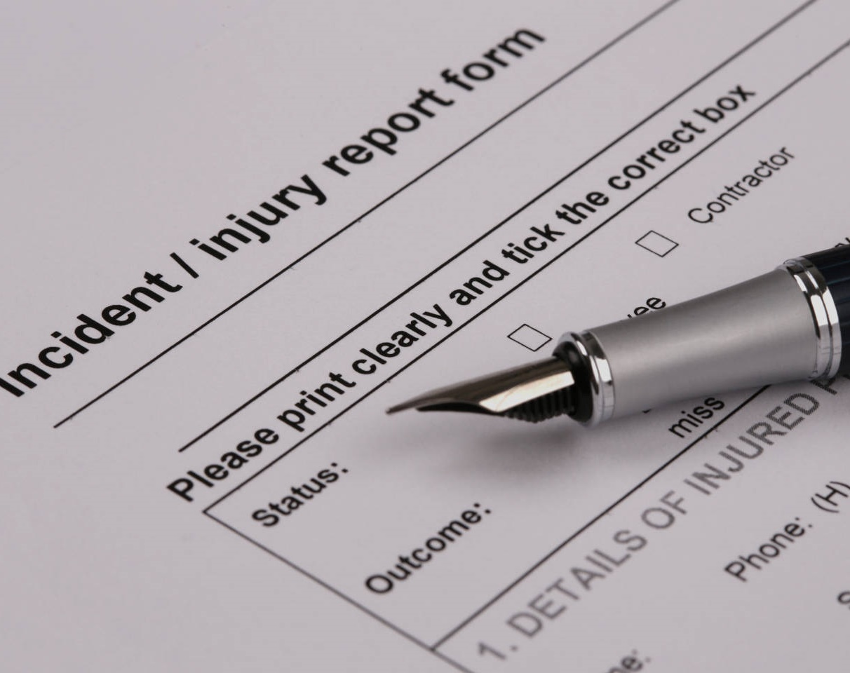
Activity – SIRS notification
When recording a SIRS reportable incident you need to include:
Detailed description of the alleged incident
Actions taken to ensure the health, safety and wellbeing of the older person(s) involved
Consideration of the appropriate level of psychological or physical impact to the older person(s) involved
What actions have been taken to manage/ minimise the risk of reoccurrence or a similar incident happening
45
Notes:
Optional activity instructions: (do not present this content)
This is an optional activity you may wish to complete with your staff.
The purpose of this activity is to consider the type of information and level of detail you will need to provide when completing a SIRS notification by looking at 4 key considerations (displayed on the slide).
We suggest that you use a prepared SIRS reportable incident from your organisation, or a fictional example like the one previously mentioned in this presentation.
Purpose: Understand the key information that needs to be included in a SIRS report notification.
Activity:
Ask the group to take on the role of being a manager and needing to complete a SIRS notification.
Start the activity by advising participants that one of your workers comes to them with a SIRS reportable incident.
Consider making available a hard copy of the reporting notification document and then have a discussion with the group using the prompt questions below as required.
Ask the group/individuals to consider: what considerations do you have for each of the 4 items of the slide? What questions would you ask your worker to gather the necessary information?
Experiencing the process from this perspective can help people to understand what information they need to gather and provide to a manager when advising them of a SIRS reportable incident.
Below are some suggested prompts, if required, to generate discussion.
1. A detailed description of the alleged incident.
Always include enough information so that a person who wasn’t there can understand what happened.
You will need to describe the situation at the time the incident happened e.g. how and when the older person was found impacted/injured/deceased and who found them. This may require you to interview relevant people as clinical notes may not give enough information. Other information to consider: what happened in the lead up to the incident? What happened initially after the incident?
You are reporting the “what, where, when, how, and who” aspects of the incident.
2. Specific actions that have been taken to ensure the health, safety, and wellbeing of the older person(s) involved.
Be clear about how the specific actions taken are relevant to ensuring the health, safety, and wellbeing of the individual following the incident.
Explain what you have done to help the older person feel safe. Identify immediately if authorities (e.g. police, ambulance) need to be contacted.
Remember, you must involve each person affected by the incident (or their representative) in managing and resolving the incident.
Ask the affected older person and other people who know them well (e.g. family, health professionals, other staff) what help or support they need to be healthy, safe, and well.
What assessments were done?
3. If there were psychological and/or physical impacts to the older person and/or subject of the notification, select the appropriate level of impact.
You need to outline the details of the actual harm caused, consequences of the harm, or harm that could have been caused (e.g. type and seriousness of injury/ illness, symptoms and/or clinical observations).
Describe the older person’s response; this could include any observed behaviour. For example, crying, shaking, throwing things, not speaking, not wanting to be around other people, or doing unusual activities.
Explain how and why any behaviour identified is different from the older person’s usual behaviour.
Describe any medical and/or psychological treatment provided in response to the incident.
Consider the older person’s response including – pain levels/change in behaviour/emotional cues/lowered mood?
4. What specific actions have been taken to manage or minimise the risk of this incident or a similar incident happening again in the future?
Describe what actions have been taken or are being taken to reduce the occurrence of a similar incident in the future.
Whether the incident has been assessed to determine whether it could have been prevented or caused less harm, and the outcome of that assessment.
The preventative measures, including remedial actions that have been put in place to identify and manage similar risks.
Identify triggers for aggression, unmet needs, behaviour chart, medication review, involvement of GP/rep etc – what can we do to minimise risk of reoccurrence (e.g. additional worker training, update care and services plan, environmental modification).
Provide worker training on how to de-escalate aggression, what to do when an incident occurs, how to share learnings.
Always provide sufficient detail in response to the questions above when completing a notice in the My Aged Care Service and Support Portal.

Slide 46
Key reflections
Notes:
We will now revisit what has been covered in this session along with some useful resources.

Slide 47
Key reflections
You must be familiar with your legislative requirements.
An effective IMS supports you to meet your legislative requirements, continuously improve and deliver safe and quality aged care services.
You can use the SIRS decision support tool to help you work out what incidents you need to report to the Commission.
Make sure that every SIRS notification includes the required information.
We all have a role to play in the prevention and management of incidents.
Notes:
Just to recap some key messages from today’s session:
You must be familiar with the legislative requirements of IMS and SIRS reportable incidents. Read the Aged Care Rules 2025 if you are not already familiar with them. Our compliance will be measured against the Aged Care Act 2024 and Aged Care Rules 2025 and it’s important that we embed these principles in your IMS and SIRS incident reporting.
Having an effective IMS will support us to meet legislative requirements, undertake continuous improvement and deliver safe and quality aged care services to older people.
Not all incidents are SIRS reportable. However, all incidents and near misses should be recorded and managed in our IMS.
Use the Commission decision support tool and other guidance resources to assist you in providing timely notification of all SIRS reportable incidents.
Ensure that your SIRS notification includes the required information – this demonstrates your understanding of the cause of the incident, the impact on the older person and prevention of future incidents. Remember, the SIRS aims to reduce the risk of abuse and neglect of older people receiving funded aged care services.
We all have a role to play in the prevention and management of incidents to ensure safe and quality person-centred care.

Slide 48
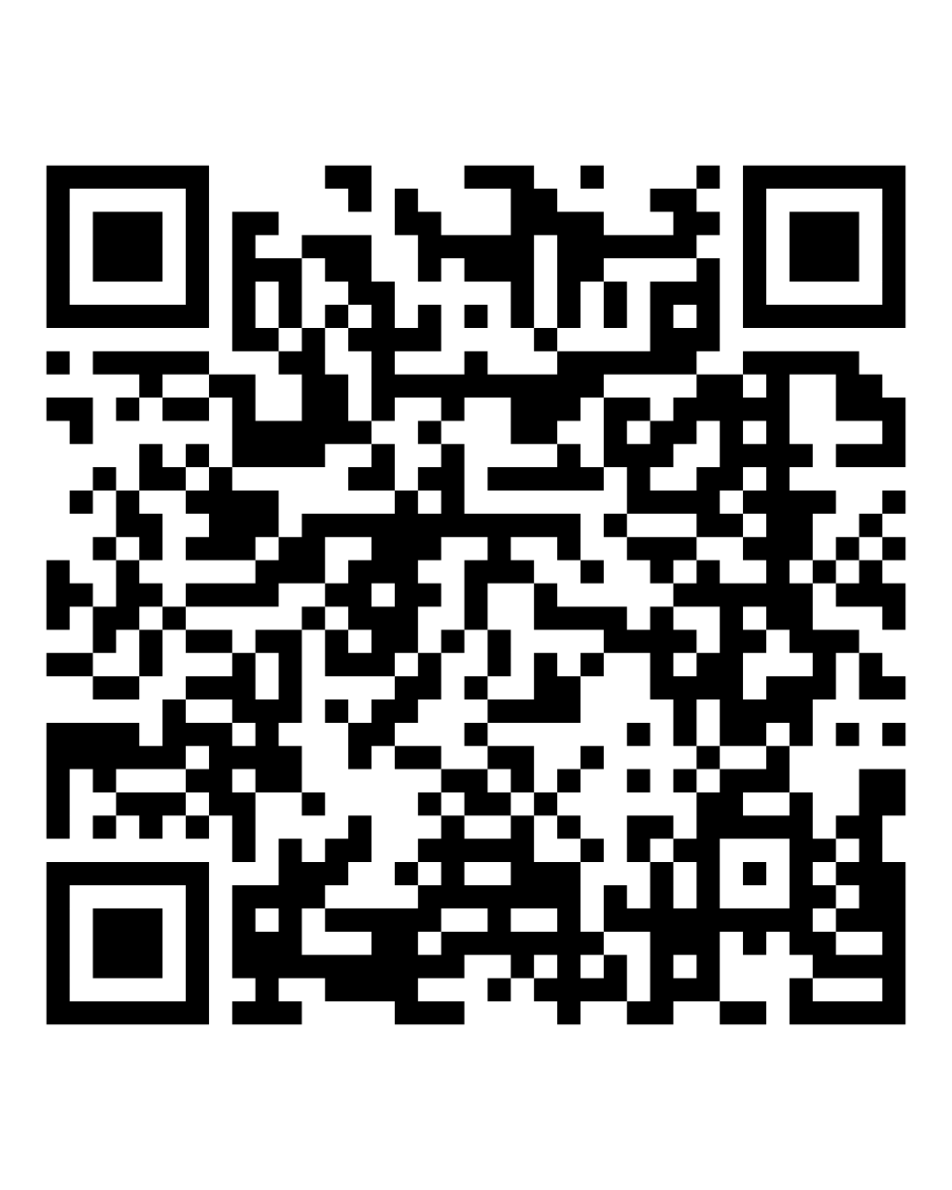
Queries about the SIRS
Call
1800 081 549 between 9.00am and 5.00pm (AEST) seven days a week.
Email
sirs@agedcarequality.gov.au
Notes:
Here are the Commission’s contact details for SIRS related enquiries. This is also the same email address you can use to send any updates or significant new information about notifications you have submitted a notification through the Service and Support Portal.
If you have an enquiry about the SIRS, you can:
Call us on 1800 081 549 between 9.00am and 5.00pm (AEST) seven days a week.
Email us at sirs@agedcarequality.gov.au
For questions about how to report a SIRS incident:
Providers must report incidents using the SIRS tile on the My Aged Care Service and Support Portal. Contact My Aged Care on 1800 200 422.

Slide 49

SIRS guidance and resources
SIRS learning modules on Alis
SIRS guidance resources
SIRS decision support tool
Quality Bulletin and Regulatory Bulletin
Reportable incidents and SIRS – quick guide
Notes:
You can find further information about IMS and the Serious Incident Response Scheme on the Commission website.
There are modules on SIRS and SIRS reportable incidents in the ALIS learning platform: https://www.agedcarequality.gov.au/online-learning#register-for-alis
Further guidance resources for providers and workers: https://www.agedcarequality.gov.au/providers/serious-incident-response-scheme
Access the quick guide to SIRS reportable incident changes introduced with the Act and Rules: https://www.agedcarequality.gov.au/resource-library/reportable-incidents-and-sirs-quick-guide-changes-1-nov-2025
You can access the SIRS decision support tool: https://www.agedcarequality.gov.au/sirs/decision-support-tool
Or read and subscribe to the Commission’s Quality Bulletin or Regulatory Bulletin to receive important information for aged care providers and workers about responsibilities, the Commission’s work, and changes affecting the aged care sector: https://www.agedcarequality.gov.au/regulatory-bulletin

Slide 50
Thank you
For further information, contact:
[Insert contact person at your organisation for information regarding incidents and reporting]
Notes:
Thank you for your attention and participation today.
If you have any organisation specific questions regarding IMS and incident reporting in our organisation, please contact [Insert contact person at your organisation for information regarding incidents and reporting].

