Slide 1
How to use this PowerPoint resource
This resource is designed for use within your aged care service and is available for non-commercial use only. This presentation will be updated, as new information is available or legislation changes – so please ensure you have the latest version before you deliver a session.
This presentation is customisable. It is divided into sections, giving you the option to cover the information in its entirety or by selecting the sections you want to focus on. It includes some optional activities you may wish to use, and we encourage you to contextualise it to your service.
If you need any support using this resource or if you have feedback or questions about any educational materials available from the Commission, please email us at education@agedcarequality.gov.au.

Slide 2
The Serious Incident Response Scheme (SIRS) for home services
Date: May 2025
VERSION 2.4

Slide 3
Release of information
The information contained in this presentation is current at the time of release. It is the responsibility of the provider to ensure any information added to this document prior to and during training delivery is accurate.
The Commission does not take responsibility for this document once modifications have been made and recommends providers monitor the Aged Care Quality and Safety Commission’s website.
UNCONTROLLED ONCE RELEASED.
Notes:
The information contained in this presentation is current at the time of release. It is the responsibility of the provider to ensure any information added to this document prior to and during training delivery is accurate.
The Commission does not take responsibility for this document once modifications have been made and recommends providers monitor the Aged Care Quality and Safety Commission’s website.
It is uncontrolled once released.

Slide 4
Important to note:
You are responsible for using your knowledge about incidents that happen in your service to decide when they must be reported and how they should be managed.
If you have a question about a specific incident, you can:
        call us on 1800 081 549 between 9:00 am and 5:00 pm (AEST) seven days a week
        email us at sirs@agedcarequality.gov.au
You may also wish to seek independent commercial or legal advice about incident management in your service.
Notes:
Important to note: You are responsible for using your knowledge about incidents that happen in your service to decide when they must be reported and how they should be managed.
If you have a question about a specific incident, you can:
call us on 1800 081 549 between 9:00 am and 5:00 pm (AEST) seven days a week
email us at sirs@agedcarequality.gov.au
You may also wish to seek independent commercial or legal advice about incident management in your service.
Please note: Throughout this presentation, where the term reportable incidents is referred to, this relates to SIRS reportable incidents.

Slide 5
Presentation sections
Section 1: Overview of incident management systems Slides 6-12
Section 3: Reporting obligations of the SIRS Slides 16-28
Section 2: What is the SIRS? Slides 13-15
Section 5: Activity – identifying reportable incidents Slides 39-42
Section 6: SIRS notifications and activity Slides 43-47
Section 4: Eight reportable incident types Slides 29-38
Section 7: Reflections and additional resources Slides 48-51
Notes:
This presentation is broken into 7 sections. If you wish to only cover certain sections, this slide indicates what slide each section will start on.

Slide 6
SECTION 1:
An overview of incident management
Notes:
Please note: the following slides do not cover every aspect of incident management systems (IMS) in detail. If you are interested in more detailed information or training materials, the slides refer to other resources for further learning.

Slide 7



Incident Management and Incident Management Systems (IMS)
The SIRS sets out legislative obligations for providers to:
have an effective IMS
Use data from your IMS to drive continuous improvement
report certain incidents to the Commission.
7
Notes:
Before looking at the SIRS, it is helpful to briefly talk about incident management and your IMS responsibilities.
The SIRS sets out legislative requirements for providers to:​​
Have an effective incident management system (IMS) in place;​
Use data from the IMS to drive continuous improvement; and​​
Report certain incidents to the Commission.​
We know that incident management is something that providers do in the day-to-day management of their business. Having good incident management processes and practices in place will ensure:
your organisation provides the highest quality care and services for older people
you’re in the best possible position to meet your SIRS responsibilities.
It's important to remember that:
legislation requires you to have an incident management system
your incident management system and practices must be used to manage and document ALL incidents and near misses and
your IMS is the critical tool to meet your requirements of SIRS and ensure you improve your processes, so you effectively manage current incidents and prevent future incidents.

Slide 8
Incident Management Systems (IMS)
What is it?
A set of:
policies and processes
To prevent or identify, respond to and manage any incidents or near misses that occur at your service and during the delivery of care and services to older people.
What does it look like?
standard operating procedures
tools
training and culture for managing incidents.
What is it used for?
Must be suited to the context of the care you provide.
Determined by providers
Notes:
The table on screen summarises the different aspects of incident management systems: what they are, what they are for, and the format they take. ​
​
What is it?
Your IMS includes policies, processes, and procedures that staff can use to prevent and manage incidents; the tools that they use to document information about incidents and find solutions; and the training and culture they rely on to continuously improve your services.
What is it for?
It helps to prevent incidents or to identify, respond to and manage any incidents or near misses that occur at your service and while you are delivering care and services to older people. Remember that your IMS should capture all incidents which take place at your service, including those which are not reportable under the SIRS.
What does it look like?
That’s up to you as providers. It must be suited to the context of the care you provide, and it could be anything from a spreadsheet to complex risk management software, depending on the size and complexity of your service. The Quality of Care Principles 2014 – part 4B stipulate elements that your IMS needs to have.
For your IMS to be effective, you will need to ensure all staff are trained on how to use it and that it is regularly reviewed, with your leadership and governance team involved in the process.

Slide 9
Legislative responsibilities for an IMS
The Aged Care Quality Standards
Quality of Care Principles 2014 – Part 4B
      Division 2: Sections 15LA, 15LB
      Division 3: Sections 15MA, 15MB, 15MC, 15MD
      Division 4: Reporting requirements
Notes:
As providers you have legislative responsibilities to have an effective IMS in place.
The Aged Care Quality Standards (current Aged Care Quality Standards)
All providers must meet the requirements of the Quality Standards.
Standard 8 Organisational governance specifically requires you to have effective risk management systems and practices for preventing and managing incidents, including the use of an incident management system. Effective incident management is a feature of safe and high-quality care and services, and an important element of quality improvement and a person-centred approach to aged care.
Additionally, as outlined under the Quality Standards, providers must use an open disclosure process in their prevention and management of any incidents affecting older people. Refer to: Standard 6 Feedback and complaints, Requirement (3)(c) and Standard 8 Organisational governance, Requirement (3)(e).
The Quality of Care Principles 2014
The Quality of Care Principles 2014 outline your legislative responsibilities. More specifically, it details responsibilities for:
managing incidents
types of incidents that must be covered
incident documents
record keeping and data analysis
roles, responsibilities, compliance, and staff training
reportable incidents.
Resource: Quality of Care Principles 2014: https://www.legislation.gov.au/Series/F2014L00830

Slide 10
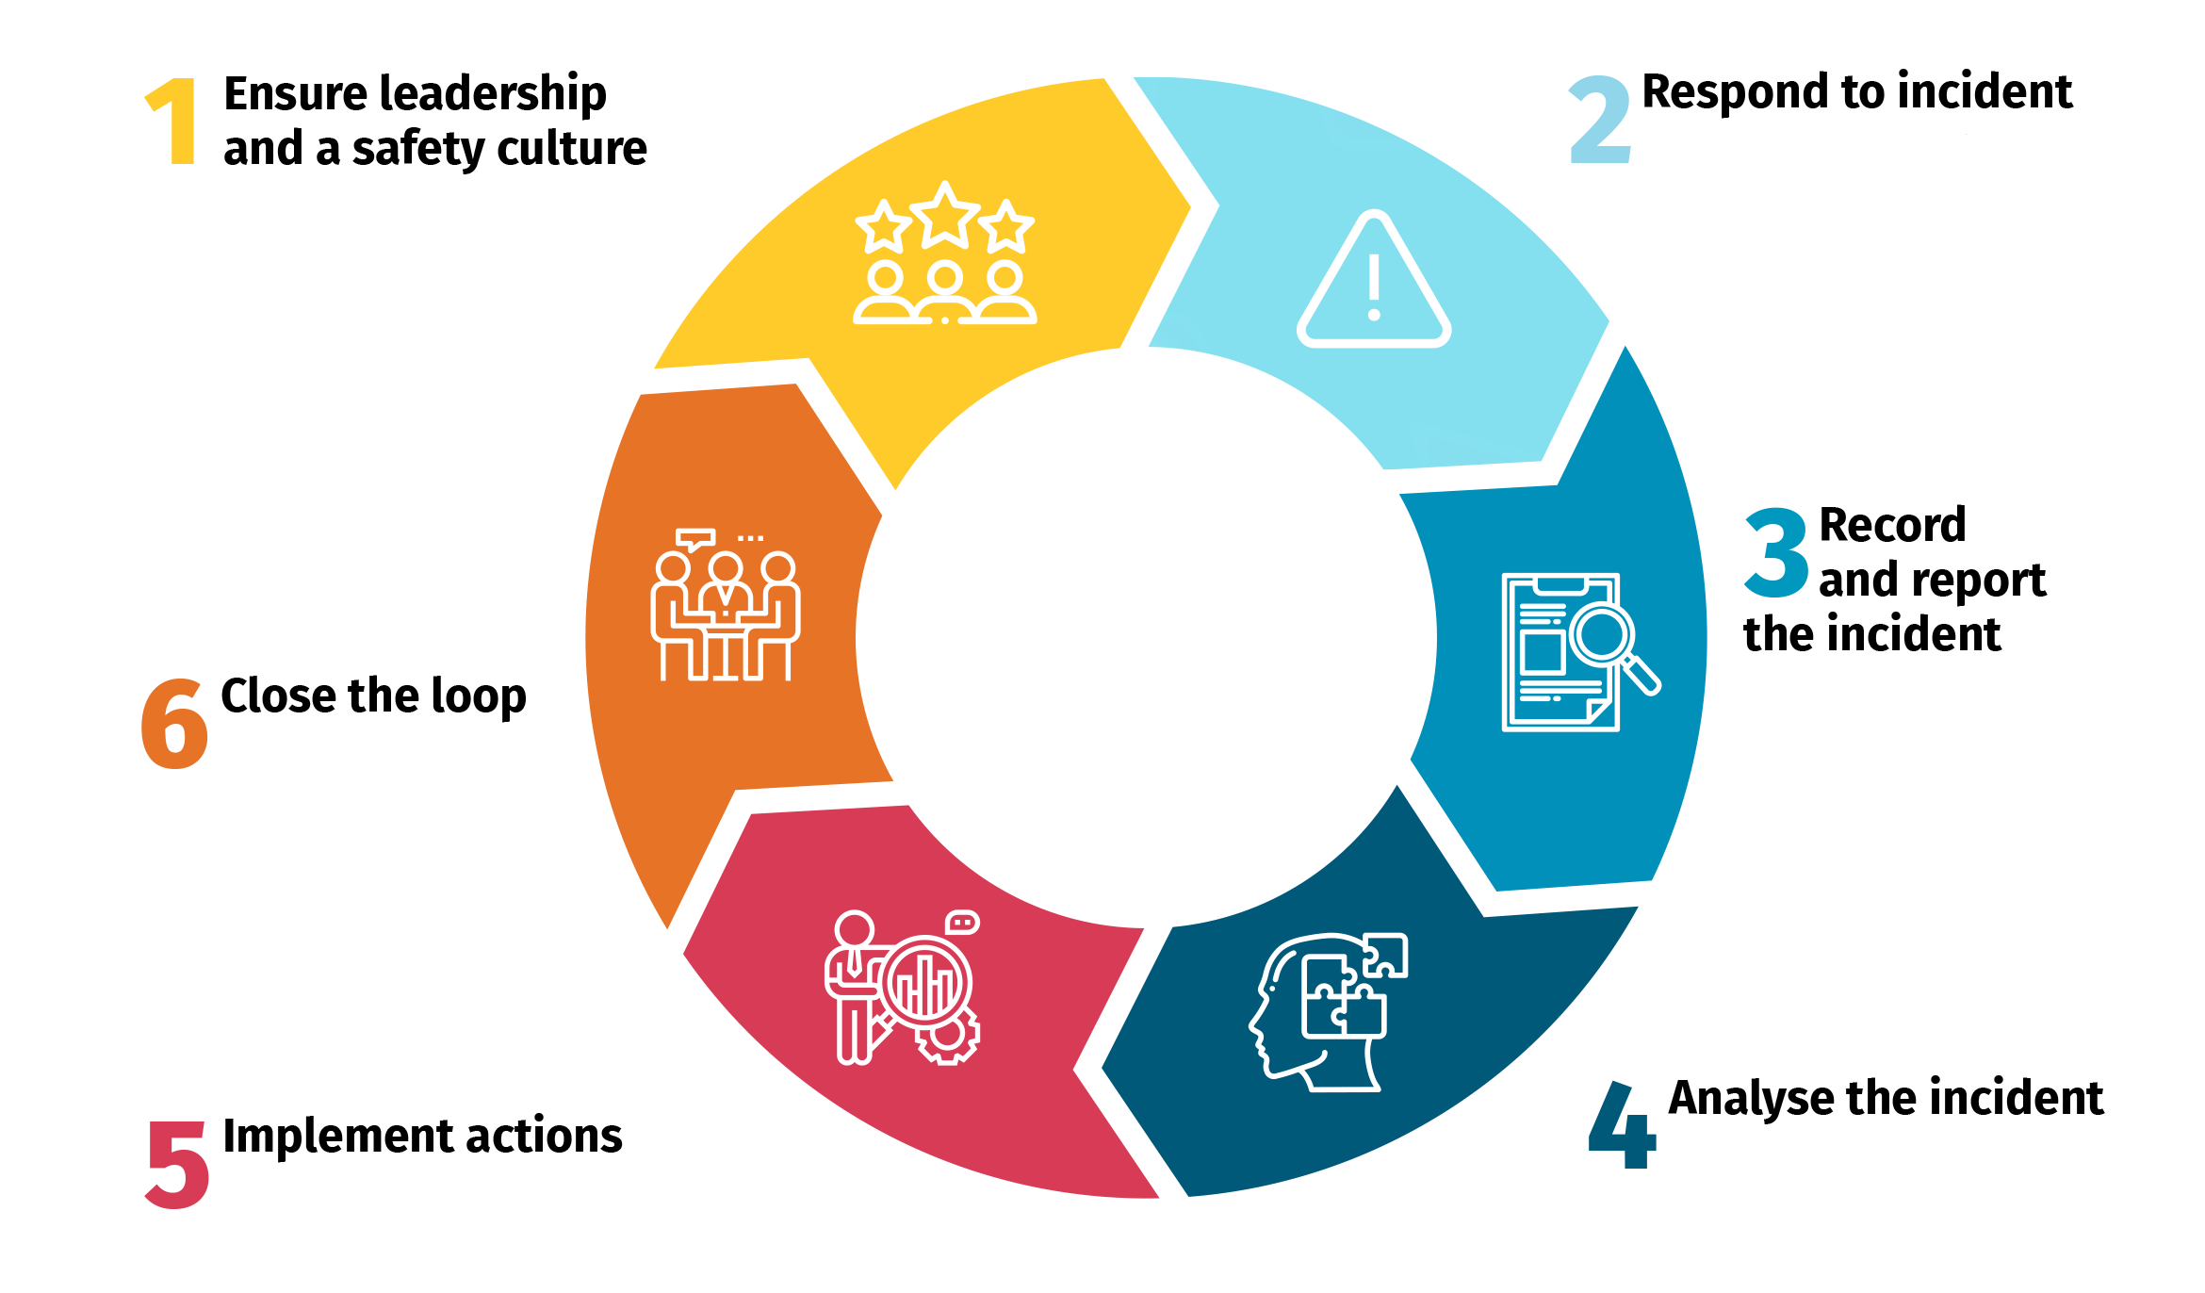
Elements of an effective IMS
Notes:
The image on screen shows 6 essential elements of an effective IMS.
This is a comprehensive approach to preventing, managing and learning from incidents. To be effective, an incident management system:
requires leadership commitment and an organisational culture that values openness, accountability and continuous improvement in quality and safety
must exist within a clear governance framework
should include comprehensive policies and procedures relating to incidents and near misses, and their management
should include a mechanism that enables incidents to be easily recorded, safely and securely stored, and easily accessed
must be well understood and used by staff, as well as older people, and their families and representatives
must enable you to respond to incidents including to:
identify and respond to an incident, and immediately supporting those affected
report the incident, make necessary notifications and record the incident appropriately
review, analyse and, if necessary, investigate how and why it happened
implement changes to reduce the risk of recurrence and to make aged care safer and
support you to continuously improve, share learnings and analyse trends and should regularly be reviewed.

Slide 11
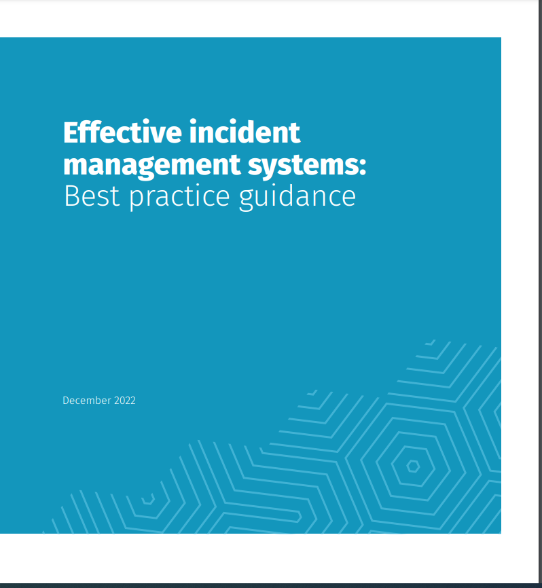
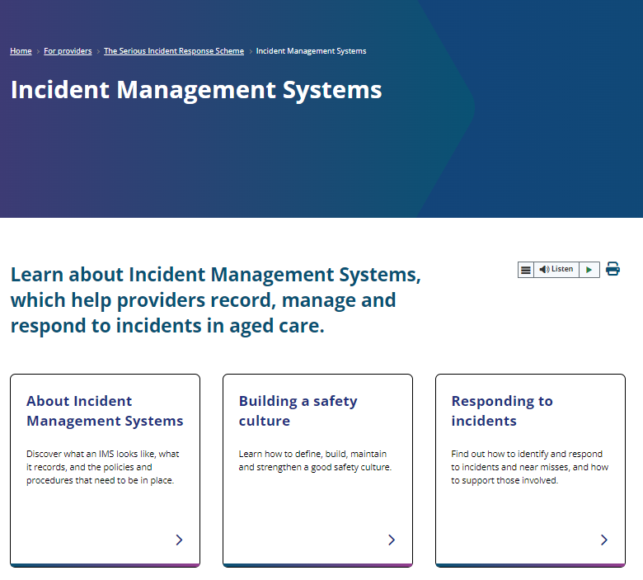
Resources for Incident Management
Notes:
For more information on the 6 essential elements of an IMS, you can refer to the Effective incident management systems: Best practice guidance, found on the Commission’s website.
The SIRS Provider Resource page also has a section on Incident Management Systems. Reading through this, you will see how it compliments information detailed in the Quality of Care Principles 2014 Part 4B.
There is a whole range of other resources around incident management systems that can also be found on the website. There are also modules in Alis, the Commission’s online learning platform on incident management.
Resource: https://www.agedcarequality.gov.au/providers/serious-incident-response-scheme/incident-management-systems

Slide 12
Incident management under the SIRS
Ensure the wellbeing of all involved and take appropriate immediate action
2
Follow your service’s IMS – you need to record ALL incidents in your IMS
3
Determine if it is a SIRS reportable incident
4
Identify the incident or near miss
1
If reportable, consider the priority level and reporting obligations
5
Notes:
There are some basic steps that need to be followed when an incident occurs at your service. Staff must be familiar with these steps because everyone has a role to play in managing and reporting incidents under the SIRS. You need to ensure all staff are aware of the role they play, what their responsibilities are and that they follow your IMS policies and procedures.
As an example, frontline staff might be involved in identifying the incident or near miss and ensuring the wellbeing of all involved by taking appropriate actions. They might also be responsible for documenting and escalating the incident or near miss. Clinical staff or management might be the ones who investigate, direct, or implement appropriate actions taken as required. They will also need to determine if the incident is a SIRS reportable incident and if so the priority level and ensuring the Commission is notified within the appropriate time frames.
You will also need to be aware of other reporting obligations, for example report to the police or the Australian Health Practitioner Regulation Agency (AHPRA).
You must do something about every incident, but not every incident is reportable.

Slide 13
SECTION 2:
What is the Serious Incident Response Scheme (SIRS)?
Notes:
This sections looks at what the SIRS is.

Slide 14

About the SIRS
An initiative to help prevent and reduce incidents of abuse and neglect among people receiving aged care.
Three major components:
      incident management obligations
      continuous improvement
      reporting and response obligations
14
Notes:
The Serious Incident Response Scheme (SIRS) is an initiative that aims to reduce abuse and neglect among people receiving aged care.
It sets out your responsibilities to manage and take reasonable action to prevent incidents with a focus on the delivery of care which is safe, supports health and wellbeing, and enables a high quality of life .
​
There are 3 major components of SIRS that must be implemented: ​
incident management obligations, which we briefly explored
continuous improvement - using data from your IMS to drive quality improvement within your service and
serious incident reporting and response we will be looking at as we move through the remainder of the session. ​

Slide 15
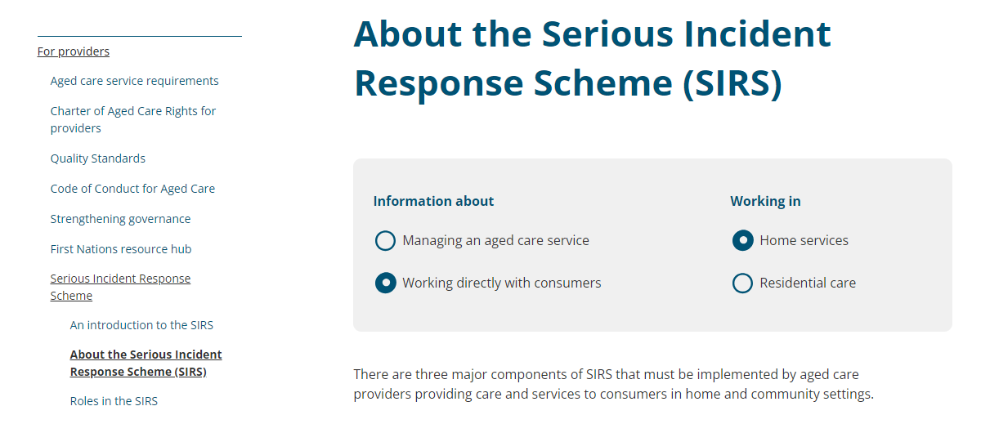
Resources for SIRS
Notes:
Information about SIRS can be found on the Commission’s website. A key resource is About the Serious Incident Response Scheme. You can choose your own adventure by selecting from the options available to tailor the information it gives you. For example, Home services, working directly with consumers.
Resource: https://www.agedcarequality.gov.au/providers/serious-incident-response-scheme/about-serious-incident-response-scheme-sirs?info_about=8487&working_in=8489

Slide 16
SECTION 3:
Reporting obligations of the SIRS
Notes:
This next section will look at important terminology you need to understand to assist you with:
your reporting obligations
what SIRS reportable incidents are
the 8 types of reportable incidents
what makes an incident a Priority 1 or 2 under SIRS. ​

Slide 17

What is a SIRS reportable incident?
One of the 8 reportable incident types
Has occurred, or is alleged or suspected to have occurred (even if you can’t prove it) while providing care and services to an older person
Has caused or could have caused harm to an older person in your care.
17
Notes:
The next few slides, look at what a reportable incident is.
Firstly, an incident is something that happens, which causes or has the potential to cause intentional or unintentional harm to an older person in your care.
As mentioned previously, all incidents that occur need to be managed in your IMS. Some incidents will only need to be managed in your IMS, but there are 8 types of incidents (more on that later), which are considered reportable incidents in the serious incident response scheme, that you are required to report to the Commission.
What is a SIRS reportable incident?
An incident is reportable if it:
is one of the 8 reportable incident types
has occurred, or is alleged to have occurred, or suspected to have occurred (even if you can’t prove it) to an older person in your care
has occurred in connection with the provision of care and services
has caused harm or could have caused harm to the older person.
Even if the incident caused no actual harm, it still needs to be reported. This is to account for situations where an incident occurred, and that incident could reasonably be expected to cause harm or discomfort.
For example, a care worker supports an older person with limited mobility to the toilet but then leaves them on the toilet unattended for a long period of time. When they return, the person seems unaffected – they are not physically harmed, and they do not express their distress in any obvious way. However, it is reasonable to consider that they might have been uncomfortable and/or concerned about being left unaided and that this incident could have caused harm to them.
Let’s take a closer look at some important phrases in the definition for a reportable incident.

Slide 18
What is a reportable incident continued…
“In connection with” the delivery of services. This includes:
  Occurs while care and services are being provided (e.g. when staff take an older person to appointments or support them in participating activities)
  Occur due to the lack of providing care and services
  Occur while staff are undertaking duties as part of their roles (e.g. failure to document and escalate a pressure injury)
  Arise out of the failure to provide care and services
  May not have occurred while services were being provided but are connected because the harm (or potential harm) arose from the provision of services.
Notes:
For something to be a SIRS reportable incident, it must be an older person in your care who is impacted.
The legislation highlights that an incident is reportable where it takes place while you are providing care and services or "In connection with" the delivery of services. This includes any incidents that:
occur while care and services are being provided (for example, when staff take an older person to appointments or support them to participate in activities)
occur due to the lack of providing care and services
occur while staff are undertaking duties as part of their roles ​(e.g. failure to document and escalate a pressure injury)
​arise out of the failure to provide care and services
may not have occurred while services were being provided but are connected because the harm (or potential harm) arose from the provision of services.
You need to consider the concerns or complaints raised by the older person, their representatives, staff members or other people, to determine if they fit into one of the 8 categories of reportable incidents. Taking this step will enable you to meet your obligations for incidents which are alleged or suspected to have occurred.

Slide 19
What is a reportable incident continued…
You need to tell the Commission about all reportable incidents that:
  are suspected or alleged, even if you can’t confirm the incident
  are under investigation (e.g. internal or police investigation)
  involve older people in your care who don’t want to report the incident
  involve older people, including those with cognitive impairment.
Incidents do not need to be reported:
  if harm has been caused to a staff member, an older person’s family member or others
  if an older person makes an informed decision to refuse care or services
  where the older person is not following a recommended course of action.
Notes:
You will need to tell the Aged Care Quality and Safety Commission (the Commission) about all reportable incidents, including incidents that:
are suspected or alleged, even if you can’t confirm the incident
are under investigation (e.g. internal or police investigation)
involve an older person who doesn’t want to report the incident
involve older people in your care, including those with cognitive impairment.
Incidents that do not need to be reported, but should be reported in the service’s IMS include:
if harm has been caused to a staff member, an older person’s family member or others, for example, an older person’s spouse trips over the vacuum cleaner left in the lounge by a staff member
if an older person makes an informed decision to refuse care or services or
where the older person is not following a recommended course of action.

Slide 20

What is a near miss?
When an incident, event or oversight happens that does not result in harm to an older person or another person but had the potential to do so.
Near misses need to be captured in your IMS.
20
Notes:
A near miss is an important term to consider.
A near miss is when an incident, event or oversight happens that does not result in harm (such as injury, illness, or danger to health) to an older person in your care or another person but had the potential to do so during the delivery of service.
Near misses should be captured in your IMS and you should consider the effect the near miss could have caused to that older person. You do not need to report near misses under the SIRS.
Examples of near misses include things like:
poor lighting that results in a staff member tripping and almost falling over an extension cord, or
equipment left in a blind spot in a corridor that could have resulted in a collision involving a staff member, the older person or their family members, or
a stack of boxes in a day respite centre falling over, where no one was injured.
Being proactive about reporting near misses is an opportunity for your organisation to build a safety culture and assess and learn from events so that you can understand risks and prevent incidents from occurring. Staff should be supported to recognise and report near misses and be part of the learning and quality improvements that come out of near misses or close calls.

Slide 21
The eight SIRS reportable incident types
Unreasonable use of force
Unlawful sexual contact or inappropriate sexual conduct
Unexpected death
Psychological or emotional abuse
Stealing or financial coercion by a staff member
Neglect
Inappropriate use of restrictive practices
Missing consumers
Notes:
The eight reportable incident types under the SIRS in home services are:
Unreasonable use of force
Unlawful sexual contact or inappropriate sexual contact
Psychological or emotional abuse
Unexpected death
Stealing or financial coercion by a staff member
Neglect
Inappropriate use of restrictive practices
Missing consumers
Resource: Information on the 8 reportable incident types can be found on the Commission’s website - https://www.agedcarequality.gov.au/for-providers/serious-incident-response-scheme/sirs-provider-resources

Slide 22
Priority 1 and Priority 2 reportable incidents
Priority 1 | Priority 2 | Non-reportable incidents
A physical or psychological injury or discomfort that needs medical or psychological treatment to resolve | All SIRS reportable incidents that are not a priority 1 incident | Need to be managed in your services IMS
Unlawful sexual contact or inappropriate sexual conduct inflicted on an older person | Must be reported to the Commission within 30 days of becoming aware of the incident
Unexpected death of an older person
Missing consumer
If you believe an incident involves crime or ongoing danger where there are reasonable grounds to report to the police
Must be reported to the Commission within 24 hours of becoming aware of the incident
Notes:
When SIRS reportable incidents occur, you need to determine if they are a priority 1 or a priority 2 reportable incident, This determines how long you have to complete your reporting.
Priority 1 reportable incidents include incidents that have caused or could have reasonably been expected to have caused and of the following:
a physical or psychological injury or discomfort that needs medical or psychological treatment to resolve
if you believe an incident involves a crime or ongoing danger where there are reasonable grounds to report to the police.
unlawful sexual contact or inappropriate sexual conduct inflicted on a person receiving aged care services
the unexpected death of a person receiving care,
a missing consumer.
All Priority 1 incidents must be reported to the Commission within 24 hours of the provider becoming aware of the incident. Incidents that are unlawful or considered to involve crime (i.e. the incident would be considered a criminal offence under Commonwealth, State or Territory laws) must also be reported to police within 24 hours of the provider becoming aware of the incident. In some instances, you may need to make further notifications to others depending on the nature of the incident, so you also need to be aware of your reporting requirements and responsibilities to other agencies such as AHPRA.
Priority 2 SIRS reportable incidents are all reportable incidents that don’t meet the requirements of a Priority 1. These incidents need to be reported to the Commission within 30 calendar days of the provider becoming aware of the incident.
A few things to be aware of:
notifications of reportable incidents must be lodged electronically using the form available to providers through the My Aged Care Service and Support portal.
staff who may need to report an incident (including out of hours and weekends) must have access to the My Aged Care Service and Support portal.
The next few slides clarify some of these concepts in more detail and should be considered when determining if incidents are priority 1 or 2. For further information, about these concepts, you can refer to the SIRS Guidelines for providers of home services.

Slide 23
Key concepts for Priority 1 and 2 incidents
Reporting to police
Older people with cognitive impairment
Medical treatment or psychological treatment
Notes:
The next few slides, will unpack the following key concepts:
Reporting to police
Older people with cognitive impairment
Medical treatment or psychological treatment

Slide 24
Reporting to police
  Reasonable grounds: includes incidents that would be considered a criminal offence under the Commonwealth, State or Territory laws or where you believe an incident may involve a criminal offence or there is ongoing danger.
  You do not need permission from the affected older person or their representative to report to the police. However, police may not start their investigation until they have received a complaint.
Notes:
You must report incidents of a criminal nature to police – whether they be actual, suspected or alleged (i.e. the incident would be considered a criminal offence under Commonwealth, State or Territory laws).
You also need to report the incident if there are reasonable grounds (i.e. you have reason to believe an incident may involve a criminal offence or if there is ongoing danger). Each state and territory describe criminal offences differently but broadly these include homicide, physical assault, sexual offences, and stealing/ theft or fraud.
A couple of things that are important to note:
You don’t need permission from the affected older person and/or their representative to report the incident. However, police may not start an investigation until they have received a complaint from that person or their representative.
In some circumstances, police may not investigate as they have their own processes and thresholds for commencing and conducting investigations. It is important to note that police decisions, do not impact your obligations.
If you report a SIRS-reportable incident to police it automatically becomes a Priority 1, even if the police decide not to take any action.

Slide 25
Older person with cognitive impairment
Incidents involving older people you provide care and services to must be reported regardless of whether that person has an assessed cognitive impairment.
Notes:
The second concept is older people with cognitive impairment. There are no exemptions from reporting incidents relating to the older person with an assessed cognitive or mental impairment. For example, if a staff member witnesses a person with a diagnosis of dementia using unreasonable force on another older person in your care, this must be reported.

Slide 26
Medical treatment or psychological treatment
May include any medical or psychological treatment used to cure a disease or condition or is in the context of s15NE(2) of the Quality of Care Principles 2014, to treat and resolve physical or psychological injury or discomfort.
Notes:
The third concept is Medical treatment or psychological treatment under the SIRS.
This includes any medical or psychological treatment used to cure a disease or condition, or to treat and resolve physical or psychological injury or discomfort, regardless of whether:
the impact on the older person is temporary or permanent AND
the type of treatment is provided to the older person at the service or elsewhere.
Physical or psychological injury or discomfort includes a range of issues such as:
a person’s distress requiring support or counselling
cuts, abrasions, burns, fractures or other physical injury to an older person requiring assessment and/ or treatment by a nurse, doctor or allied health professional
bruising, including large individual bruises or a number of small bruises that require medical treatment to resolve
head or brain injuries which might be indicated by concussion or loss of consciousness
injury or impairment requiring the older person’s attendance at or admission to a hospital
the death of an older person.
Some examples of medical or psychological treatment include:
using an ice pack
elevating a limb
escalation to a medical officer for review
the need for a person to be offered specific emotional support resulting from the incident (step above routine emotional support offered post incident)
the need for an older person to be involved in a counselling session.
If any medical or psychological treatment is used to treat a SIRS-reportable incident, the incident automatically becomes a Priority 1, regardless of the extent of the injury or discomfort, or the amount or type of treatment provided.

Slide 27
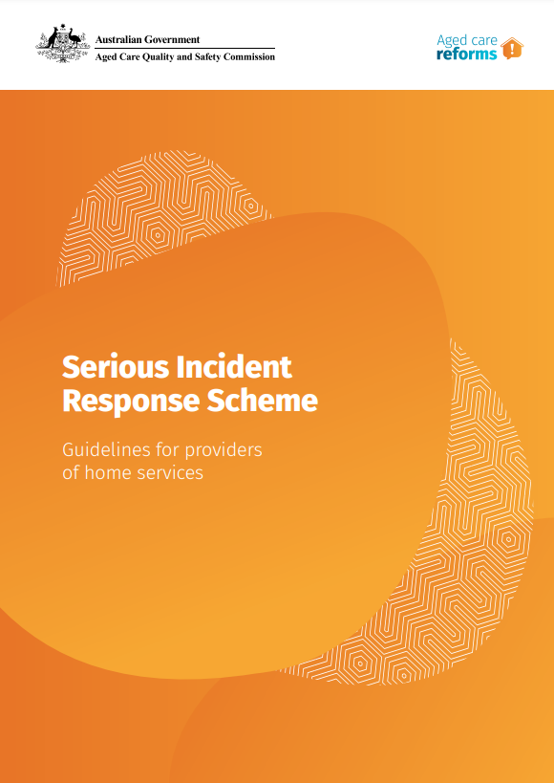
SIRS Guidance Resource
Notes:
The Serious Incident Response Scheme Guidelines outline your responsibilities regarding the SIRS, including details on each type of incident and notifying a reportable incident. They are available on the Commission’s website.
Resource: https://www.agedcarequality.gov.au/resource-library/serious-incident-response-scheme-guidelines-providers-home-services

Slide 28
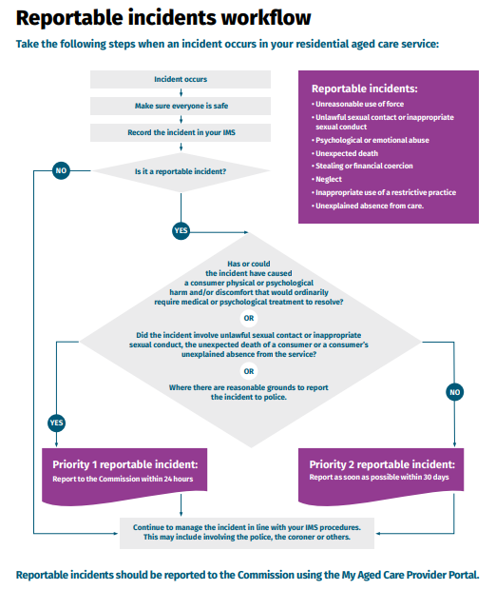
Reportable incidents workflow
Notes:
Another useful resource is the reportable incidents workflow, which is accessible via the Commission’s website. It walks you through some questions to help determine what to do if an incident is reportable – would it be a Priority 1 or 2?
Resource: https://www.agedcarequality.gov.au/sites/default/files/media/reportable-incidents-workflow_1.pdf

Slide 29



SECTION 4:
The 8 SIRS reportable incident types
29
Notes:
This next section looks at the 8 reportable incident types under the SIRS.

Slide 30
The eight SIRS reportable incident types
Unreasonable use of force
Unlawful sexual contact or inappropriate sexual conduct
Unexpected death
Psychological or emotional abuse
Stealing or financial coercion by a staff member
Neglect
Inappropriate use of restrictive practices
Missing consumers
Notes:
This is a recap of the 8 reportable incident types that were mentioned earlier.
Resource: Information on the 8 reportable incident types can be found on the Commission’s website - https://www.agedcarequality.gov.au/for-providers/serious-incident-response-scheme/sirs-provider-resources

Slide 31
Unreasonable use of force
Includes:
      conduct with an older person that ranges from the use of unwarranted or unjustified physical contact that has caused harm or has the potential to cause harm.
      hitting, punching pushing, shoving, kicking or rough handling
      repeated minor incidents of non-consensual physical contact that may have an impact over time.
Applies to incidents between staff and the older person(s), as well as incidents which take place between two or more older people.
Does not include physical contact with a lawful justification, e.g. pushing an older person out of the way of an oncoming car.
Notes:
The first reportable incident we will look at is unreasonable use of force.
Unreasonable use of force is behaviour with an older person that includes actions like:
the use of unnecessary physical force
a deliberate and violent physical attack. In some cases, this could be between staff and the older person.
shoving, pushing, hitting, punching, kicking or rough handling of an older person.
repeated minor incidents of non-consensual physical contact that have an impact on a person over time.
If you push an older person out of harm’s way this is not considered unreasonable use of force. For example, pushing an older person out of the way of an oncoming car that would otherwise hit them or out of the way of a falling item to avoid death or serious injury to them.
It also does not include gently touching the person while providing care, to attract the person's attention, to guide the person, or to comfort the person when they are distressed.

Slide 32
Unlawful sexual contact or inappropriate sexual conduct
Always Priority 1, must be reported to the Commission within 24 hours.
Includes:
    any sexual behaviour that is an offence under State, Territory or Commonwealth laws
    sexual contact or conduct where an older person is unable to consent
    any conduct or contact of a sexual nature inflicted on the older person by a worker, or a person who provides care or services while that person is providing such services (e.g. volunteers on duty).
    engaging in conduct with the intention of making it easier to procure the older person to engage in sexual contact or conduct.
Does not include:
    consensual sexual relations between older people, including between an older person and their partner who does not receive care and services.
    consensual acts of affection or gestures of comfort.
Notes:
There are two broad types of unlawful sexual contact or inappropriate sexual conduct:
1) ANY sexual contact or conduct between a staff member (or volunteer on duty) and an older person, REGARDLESS OF CONSENT, or
2) Sexual contact or conduct towards an older person by any person WITHOUT CONSENT.
All incidents of unlawful sexual contact or inappropriate sexual conduct are Priority 1 reportable incidents and must be reported to the Commission within 24 hours of the provider becoming aware of the incident. And we already know that incidents that are unlawful or considered to be of a criminal nature (for example sexual assault) must also be reported to police within 24 hours of becoming aware of the incident.
What is not reportable: consensual sexual relations between 2 older people receiving care and services, or between an older person and their partner or a person who is not a receiving care and services by your organisation.
Remember that consent can be withdrawn at any time, and you should be aware that while the person may have consented to the conduct previously, it does not mean that they consent to the same conduct in the future.
Also not included are actions of comfort, such as a carer rubbing a person’s back or patting a person on the knee, where these acts are consensual and align with the person’s personal preferences. You need to understand whether the older person thinks the gesture to be comforting.
It is important to note that the SIRS notification requirements are designed to protect vulnerable people, not to restrict their sexual freedoms. Older people have the right to make choices about their personal and social life, including the right to sexual freedom and to give and receive affection. Only the person themselves can give consent. Their family/representatives cannot give consent on behalf of them.
Any older person who lacks the capacity to consent to an activity at the time the incident happens cannot consent.
You need to be familiar with assessing capacity and have existing systems and processes in place to support you to determine a person’s capacity to make informed decisions and provide consent.
It is acknowledged that older people can have decision-making capacity for some matters and not others and that capacity can fluctuate; however, it is expected that your workforce is trained and equipped to manage issues of consent and determine a person’s ability to make decisions.

Slide 33
Psychological or emotional abuse
Includes:
conduct that has caused (or could reasonably have been expected to have caused) an older person psychological or emotional distress.
yelling, name calling, unreasonably ignoring an older person, making threatening gestures, or refusing a person access to care as punishment.
disparaging an older person’s gender, sexual orientation, sexual identity, cultural identity or religious identity.
Does not include raised voices to get the attention of an older person with hearing difficulties, minor disagreements between older people, or making reasonable requests such as encouraging a person to eat their meal.
Notes:
Psychological or emotional abuse includes behaviour that has caused, or that could have caused, the older person psychological or emotional distress.
For example, taunting, bullying, harassment or intimidation, humiliation, unreasonable refusal to interact with the older person or acknowledge their presence, unreasonable restriction of the person’s ability to engage socially or otherwise interact with people.
This category includes incidents that:
are a single event (such as a someone yelling at the older person) OR
are part of a pattern of abuse. While the behaviour may not cause significant harm or suffering to the older person every time, over time the repetitiveness of that behaviour increases and intensifies the level of harm to that person.
Staff may witness others interacting with an older person in a way they consider inappropriate or disrespectful. Examples include making disparaging comments about the older person’s gender, sexual orientation, or cultural, religious identity or constantly criticising an older person.
Other examples of psychological or emotional abuse include making repeated actions such as flicks, taps and bumps to an older person (where the action itself is not considered unreasonable use of force, but the repetitiveness of the action causes psychological or emotional anguish, pain or distress). These incidents are reportable because there was intent or potential to cause psychological or emotional distress or discomfort.
This category does not include: raised voices to get the attention of an older person with hearing difficulties, minor disagreements between two older people you provide care and services to (e.g. at a day respite centre) or making reasonable requests such as encouraging a person to eat their meal.

Slide 34
Unexpected death
Always Priority 1, must be reported to the Commission within 24 hours.
Includes where a death is the result of care, or services provided by the provider or a failure by the provider to provide care or services.
A death may occur immediately or sometime after a mistake, a failure or incident occurred. Where the death could reasonably be considered to be related to a mistake, failure or incident, you must notify the Commission.
Does not include an older person dying of an illness or disease that was appropriately assessed, monitored and managed; or dying of unrelated illness after being involved in an incident.
Notes:
The unexpected death of an older person includes any death which is the result of:
care or services provided to a person
a failure to provide care or services
reasonable steps not being taken to prevent the death.
You must notify the Commission of any incidents of unexpected death where:
your staff and professionals working at your service made a mistake resulting in death
your service did not deliver care and services in line with a person’s assessed care needs, resulting in death
your service provided care and services that were poorly managed or not in line with best practice, resulting in death.
All reportable unexpected deaths must be reported as a Priority 1 reportable incident to the Commission within 24 hours of the provider becoming aware.
Keep in mind that a reportable unexpected death may occur immediately or sometime after the care and services were provided or failed to be provided.
You may not be able to establish whether the death is related to the provider’s action or inaction until a Coroner has assessed the death. The Commission understands this process can take some time, which means you may not be able to provide all the required details at the time of reporting the incident to the Commission. Any time you reasonably suspect that a death may be related to the care and services you provided or failed to provide, you must report it to the Commission. You are then expected to notify the Commission as significant new information becomes available.
You are not required to notify the Commission of an older person’s unexpected death if the cause was unrelated to either the care or services that you provided or failed to provide. You are also not required to report all deaths where the cause of the death is yet to be confirmed. Providers should only report those where there are reasonable grounds to believe that the death may have occurred because of the provider’s action or inaction.
Example of what is not a reportable unexpected death include an older dying of an illness or disease that was appropriately assessed, monitored and managed; or dying of unrelated illness after being involved in an incident.

Slide 35
Stealing or financial coercion by a staff member
Stealing from an older person by a worker
Includes conduct by a worker that is:
      financially coercive towards an older person
      deceptive about an older person’s financial affairs
Also includes conduct by a worker that unreasonably controls a person’s finances.
Does not include an older person, with cognitive capacity, willingly offering to buy a worker a coffee on an outing, or a gift to thank them.
Does not include an older person complaining to a worker about feeling financially pressured by their family.
Notes:
Reportable incident of stealing or financial coercion by a staff member includes:
Stealing from an older person by a staff member of the provider.
Conduct by a staff member of the provider that:
is coercive or deceptive in relation to the older person’s financial affairs, or
unreasonably controls the financial affairs of the person.
This incident type includes any items belonging to a person in your care, such as money, valuables, personal effects, and medication. There is no financial value threshold applied to this incident type. Therefore, an allegation of the theft of $5 is reportable, along with an allegation of the theft of $5000 diamond earrings.
Where an older person’s money or valuables go missing without explanation, you should try to help the person to locate the item(s). If they can’t be found and there is still a suspicion that a staff member is responsible (for example the older person has told you that a staff member is responsible), you should report the incident to the Commission. If the item is subsequently located, you should provide an update to the Commission.
Note that reportable incidents of stealing or financial coercion which are notifiable under the SIRS are limited to the actions of a staff member of the provider, against a person receiving care and services.
Examples of what is not stealing or financial coercion:
where an older person or their family gives a staff member a gift to thank them for their services and support.
where items go missing but are found to have been misplaced.
where a person complains to a staff member that they feel financially pressured by their family.
There may be circumstances where staff are out with an older person (for example, accompanying them to an appointment) and the older person offers to purchase the staff member a coffee or lunch. While this should generally be discouraged, and your organisation may have rules or a professional code of conduct that prevents this, this is not the type of incident that would qualify as a reportable incident for SIRS notification purposes.
However, if you witness (or receive an allegation/hold a suspicion about) a staff member specifically asking for even items of low value such as a cup of coffee, this should be reported.

Slide 36
Neglect
Neglect can be a single incident, or it can be ongoing, repeated failures by the service to meet a person’s physical or psychological needs.
Includes:
a breach of duty of care to an older person by a provider or worker
a gross breach of professional standards in providing care to an older person.
It may include depriving a person of basic necessities, withholding personal care, or regular late or missed administration of medications.
Does not include incidents resulting from an informed choice made by the older person.
Notes:
Neglect is:
a breach of the duty of care to an older person by the provider, or a staff member, or
a gross breach of professional standards by a staff member in providing care or services to the older person.
Neglect includes an action, or a failure to act, by the provider or a staff member towards an older person that has resulted in or contributed to (or could have resulted in) harm and/or discomfort, injury, poor health outcomes, emotional distress or the death of an older person. It can be a single incident where, for example, a carer fails to fulfil a duty, resulting in actual harm to a person or where there is the potential for harm to an older person. Neglect can also be ongoing, repeated failures by a provider to meet a person’s physical or psychological needs.
Some examples of neglect may include depriving a person of basic necessities, withholding personal care, or regular late or missed administration of medications.
Neglect does not include:
a one-off incident of late or missed administration of medications where there is no significant harm and/or discomfort caused to the person
rapid weight loss because of a diagnosis/disease, where all reasonable efforts are made to ensure the person is receiving adequate nutrition
where a person chooses not to receive care and services in line with their assessed care need.
However, such incidents should still be recorded and managed in your IMS.

Slide 37
Inappropriate use of restrictive practices
Restrictive practice is any practice or intervention that has the effect of restricting the rights or freedom of movement of an older person.
Inappropriate use of restrictive practice includes any use of a restrictive practice that is not consistent with the requirements in the Quality of Care Principles (2014).
Does not include where a provider uses a restrictive practice on an older person:
    consistent with the person’s documented care and services plan, it’s used while providing care in a home or community setting and it’s recorded as soon as possible following the use of the restrictive practice.
    Use of a restrictive practice in an emergency situation will be a reportable incident.
Notes:
Restrictive practices include any practice or intervention that has the effect of restricting the rights or freedom of movement of an older person. Whether the use of a restrictive practice is a reportable incident, depends on the circumstances in which it is used, and whether these are consistent with requirements as described in Part 4A of the Quality of Care Principles.
General examples of restrictive practices include:
installing bed rails that make it difficult for a person to get out of bed
placing a table or something in front of a person to limit their ability to move
locking a person’s door so they can’t exit a certain room or their home
moving a mobility aid like a walker out of reach
any drug that is used to control, sedate, or restrict the movement or behaviour of a person.
For home services providers, the Quality of Care Principles set out that the use of a restrictive practice is not a reportable incident where a provider uses the restrictive practice in line with the person’s documented care and services plan, uses the restrictive practice in the course of providing aged care in a home or community setting, and records the use of the restrictive practice as soon as possible following the use.
However, use of a restrictive practice in an emergency situation will be a reportable incident in home services, as emergency use will not meet all the requirements including matters that need to be detailed in the person’s care and services plan prior to its use.
The guidance material has a lot more detail about the requirements for what needs to happen and be documented before the use of the restrictive practice.

Slide 38
Missing consumers
Missing consumers is where an older person goes missing in the course of delivering care and services and there are reasonable grounds to report that fact to police.
This incident type is intended to only capture situations where a provider has the older person in their physical care immediately prior to the absence.
You are not required to notify the Commission of incidents where a staff member arrives for a scheduled visit and the person is not present or where the person leaves their home while, for example, home maintenance services are being provided (and there are no reasonable grounds to contact the police).
All reportable incidents of missing consumers are Priority 1 and must be reported to the Commission within 24 hours of becoming aware.
Notes:
Where an older person goes missing in the course of delivering care and services and there are reasonable grounds to report that fact to police, this is a reportable incident under the SIRS.
This definition is intended to capture situations where a provider has the person in their physical care immediately prior to their absence. For example:
a staff member has taken the person to the shops, and the person has gone missing during the outing
a person goes missing while a staff member is delivering care and services in the person’s home, and there is reason for concern (e.g. they could be harmed if they were wandering alone) and
any time a person goes missing in the course of delivering care and services, and there are reasonable grounds to contact the police.
This definition does not require you to notify the Commission of incidents where a staff member arrives for a scheduled visit and the older person is not present or where they leave their home while, for example, home maintenance services are being provided (and there are no reasonable grounds to contact the police).
However, if a person is not present when service delivery has been scheduled and there is reason for concern (or no reasonable explanation for their absence), staff members would be responsible for alerting the provider to the older person’s unexpected absence, and the provider would be expected to follow this up (as per existing procedures agreed with each person). All unexpected absences of a home services consumer should be recorded in your IMS and their care plan so that behaviours (including wandering patterns in community settings) can be understood and appropriately managed.
You are expected to report a missing older person to the police within 24 hours if there are reasonable grounds to do so, so an appropriate response and actions can be taken to locate the person.
If initially there are no grounds to report to police, but those grounds later become apparent, then the provider has 24 hours from the time of becoming aware of those reasonable grounds, to report to police.
All reportable incidents of missing consumers are Priority 1 reportable incidents for the purposes of notifying the Commission.
FYI, this incident type is referred to an ‘unexplained absence’ in the My Aged Care Provider Portal.

Slide 39
SECTION 5:
Activity - Identifying reportable incidents
Notes:
This next section includes an optional activity on identifying reportable incidents.

Slide 40
Activity: Assessing an incident
Consider the criteria for determining whether an incident is a SIRS reportable incident or not, and whether a reportable incident is a P1 or P2.
Focus on the process for making your determination.
You will need to:
select some examples of incidents that have occurred at your service for discussion
refer to the relevant sections of the SIRS guidelines for home care providers
note down and discuss the criteria you used in coming to a view
Notes:
This is an activity you may wish to complete with your staff.
To complete the activity, you need to select an incident and then take a look at the guidance material to determine whether it meets the threshold for reporting and then where it is reportable, determine whether it is a priority 1 or priority 2 incident. If you don’t have an example from your service in mind, you can use the example scenario provided on the next slide. You could also use an example of a non-reportable incident (which still needs to be documented in your IMS) to show your team the difference and reiterate their responsibilities for broader incident management and reporting.
The purpose of this activity is:
to identify whether an incident would be reportable and why. What criteria do you need to consider and
if it is reportable, what criteria do you need to consider to determine if it is a Priority 1 or 2.
Instructions
Select some examples of incidents that have occurred at your service. You may want to include an incident that is not reportable under the SIRS to show your staff how it’s different. You can also use the example on the next slide if you don’t have an example from your service.
Refer to the relevant sections of the SIRS guidance found on the Commission’s website - https://www.agedcarequality.gov.au/resource-library/serious-incident-response-scheme-guidelines-providers-home-services
Note down and discuss the criteria you used in coming to a view.

Slide 41
Activity – Neglect
Ada’s home care package includes assistance with hygiene and toileting.
The care worker does not arrive for the scheduled visit, resulting in Ada’s continence aids not being changed. Ada was emotionally distressed as a result.
The service offers Ada counselling.
Would this be a reportable incident?
Why? Consider the criteria.
If it is reportable, is it Priority 1 or Priority 2?
Why? Consider the criteria for each.
Notes:
You may wish to use this scenario as an example prior to doing the activity on the previous slide using your own scenarios. The purpose is to work through the scenario and answer the questions using the SIRS guidelines.
Use the SIRS Guidelines for home service providers to help with determining if this would be a reportable incident and if it is, would it be a priority 1 or 2?
Resource - https://www.agedcarequality.gov.au/sites/default/files/media/acr_shs_003_sirs_home_services_provider_guidelines_0.pdf.
Refer to pages 38 - 42 of the guidance document for this activity.
Refer to the scenario on the slide.
Would this be a reportable incident? Why? Consider the criteria.
Answer: This is a reportable incident of neglect as it has caused psychological harm to the Ada (and may result in poor health outcomes due to hygiene issues). It is a breach of the duty of care owed by the provider, or a staff member, to Ada.
The older person’s reaction can help determine whether this incident is reportable.
If it is reportable, is it Priority 1 or Priority 2? Why? Consider the criteria for each.
Answer: This is a P1 notification as the incident caused or could reasonably have been expected to have caused the older person physical or psychological injury or discomfort that requires medical or psychological treatment to resolve. In this instance, Ada was distressed and offered counselling.

Slide 42
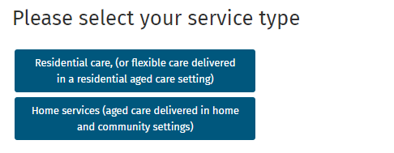
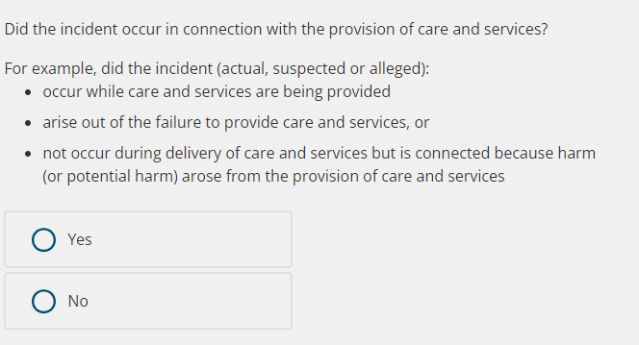
SIRS decision support tool
Home services incident selection
Notes:
The guidance provides the most comprehensive information on the SIRS, but if you’re unsure whether an incident is reportable, you can use the Commission’s decision support tool to help guide you. It’s available on the Commission’s website.
The information contained in the tool is intended to provide you with general guidance to help you decide whether an incident should be notified to the Commission and if it is reportable if this would be a Priority 1 or 2.
Note that it is a guide only and it’s still your responsibility to make your own assessment about the notification of a reportable incident and to be aware of your legislative requirements.
Resource: https://www.agedcarequality.gov.au/resource-library/serious-incident-response-scheme-decision-support-tool

Slide 43
SECTION 6:
SIRS notifications and activity

Slide 44
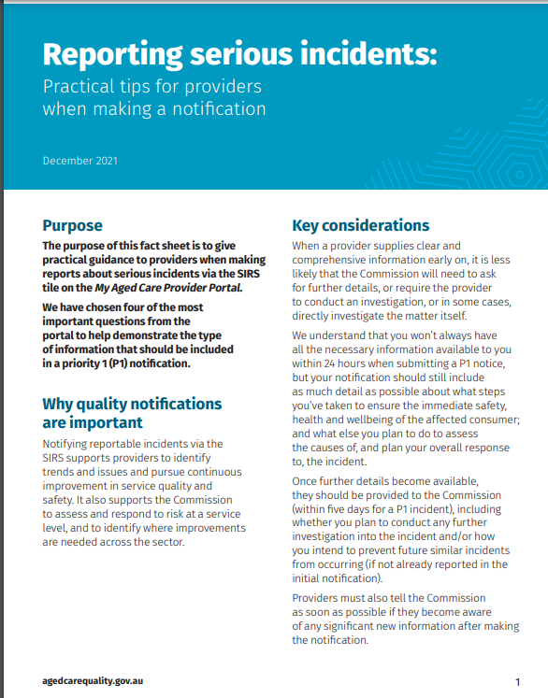
Let’s talk about SIRS notifications
Notes:
Reporting serious incidents: Practical tips for providers when making a notification.
This resource, available on the Commission’s website, covers the key elements to consider when making a SIRS notification and what to include to ensure your notification has all the information required.
Resource: https://www.agedcarequality.gov.au/resources/reporting-serious-incidents-practical-tips

Slide 45
Some features of a high-quality SIRS notification
A detailed description of the alleged incident
A description of the harm caused, or that could have been caused, because of the incident
Specific actions taken to ensure the health, safety and well-being of the older person(s) involved
Specific actions taken to manage or minimise the risk of recurrence of this or a similar incident in future
Notes:
Some features of a high-quality SIRS notification
A good-quality incident notification requires you to do more than just provide information from your service’s IMS. It is important that the person making the notification is familiar with what happened and has applied a problem-solving approach. Your notification needs to show that you understand the causes and risks and show a good understanding of how to respond to the incident or what steps will be taken to minimise risk of recurrence for the incident.
Your SIRS notification should include the following:
description of the incident, including who was directly involved in the incident, where it happened, what time and date it occurred (or was alleged or suspected to have occurred), an explanation of the circumstances leading to the incident if known, what occurred immediately after the incident, etc.
description of the harm caused, or that could have been caused if it weren't for the older person’s cognitive impairment, memory deficit, or such other condition that prevents them from articulating or displaying evidence of harm or distress. Some (not all) people with cognitive impairments may be limited in their ability to, for example verbally express pain or other impacts of an incident - and that alone doesn't mean that no harm was caused.
specific actions that were taken, or will be taken, to ensure the safety, health and wellbeing of any older person affected by this incident
Note: this may include older people who witnessed or are aware of the incident as well as older people directly involved in the incident;
specific actions that were taken, or will be taken, to minimise the risk of an incident of a similar nature taking place
Note: for unexpected deaths, for example, think about what actions you may need take to minimise the risk of other older people at the service being harmed in a similar incident.

Slide 46
The Commission’s response to SIRS notifications
Holistically consider SIRS notifications​
Apply ongoing risk assessment and management​
Use a range of actions and tools​
Engage with providers ​
Provide education on SIRS
Notes:
When it comes to the SIRS and SIRS notifications, the central role of the Commission is to quickly understand whether older people are at immediate risk and determine what, if any, actions the Commission might take to better understand or mitigate that risk. The Commission does this by:
Holistically consider SIRS notifications. The Commission’s focus is on understanding:
the incident, including why or how it happened and the impact on the person/s involved
the risk to the older person and to other older people
the adequacy of the steps taken by the provider to understand the risk and to mitigate the risk (both immediately and in a sustained way)
any other factors that may influence the Commission’s confidence in the provider to manage the risk and reduce the risk of reoccurrence.
Apply ongoing risk assessment and management - From the moment the Commission receives a notification, the Commission will assess risk, with a focus on understanding the risks to, and impacts on, the older person/s.
Use a range of actions and tools - The Commission has access to a suite of tools to effectively regulate, assimilate and analyse information, understand sources of risk, and to draw conclusions about the likelihood of events and consequences.
We engage with providers - The matters on which the Commission will engage with providers (and the outcomes sought) will differ from case to case; but the Commission’s engagement with providers will be purposeful, respectful, timely and clear.

Slide 47
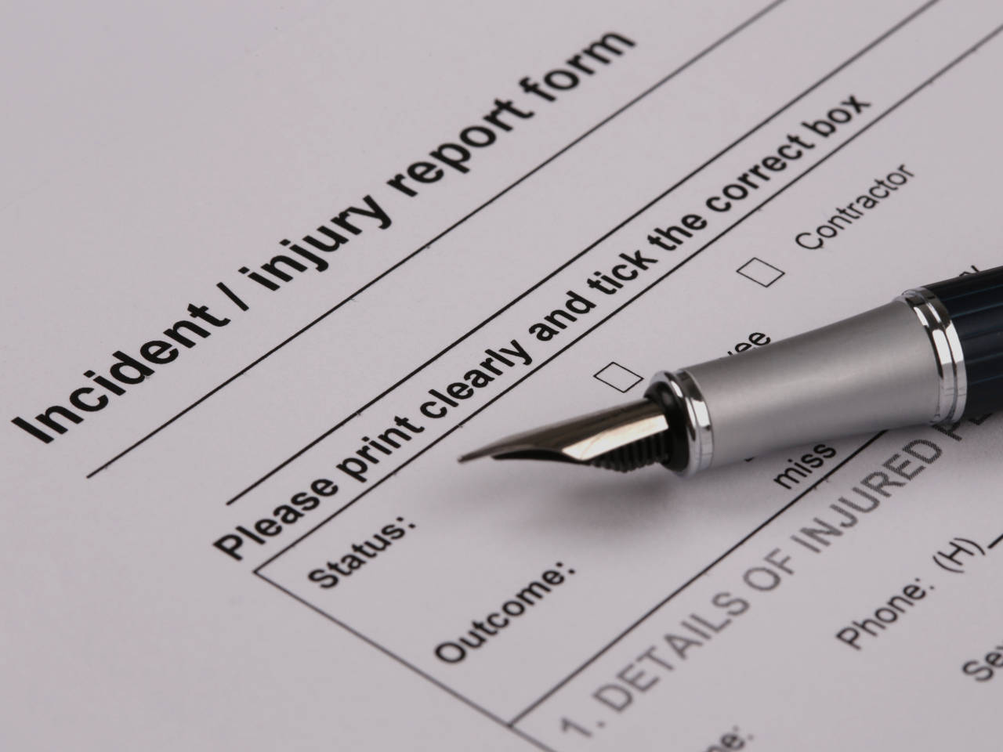
Activity
When recording a SIRS reportable incident you need to include:
  Detailed description of the alleged incident
  Actions taken to ensure the health, safety and wellbeing of the older person(s) involved
  Consideration of the appropriate level of psychological or physical impact to the older person(s) involved
  What actions have been taken to manage/ minimise the risk of reoccurrence or a similar incident happening
47
Notes:
This is an activity you may wish to complete with your staff.
The purpose of this activity is to consider the type of information and level of detail you will need to provide when completing a SIRS notification by looking at 4 key considerations, which you can see them on the slide.
We suggest that you use a SIRS incident from your service, or a fictional example like the one previously mentioned, and then ask the group to take on the role of being a manager and needing to complete a notification. Start the activity by advising participants that one of your staff comes to them with a reportable incident.
Consider making available a hard copy of the reporting notification document and then have a discussion with the group using the prompt questions below as required. The main purpose is to help people understand the key information that needs to be included in a SIRS report. So ask the group/individuals to consider: what considerations do you have for each of the 4 items of the slide? AND What questions would you therefore ask your staff member to gather the necessary information? Experiencing the process from this perspective can help people understand what information they need to gather and provide to a manager when advising them of a reportable incident.
Below are some suggested prompts, if required, to prompt discussion.
A detailed description of the alleged incident.
Always include enough information so that a person who wasn’t there can understand what happened.
You will need to describe the situation at the time the incident happened e.g. how and when the person was found impacted/ injured/ deceased and who found them. This may require you to interview relevant people as clinical notes may not give enough information. Other information to consider: what happened in the lead up to the incident? What happened initially after the incident?
You are reporting the “what, where, when, how, and who” aspects of the incident.
2. Specific actions that have been taken to ensure the health, safety, and wellbeing of the older person(s) involved.
Be clear about how the specific actions taken are relevant to ensuring the health, safety, and wellbeing of the older person following the incident.
Explain what you have done to help the person feel safer. Identify immediately if authorities (e.g. police, ambulance) need to be contacted.
Remember, you must involve each person affected by the incident (or their representative) in managing and resolving the incident.
Ask the affected person and other people who know them well (e.g. family, health professionals, other staff) what help or support they need to be healthy, safe, and well.
What assessments were done?
3. If there were psychological and/or physical impacts to the victim and/or subject of the allegation, select the appropriate level of impact.
You need to outline the details of the actual harm caused, consequences of the harm, or harm that could have been caused (e.g. type and seriousness of injury/ illness, symptoms and/or clinical observations).
Describe the person’s response; this could include any observed behaviour. For example, crying, shaking, throwing things, not speaking, not wanting to be around other people, or doing usual activities.
Explain how and why any behaviour identified is different from the person’s usual behaviour.
Describe any medical and/or psychological treatment provided in response to the incident.
Consider the older person’s response including – pain levels/ change in behaviour/ emotional cues/ lowered mood?
4. What specific actions have been taken to manage or minimise the risk of this or a similar incident from happening again in the future?
Describe what actions have been taken or are being taken to reduce the occurrence of a similar incident in the future.
Whether the incident has been assessed to determine whether it could have been prevented or caused less harm, and the outcome of that assessment.
The preventative measures, including remedial actions that have been put in place to identify and manage similar risks.
Identify triggers for aggression, unmet needs, behaviour chart, medication review, involvement of GP/ rep etc – what can we do to minimise risk of reoccurrence (e.g. additional staff training, update care plan, environmental modification).
Provide staff training on how to de-escalate aggression, what to do when an incident occurs, how to share learnings.
ALWAYS provide sufficient detail in response to the questions above when completing a notice in the MAC Service and Support Portal.

Slide 48
SECTION 7:
Reflections and additional resources
Notes:
This next section provides an opportunity to recap what has been covered I this section along with some useful resources.

Slide 49
Key reflections
You must be familiar with legislative requirements.
An effective IMS supports legislative requirements, continuous improvement and quality care and services.
Use the decision support tool and other resources.
Ensure that every SIRS notification includes the required information.
“We all have a role to play in the prevention and management of incidents.”
Notes:
Just to recap some key messages from today’s session:
You must be familiar with the legislative requirements of IMS and reportable incidents under SIRS. Read the Quality of Care principles if you are not already familiar with them. As a provider, your compliance will be measured against the Quality of Care Principles; it’s important that you embed these principles in your IMS and SIRS reporting.
Having an effective IMS will support you to meet legislative requirements, undertake continuous improvement and deliver quality care and services to the people you provide care and services to.
Not all incidents are reportable. However, all incidents and near misses should be managed through your IMS.
Use the decision support tool and other resources to assist you in providing timely notification of all reportable incidents under SIRS.
Ensure that your SIRS notification includes the required information – this demonstrates your understanding of the cause of the incident, the impact on the older person and prevention of future incidents. Remember the SIRS aims to reduce the risk of abuse and neglect of older Australians receiving aged care services.
We all have a role to play in the prevention and management of incidents. Don’t leave the incident unattended assuming it’s someone else’s responsibility. We encourage you to share with your team what you have learnt from the workshop today.

Slide 50
Queries about SIRS
Call
1800 081 549 between 9.00am and 5.00pm (AEST) seven days a week.
Email sirs@agedcarequality.gov.au
Notes:
Here are the Commission’s contact details for SIRS enquiries. This is also the same email address you can use to send any updates or significant new information about notifications you have submitted through the Service and Support Portal.
If you have an enquiry about the SIRS, you can:
Call us on 1800 081 549 between 9.00am and 5.00pm (AEST) seven days a week.
Email us at sirs@agedcarequality.gov.au
For questions about how to report a SIRS incident:
Providers must report incidents using the SIRS tile on the My Aged Care Service and Support Portal. Contact My Aged Care on 1800 200 422.

Slide 51


Useful resources on SIRS
Modules on the SIRS and SIRS reportable incidents in Alis
Commission’s website links for SIRS
SIRS decision support tool
Regulatory Bulletin
Facebook
Twitter
@agedcarequality
@agedcarequality
Notes:
Useful resources:
Modules on SIRS and SIRS reportable incidents in ALIS: https://www.agedcarequality.gov.au/online-learning#register-for-alis
Commission’s website links for SIRS: https://www.agedcarequality.gov.au/providers/serious-incident-response-scheme
Decision Support Tool: https://www.agedcarequality.gov.au/sirs/decision-support-tool
Regulatory bulletin: https://www.agedcarequality.gov.au/regulatory-bulletin

