Slide 1
How to use this PowerPoint resource
This resource is designed for use within your aged care organisation and is available for non-commercial use only. This presentation will be updated routinely as new information – so please ensure you have the latest version before you deliver a session.
This presentation is customisable. It is divided into sections, giving you the option to cover the information in its entirety or by selecting the sections you want to focus on. You may choose to deliver as a PowerPoint presentation, or to print and deliver as a workbook, and we encourage you to contextualise it to your organisation. There are opportunities throughout the session for participants to reflect on their learning.
If you need any support using this resource or if you have feedback or questions about any educational materials available from the Commission, please email us at education@agedcarequality.gov.au.

Slide 2
The strengthened Quality Standards: Preparing for the changes
Provider resource - home or community settings
Notes:
Facilitator notes:
This resource is designed for use by registered providers (providers) delivering services in home or community settings.

Slide 3
Release of information
The information contained in this presentation is current at the time of release. It is the responsibility of the registered provider (provider) to ensure any information added to this document prior to and during training delivery is accurate.
The Commission does not take responsibility for this document once modifications have been made and recommends providers monitor the Aged Care Quality and Safety Commission’s website.
UNCONTROLLED ONCE RELEASED.

Slide 4
Learning Outcomes
Completing this learning should support you to:
Apply the requirements of the strengthened Quality Standards to a case study
Develop understanding of the connections between the strengthened Quality Standards
Reflection opportunity
Thoughts about the strengthened Quality Standards:

Slide 5
Outline of resource
Introduction – slides 6 to 9
Section 1 Transitions – slides 10 to 19
Section 2 Relating the strengthened Quality Standards to your own setting – slides 21 to 40
Where to locate information regarding the strengthened Quality Standards
Reviewing transition practices within the context of a case study
Standard 1 – slides 26 to 28
Standard 2 – slides 29 to 31
Standard 3 – slides 32 to 34
Standard 4 – slides 35 to 37
Standard 5 – slides 38 to 40
Case study information (if required) – slides 23 to 25

Slide 6
Introduction
Review of the strengthened Quality Standards

Slide 7
Registration categories
Provider registration category | Description | Service types | Application to registration categories
 |  |  | Aged care Quality Standards – 1-4 | Aged care Quality Standards – 5-7
Category 1 | Home and community services | Domestic assistance Home maintenance and repairs Meals Transport
Category 2 | Assistive technology and home modifications | Equipment and products Home adjustments
Category 3 | Advisory and support services | Hoarding and squalor assistance Social support and community engagement
Category 4 | Personal care and care support in the home or community (including respite) | Allied health and other therapy Personal care Nutrition Therapeutic services for independent living Home or community general respite Community cottage respite Care management Restorative care management | Standard 1: The individual Standard 2: The organisation Standard 3: The care and services Standard 4: The environment | Standard 5: Clinical care Outcome 5.1 Clinical governance (Applies to the service types of care management and restorative care management only)
Category 5 | Nursing and transition care | Nursing care Assistance with transition care | Standard 1: The individual Standard 2: The organisation Standard 3: The care and services Standard 4: The environment | Standard 5: Clinical care
Category 6 | Residential care (including respite) | Residential accommodation Residential everyday living Residential services Residential clinical care | Standard 1: The individual Standard 2: The organisation Standard 3: The care and services Standard 4: The environment | Standard 5: Clinical care Standard 6: Food and nutrition Standard 7: The residential community
Notes:
Facilitator Notes:
This slide includes information about the strengthened Quality Standards that apply to registered providers (providers) of services in home or community settings, based on your registration category.
There will be 6 registration categories that group service types based on similar care complexity and risk. The registration categories 4 and 5, which relate to providers of services in home or community settings can be seen in this table. You will see that strengthened Quality Standards 1 to 5 may be applicable depending on your registration category.

Slide 8



Available digital guidance
Strengthened Quality Standards | resources
Strengthened Quality Standards guidance | Aged Care Quality and Safety Commission
Strengthening the Aged Care Quality Standards | Australian Government Department of Health and Aged Care
Notes:
Facilitator notes:
7 strengthened Quality Standards (SQS) have been implemented
Link 1 = Commission resources page for SQS (show participants how to access the guidance for aged care workers (workers) from here)
Link 2 = SQS guidance. Take participants through a live demonstration to show how they can find information.
Link 3 = Department of Health, Disability and Ageing where most up-to-date information can be obtained

Slide 9
Reflection opportunity
What have you noticed about the strengthened Quality Standards digital guidance?
How might you be able to use this digital guidance to help in your daily work activities?
How might this digital guidance help when there is an issue?
Notes:
Facilitator notes:
Key messages:
The SQS are more measurable, detailed and comprehensive than the previous Quality Standards.
Outcomes are enforceable, Actions demonstrate how providers may meet that Outcome.

Slide 10



Section 1 - Transitions
10
Notes:
Facilitator notes:
Section 1 is a case study scenario with questions to take participants through when looking at the expectations of the strengthened Quality Standards. The focus of this section is older person transitions from hospital back to home or community settings. You can work your way through the activity or utilise any element that you think would be helpful in your care setting.
Slides 10 to 12 contain information required to unpack the case study.
Slide 13 is a participant sheet to note their reflections on the issues seen.
Slides 14 and 15 are for participant use when unpacking the Standards relating to transitions
Slide 16 provides specific details from Standard 3 relating to transitions
Slides 17 and 18 are for participant use, noting relevant actions, processes and policies in relation to transitions

Slide 11
The fall
Maria had a fall in her driveway, believed to be because she forgot to use her four-wheeled walker (4WW). A neighbour found Maria on the ground and called an ambulance. They also rang her daughter to let her know.
X-rays showed that Maria had fractured her right wrist, which was treated conservatively by immobilising.
While in ED, clinical staff noticed a distinct smell to Maria’s urine. A urine sample was collected and sent to pathology, confirming a urinary tract infection (UTI). Maria was admitted to the ward where she was given intravenous (IV) antibiotics to manage her UTI.
Helen rang Premium Care to let them know that Maria had a fall and asked them to suspend Maria’s services while she was in hospital.
Maria was considered fit to be discharged back home 6 days later.
Notes:
Facilitator notes:
This is the information required to set up the context of this section. This information is also available in a video through the ALIS platform at https://learning.agedcarequality.gov.au/view_course/307

Slide 12
Background information about Maria
76 years old and lives at Peaceful Retirement Village
Has dementia with mild cognitive impairment and osteoarthritis
Can be forgetful, requiring prompting to complete tasks
Supported by her daughter, who visits each day and is her mother’s substitute decision maker
Uses a 4WW but often forgets to use it when mobilising
Aged care workers (workers) assist with showering 30 minutes 3 times a week
Pain: Reports pain in knees, back, wrists and neck due to osteoarthritis
Medication: Maria manages her medications, with a Webster-pak
paracetamol 1g QID (4 times/day)
diclofenac 50mg TDS (3 times/day)
Maria’s hospital discharge summary extract
Right distal radius fracture
review with fracture clinic in weeks 2 and 6. Manage skin integrity to prevent skin damage around the edges of the cast.
UTI
Oral ciprofloxacin 250mg BD (2 times/day) until full 6-day course is finished.
Pressure injury
Developed a stage 2 pressure injury to sacrum during admission.
Keep wound clean, use adhesive foam dressings, which may be left in place for 5 days if not dirty.
New medications on discharge
Oral oxycodone 2.5mg TDS for 3 days for pain. Must be reviewed in 3 days by GP to assess for ongoing pain management.
Oral ciprofloxacin 250mg BD for 6 days for management of UTI.
Notes:
Facilitator notes:
Basic information for Maria, useful to set the context of who she is for the activities following.

Slide 13
Return from hospital
The hospital called Helen to tell her that they were discharging Maria.
Helen rang Premium Care to restart Maria’s services, but her care coordinator was away.
Maria complained of the pain from her broken wrist and sacrum (prescription but no medications sent home from hospital).
The following day, Premium Care called Helen to say they would try to find room in the schedule to restart services in the next few days.
Helen said she would stay with Maria until her Support at Home restarted.
Helen told Premium Care she was worried about Maria, felt overwhelmed and at a loss about what to do.
Notes:
Facilitator notes:
Key points of what happened when Maria transitioned back home following her 6 days in hospital after her fall. She returns home with a fractured right wrist, a UTI and a sacral pressure injury. Additional medications have been prescribed and noted on her discharge notes, but no medications sent with her.

Slide 14
Reflection opportunity
What issues did you notice relating to Maria’s transition back home?
Notes:
For facilitator knowledge, issues are:
Premium Care did not help Helen when she called due to her care coordinator being away
Maria’s care needs had changed, and she needed additional support
Maria was in pain and had lost weight
Maria’s Support at Home did not start again as soon as she returned home
Helen (Maria’s daughter) was overwhelmed and unable to cope with the additional care required by Maria

Slide 15
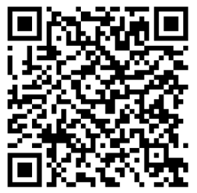
What do the Standards require?
What do the strengthened Quality Standards require when an older person transitions from hospital back to services in home or community settings?
Use the following link/QR code to find the information from Standard 3 on the digital guidance.
Strengthened Quality Standards guidance | Aged Care Quality and Safety Commission
Notes:
Facilitator notes:
Encourage participants to locate the information on the strengthened Quality Standards guidance. Point them to look at Standard 3 . Alternatively, print out Standard 3 from the website for participants to use.

Slide 16
The Standards require: Fill out the missing information below, using the digital guidance to help
Standard 3 requires:
Outcome (s)
Actions
Notes:
For participant use.
Include key elements from relevant Outcome in Standard 3. Include any relevant Actions that may support this case study to meet the Outcome.

Slide 17
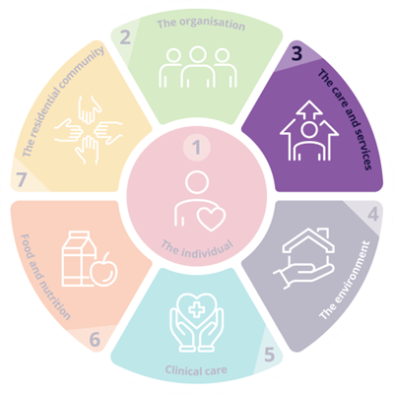
Outcome
3.4 | The provider must ensure that individuals receive funded aged care services that are planned and coordinated, including where multiple health providers and registered providers, supports of individuals and other persons supporting individuals are involved.
Actions
3.4.3 | The provider facilitates a planned and coordinated transition to or from the provider in collaboration with the individual and other providers of funded aged care services, and this is documented, communicated and effectively managed.
Outcome 3.4: Planning and coordination of funded aged care services
17
Notes:
Facilitator notes:
Look at the SQS Outcomes from Standard 3 which specifically relate to transitions and what you as a provider are expected to deliver.
Outcome 3.4 relates to the responsibility of providers to deliver planned and coordinated care services. In this case study, Premium Care could have considered Action 3.4.3 by following their ‘return from hospital’ process while Maria was still in hospital, including keeping in regular contact with Helen then coordinating Maria’s discharge with Helen and the hospital discharge planning services. A review of Maria’s care and services plan should have been conducted, taking into consideration Maria’s hospital discharge summary. Premium Care should also have organised for their registered nurse to do a clinical review. ​

Slide 18
Participant responses:
Question | Answer
What could have been done to ensure Maria’s transition back home was coordinated, planned, and managed effectively by Premium Care to ensure continuity of care?
What processes or systems do we have in our organisation that could ensure a successful transition in alignment with the Standards?
Notes:
Facilitator notes:
Suggestions for response to the first question are:
Sophie followed Premium Home Care’s ’return from hospital’ process while Maria was still in hospital including:​
keeping in regular contact with Helen and asking Helen to ring her when the hospital planned to discharge Maria so they could restart her services straight away​
coordinating Maria’s discharge with Helen and the hospital discharge planning services​
helping Helen with a referral to My Aged Care for Transition Care Program (TCP) assessment​
suggesting that Helen ring Maria’s GP to let them know about Maria’s current health issues and that she was in hospital.​
Premium Care could have agreed that a worker would visit that afternoon to help Maria settle in and prepare the evening meal.​
Premium Care could have asked Helen’s permission to review Maria’s hospital discharge summary on My Health Record so that they could review Maria’s care needs. ​
Premium Care could have organised for their registered nurse (RN) to do a clinical review alongside Sophie’s care and services plan review the next day.​
Premium Care could have work with Maria and Helen to develop a care and services plan to meet Maria’s current care needs and budget.​

Slide 19
Transitions at [insert name of your organisation here]
Our policies include:
Our processes for transition are:
Who is responsible for transitions:
What our actions should be if we don’t receive enough information:
Notes:
Facilitator notes:
Would suggest this is run as a group discussion, with information regarding your policies and processes explicitly shared with participants.

Slide 20
Facilitator information
Should you wish to access any further resources related to this case study, all modules are available via ALIS on the following link: https://learning.agedcarequality.gov.au/view_program/11
The ALIS learning includes a series of modules, taking you through the case study in detail, providing additional reflection questions to discuss within your setting.

Slide 21
Section 2
Relating Standards to your own organisation

Slide 22

Working through a case study in our organisation
Add a scenario here for a case study from an issue that happened in your setting.
Notes:
Facilitator notes:
Use a case study from your own setting to encourage participants to consider as you work through the strengthened Quality Standards. This section has been designed for you to cover in any order of your choice and focus on any of the Standards individually, as you choose.
If you don’t have a suitable case study, then use the information already provided for Maria (use the following slides 23, 24 and 25)
It would be useful for participants to look at the digital guidance, specifically at the Outcomes, as these are enforceable under legislation. Looking at Actions that suggest ways in which you might meet the Standard should also be investigated. Within the digital guidance, participants can also select to look at not only the legislation, but the guidance information which includes information on why that outcome is important, key tasks and considerations for additional Outcomes and Standards.
From slide 26 to 40, the intention is you can address each Standard as relevant to your requirements. There are three printable slides for participants to use for each focus Standard.
Slide 1: Includes facilitator notes, to provide some detail on the intent of that Standard
Slide 2: Outcome statements and additional questions to consider
Slide 3: Activity sheet for participants to use
Using your chosen case study, encourage participants to review the Outcome statement detailed on the second slide for each Standard, as this is the enforceable detail of the Standard, apply it to the case study scenario, then look for suggested Actions that could help meet the Outcome.
You could then look at policies and procedures at your setting that apply to this Outcome.

Slide 23
Background information about Maria
76 years old and lives at Peaceful Retirement Village
Has dementia with mild cognitive impairment and osteoarthritis
Can be forgetful, requiring prompting to complete tasks
Supported by her daughter, who visits each day and is her mother’s substitute decision maker
Uses a 4WW but often forgets to use it when mobilising
Workers assist with showering 30 minutes 3 times a week
Pain: Reports pain in knees, back, wrists and neck due to osteoarthritis
Medication: Maria manages her medications, with a Webster-pak
paracetamol 1g QID (4 times/day)
diclofenac 50mg TDS (3 times/day)
Maria’s hospital discharge summary extract
Right distal radius fracture
review with fracture clinic in weeks 2 and 6. Manage skin integrity to prevent skin damage around the edges of the cast.
UTI
Oral ciprofloxacin 250mg BD (2 times/day) until full 6-day course is finished.
Pressure injury
Developed a stage 2 pressure injury to sacrum during admission.
Keep wound clean, use adhesive foam dressings, which may be left in place for 5 days if not dirty.
New medications on discharge
Oral oxycodone 2.5mg TDS for 3 days for pain. Must be reviewed in 3 days by GP to assess for ongoing pain management.
Oral ciprofloxacin 250mg BD for 6 days for management of UTI.
Notes:
Facilitator notes:
This is an optional slide if you wish to use the case study Maria to unpack each Standard.

Slide 24
The fall
Maria had a fall in her driveway, believed to be because she forgot to use her 4WW. A neighbour found Maria on the ground and called an ambulance. They also rang her daughter to let her know.
X-rays showed that Maria had fractured her right wrist, which was treated conservatively by immobilising.
While in ED, clinical staff noticed a distinct smell to maria’s urine. A urine sample was collected and sent to pathology, confirming a urinary tract infection (UTI). Maria was admitted to the ward where she was given intravenous (IV) antibiotics to manage her UTI.
Helen rang Premium Care to let them know that Maria had a fall and asked them to suspend Maria’s services while she was in hospital.
Maria was considered fit to be discharged back home 6 days later.
Notes:
Facilitator notes:
This is an optional slide if you wish to use the case study Maria to unpack each Standard.
Remember that Standard 1 to 5 may apply to your setting, but Standards 6 and 7 are only relevant for Residential care homes.

Slide 25
Additional issues with care and services
Medications
The hospital did not provide any medications when Maria was discharged.
Maria was not taking her existing medications regularly.
Skin integrity
Maria felt embarrassed spilling her food when eating with her left hand.
Maria lost 2.5kg since returning home.
Nutrition and hydration
When Maria returned home, no visit was scheduled with a registered nurse to review skin integrity.
After 5 days, Maria’s sacral pressure injury was necrotic.
Workers did not report this to Premium Care.
Maria lost her appetite and said she was too tired to eat.
Helen did not know that Maria needed new medications for her pain.
Notes:
Facilitator notes:
This is an optional slide if you wish to use the case study Maria to unpack each Standard.

Slide 26
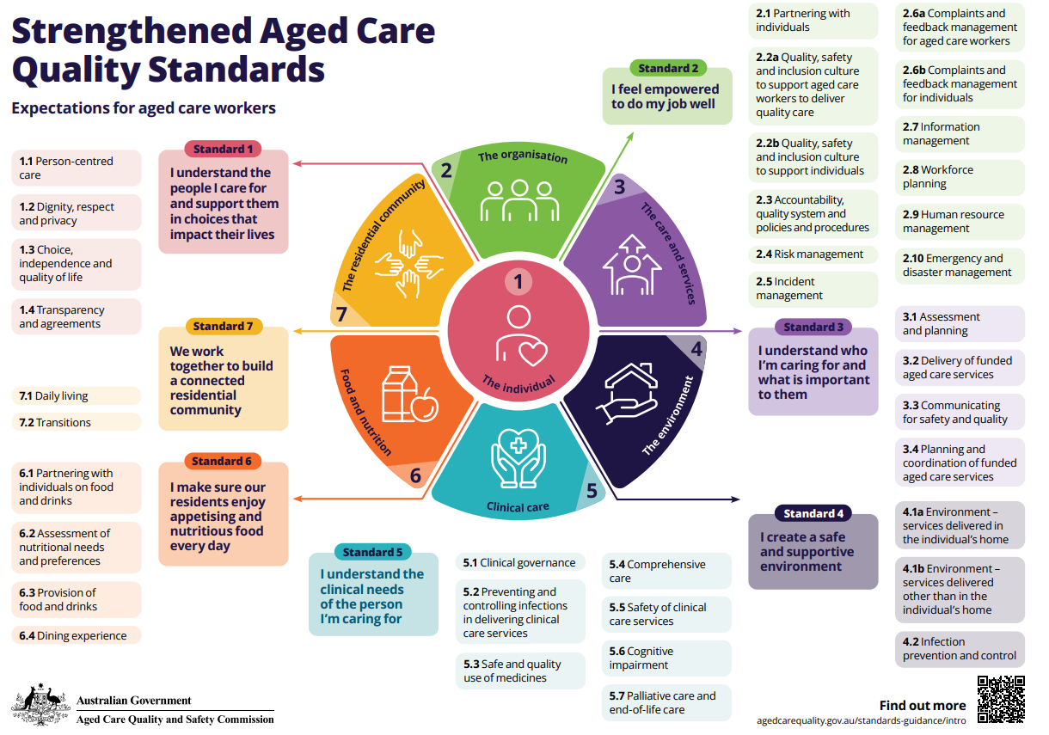
Notes:
Facilitator notes:
If we imagine [insert name of case study focus here] at the centre of the wheel, sitting in Standard 1: The Individual, you can see that all other Standards surround them. This is an intentional image, to remind us that in all circumstances Standard 1 underpins the way that providers are expected to treat older people.
As the image suggests, multiple Standards work in conjunction with one another when considering the funded aged care services of older people.

Slide 27
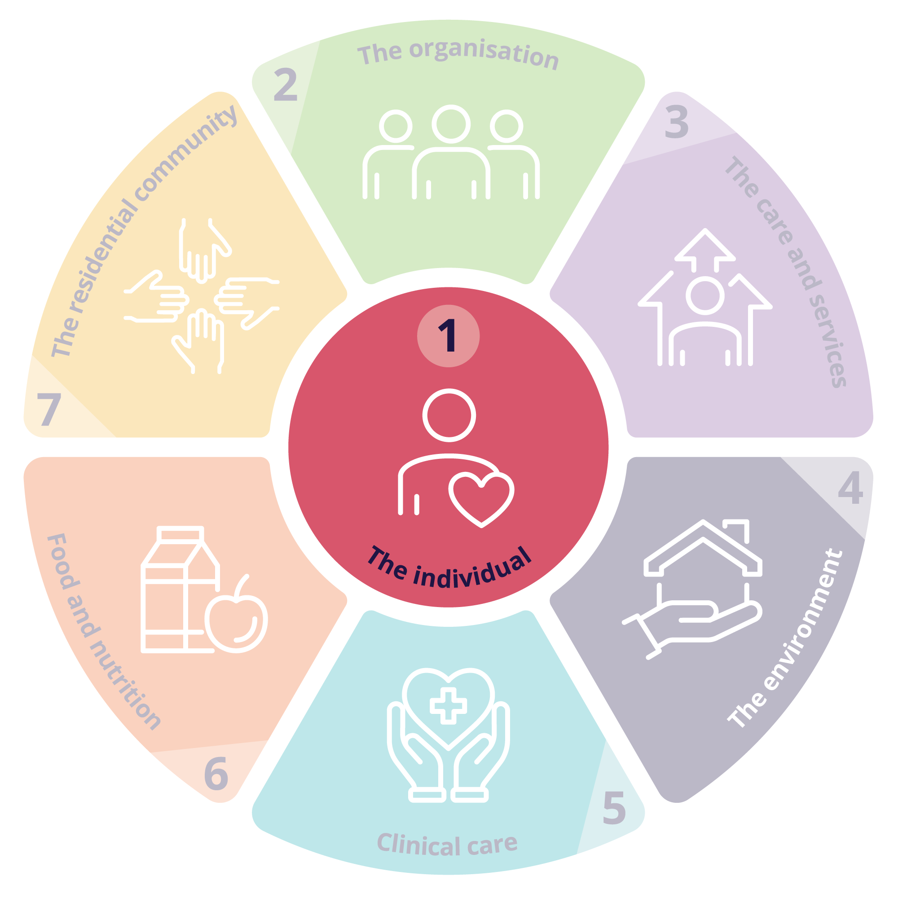
Standard 1: The individual
Outcome 1.1: Person-centred care
The provider demonstrates that the provider understands that the safety, health, wellbeing and quality of life of individuals is the primary consideration in the delivery of funded aged care services.
Outcome 1.2: Dignity, respect and privacy
The provider must deliver funded aged care services to individuals in a way that is free from all forms of discrimination, abuse and neglect, treats individuals with dignity and respect, and respects the personal privacy of individuals.
Outcome 1.3: Choice, independence and quality of life
The provider must support individuals to exercise choice and make decisions about their funded aged care services and provide them with support to exercise choice and make decisions when they want or need it.
Outcome 1.4: Transparency and agreements
Before entering into any agreements with individuals about the delivery of funded aged care services, the provider must provide individuals with the opportunity to exercise autonomy, the time they need to consider the agreement and an opportunity to seek advice.
The provider demonstrates that the provider understands and values individuals, including their identity, culture, ability, diversity, beliefs and life experiences.
The provider demonstrates that the provider develops funded aged care services with, and tailored to, individuals, taking into account their needs, goals and preferences.
The provider demonstrates that the provider understands the rights of individuals under the Statement of Rights. The provider must have practices in place to ensure that the provider acts compatibly with the Statement of Rights, in accordance with subsection 24(2) of the Act (acting compatibly with the Statement of Rights).
The provider must provide individuals with timely, accurate, tailored and sufficient information about their funded aged care services, in a way they understand.
The provider must support individuals to exercise dignity of risk to achieve their goals and maintain independence and quality of life.
The provider must support individuals to understand and make informed decisions about their agreements, fees and invoices.
Notes:
Facilitator notes:
Using your chosen case study, take each Outcome individually for review. Read through the Outcome statement with your staff, discuss meaning and purpose. Allow time for anecdotal examples of how this Outcome might be met for your case study.
Then ask staff to work through the digital guidance to locate suggested Actions that might meet the Outcome expectations for that scenario.
Questions you might ask:
How do we know this action will meet the Outcome?
What barriers to success might be experiences?
How would this action make the older person feel?
Does this suggestion support the policies and procedures already in place?
How might we need to support new staff to follow these practices?
Would our suggested course of action meet more than one Outcome or Standard? If so, which?

Slide 28

Participant Notes – Standard 1
Issue/s identified | Relevant Outcome/s | Suggested Action/s to meet the Outcome
1
2
3
Notes:
Facilitator notes:
QR code will take participants to the strengthened Quality Standards digital guidance on the Commission’s website.

Slide 29
Notes:
Facilitator notes:
The intent of Standard 2 is to set out the expectations of the governing body to meet the requirements of the Quality Standards and deliver quality funded aged care services. A provider’s governance systems and workforce are critical to the delivery of safe, quality, effective and rights-based, person-centred care for every older person, and continuous improvement of funded aged care services.
Print this slide out for staff members to use / display for reference when looking at Standard 2.
You may find it appropriate depending on your chosen case study to discuss the connections to Outcome 5.1: Clinical governance.

Slide 30
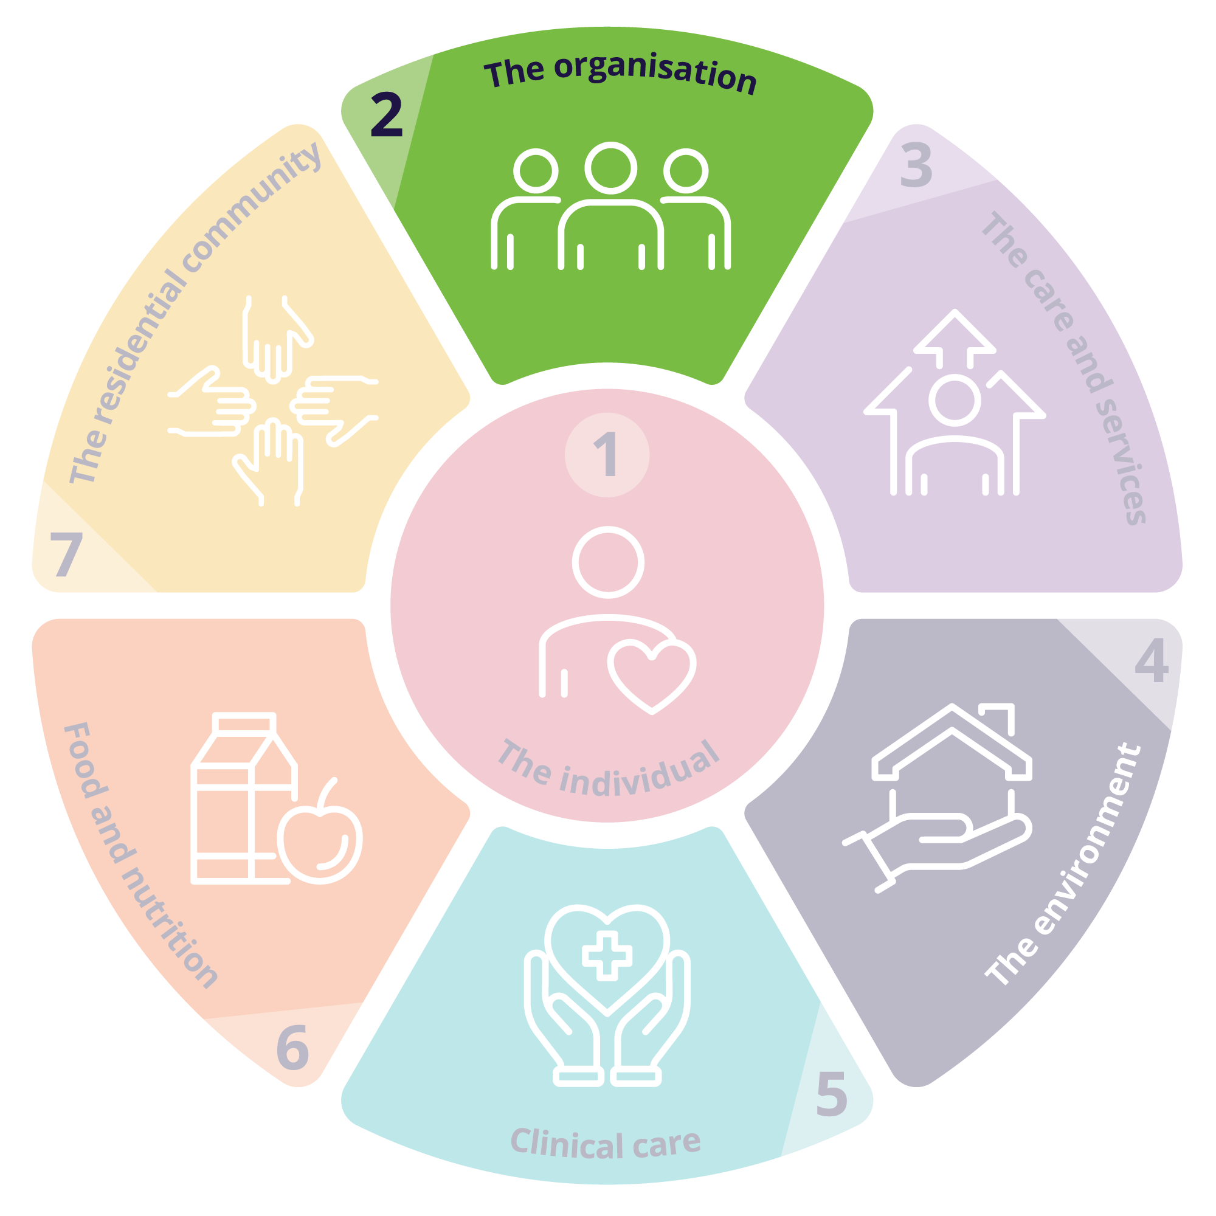
Standard 2: The organisation
Expectation statement for older people: | The organisation is well run. I can contribute to improvements to care and services. My provider and aged care workers listen and respond to my feedback and concerns. I receive funded aged care services from aged care workers who are knowledgeable, competent, capable and caring.
Outcome 2.1: Partnering with individuals | Outcome 2.2a: Quality, safety and inclusion culture to support workers to deliver quality care. | Outcome 2.2b: Quality, safety and inclusion culture to support individuals | Outcome 2.3: Accountability, quality system and policies and procedures | Outcome 2.4: Risk management | Outcome 2.5: Incident management
Outcome 2.6a: Complaints and feedback management for workers | Outcome 2.6b: Complaints and feedback management for individuals | Outcome 2.7: Information management | Outcome 2.8: Workforce planning | Outcome 2.9: Human resource management | Outcome 2.10: Emergency and disaster management
Notes:
Facilitator notes:
Select a relevant Outcome for staff to review. Use the information in your case study and read the Outcome statement, then look for Actions that might support meeting the expectations of the Outcome. Relate these Actions to relevant, practical actions that may be initiated in response to the situation being considered.
Questions you might consider:
What role do each of us play within this Standard?
How do I ensure I am aware of the policies and procedures related to this Outcome?
When things go wrong, what part can I play to prevent it from happening again?
How can I tell if this is an isolated incident, or something systemic?
How does Open Disclosure fit into this Standard?
What are my obligations when there is an incident?
What is a safety culture and how can I support this?

Slide 31

Participant Notes – Standard 2
Issue/s identified | Relevant Outcome/s | Suggested Action/s to meet the Outcome
1
2
3
Notes:
Facilitator notes:
QR code will take participants to the strengthened Quality Standards digital guidance on the Commission’s website.

Slide 32
Notes:
Facilitator notes:
Standard 3 describes the way providers must deliver funded aged care services for all types of services being delivered (noting that other Standards describe requirements relevant to specific service types).
In delivering funded aged care services, providers and workers must draw on all relevant standards, with particular reference to Standard 1, including to ensure care is tailored to the older person and what’s important to them.
Print out for staff members use / display for reference when looking at Standard 3

Slide 33

Standard 3: The care and services
Outcome 3.1: Assessment and planning
The provider must actively engage with individuals to whom the provider delivers funded aged care services, supporters of individuals (if any) and any other persons involved in the care of individuals in developing and reviewing the individual’s care and services plans through ongoing communication.
Outcome 3.2: Delivery of funded aged care services
The provider must ensure that individuals receive quality funded aged care services that meet their needs, goals and preferences and optimise their quality of life, reablement and maintenance of function.
Outcome 3.3: Communicating for safety and quality
The provider must ensure that critical information relevant to the delivery of funded aged care services to individuals is communicated effectively to the individuals, between aged care workers delivering the services, with supporters of the individuals and other persons supporting the individuals and with registered health practitioners, allied health professionals, allied health assistants and others involved in the individual’s care.
Outcome 3.4: Planning and coordination of funded aged care services
The provider must ensure that individuals receive funded aged care services that are planned and coordinated, including where multiple health providers and registered providers, supporters of individuals and other persons supporting individuals are involved.
Care and services plans must describe the current needs, goals and preferences of individuals and include strategies for risk management and preventative care.
The provider must ensure that care and services plans are regularly reviewed and are used by aged care workers to guide the delivery of funded aged care services.
The provider must ensure that funded aged care services are delivered in a way that is culturally safe and culturally appropriate for individuals with specific needs and diverse backgrounds.
The provider must ensure that risks to individuals, and changes and deterioration in the condition of individuals are escalated and communicated as appropriate.
Notes:
Facilitator notes:
Using your chosen case study, take each Outcome individually for review. Read through the Outcome statement with your staff, discuss meaning and purpose. Allow time for anecdotal examples of how this Outcome might be met for your case study.
Then ask staff to work through the digital guidance to locate suggested Actions that might meet the Outcome expectations for that scenario.
Questions you might ask:
How do we know this action will meet the Outcome?
What barriers to success might be experiences?
How would this action make the older person feel?
Does this suggestion support the policies and procedures already in place?
How might we need to support new staff to follow these practices?
Would our suggested course of action meet more than one Outcome or Standard? If so, which?
Which other Standards would we need to consider alongside this Standard?
What do the key tasks include that apply to this case study?

Slide 34

Participant Notes – Standard 3
Issue/s identified | Relevant Outcome/s | Suggested Action/s to meet the Outcome
1
2
3
Notes:
Facilitator notes:
QR code will take participants to the strengthened Quality Standards digital guidance on the Commission’s website.

Slide 35
Notes:
Facilitator notes:
The intent of Standard 4 is to ensure that older people receive funded aged care services in a physical environment that is safe, supportive and meets their needs. Effective infection prevention and control measures are a core component of service delivery to protect older people, their supporters and workers.
Print out for staff members use / display for reference when looking at Standard 4

Slide 36

Standard 4: The environment
Outcome 4.1a: Environment – services delivered in the individual's home
When delivering funded aged care services to individuals in their homes, the provider must support the individuals to mitigate environmental risks relevant to the services.
Outcome 4.1b: Environment – services delivered other than in the individual's home
Where the provider delivers funded aged care services to individuals other than in their homes, the provider must ensure that individuals are able to access funded aged care services in a clean, safe and comfortable environment that optimises their sense of belonging, interaction and function.
Outcome 4.2: Infection prevention and control
The provider must have an appropriate infection prevention and control system.
Where the provider uses equipment in the delivery of any funded aged care services to individuals, or providers equipment to individuals, the equipment must be safe and must meet the needs of the individuals.
Where the provider uses equipment in the delivery of any funded aged care services to individuals, or provides equipment to individuals, the equipment must be safe and must meet the needs of the individuals.
The provider must ensure that aged care workers use hygienic practices and take appropriate infection prevention and control precautions when delivering funded aged care services.
Notes:
Facilitator notes:
Using your chosen case study, take each Outcome individually for review. Read through the Outcome statement with your staff, discuss meaning and purpose. Allow time for anecdotal examples of how this Outcome might be met for your case study.
Then ask staff to work through the digital guidance to locate suggested Actions that might meet the Outcome expectations for that scenario.
Questions you might ask:
How do we know this action will meet the Outcome?
What barriers to success might be experienced?
Does this suggestion support the policies and procedures already in place?
How might we need to support new staff to follow these practices?
How do we ensure any equipment used is fit for purpose?
How do we know any equipment used is meeting the needs of the older person?
How do we ensure all workers understand our hygienic practices at [insert name of your organisation here]
Would our suggested course of action meet more than one Outcome or Standard? If so, which?

Slide 37

Participant Notes – Standard 4
Issue/s identified | Relevant Outcome/s | Suggested Action/s to meet the Outcome
1
2
3
Notes:
Facilitator notes:
QR code will take participants to the strengthened Quality Standards guidance on the Commission’s website.

Slide 38
Notes:
Facilitator notes:
Extract from Standard 5 intent statement
The Clinical care Standard describes the responsibilities of providers to deliver safe and quality clinical care services to older people.
At all times, clinical care services provided should be rights-based, person-centred, inclusive, safe, effective and coordinated. It should be planned and delivered in partnership with the older person, involving their supporters and others in line with the older person’s needs and preferences. Delivering safe, quality clinical care services requires a multidisciplinary approach with a skilled workforce with clear accountabilities that are supported to deliver contemporary, evidence-based care.
Effective implementation of Standard 5 is reliant on the systems and processes from Standards 1-7.
Print out for staff members use / display for reference when looking at Standard 5

Slide 39
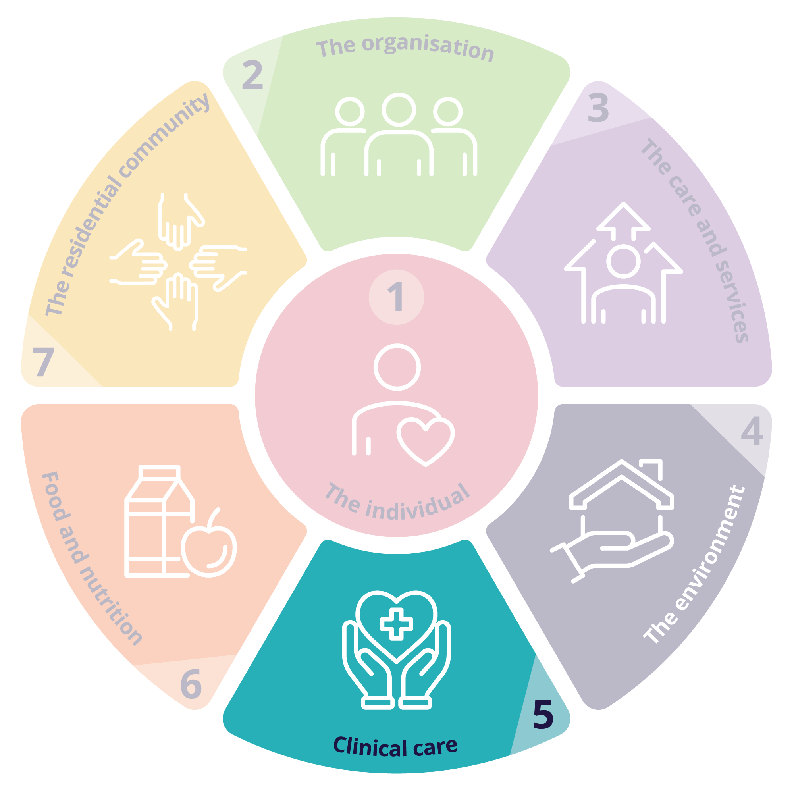
Standard 5: Clinical care
Expectation statement for older people:
I receive person-centred, evidence-based, safe, effective, and coordinated clinical care services by registered health practitioners, allied health
professionals, allied health assistants and competent aged care workers that meets my changing clinical needs and is in line with my goals and preferences.
Outcome 5.1 Clinical governance
Outcome 5.2 Preventing and controlling infections in delivering clinical care services
Outcome 5.3 Safe and quality use of medicines
Outcome 5.4 Comprehensive care
Outcome 5.5 Safety of clinical care services
Outcome 5.6 Cognitive impairment
Outcome 5.7 Palliative care and end-of-life
Notes:
Facilitator notes:
Using your chosen case study, take each Outcome individually for review. Read through the Outcome statement (found on the digital guidance) with your staff, discuss meaning and purpose. Allow time for anecdotal examples of how this Outcome might be met for your case study.
Then ask staff to work through the digital guidance to locate suggested Actions that might meet the Outcome expectations for that scenario.
Questions you might ask:
How do we know this action will meet the Outcome?
What barriers to success might be experiences?
Does this suggestion support the policies and procedures already in place?
How do we consider an older person’s supporters when meeting this Standard?
How do we most effectively coordinate clinical care when there are multiple clinical staff involved in an older person’s care?
How do we effectively monitor an older person’s needs to identify any changes?
How do we meet an older person’s clinical needs in line with their goals and preferences?
How do we build a culture of continuous improvement within our clinical care?

Slide 40

Participant Notes – Standard 5
Issue/s identified | Relevant Outcome/s | Suggested Action/s to meet the Outcome
1
2
3
Notes:
Facilitator notes:
QR code will take participants to the strengthened Quality Standards guidance on the Commission’s website.

