Slide 1
How to use this PowerPoint resource
This resource is designed for use within your aged care organisation and is available for non-commercial use only. This presentation will be updated routinely as new information becomes available – so please ensure you have the latest version before you deliver a session.
This presentation is customisable. It is divided into sections, giving you the option to cover the information in its entirety or by selecting the sections you want to focus on. You may choose to deliver as a PowerPoint presentation, or to print and deliver as a workbook, and we encourage you to contextualise it to your organisation. There are opportunities throughout the session for participants to reflect on their learning.
If you need any support using this resource or if you have feedback or questions about any educational materials available from the Commission, please email us at education@agedcarequality.gov.au.

Slide 2
The strengthened Quality Standards: Preparing for the changes
Residential Care Provider resource

Slide 3
Release of information
The information contained in this presentation is current at the time of release. It is the responsibility of the registered provider (provider) to ensure any information added to this document prior to and during training delivery is accurate.
The Commission does not take responsibility for this document once modifications have been made and recommends providers monitor the Aged Care Quality and Safety Commission’s website.
UNCONTROLLED ONCE RELEASED.

Slide 4
Learning Outcomes
Completing this learning should support you to:
Apply the requirements of the strengthened Quality Standards to a case study
Develop understanding of the connections between the strengthened Quality Standards
Reflection opportunity
Thoughts about the strengthened Quality Standards:

Slide 5
Outline of resource
Introduction – slides 6 to 8
Section 1 Transitions – slides 9 to 18
Section 2 Relating the strengthened Quality Standards to your own setting – slides 20 to 45
Where to locate information regarding the strengthened Quality Standards
Reviewing transition practices within the context of a case study
Standard 1 – slides 25 to 27
Standard 2 – slides 28 to 30
Standard 3 – slides 31 to 33
Standard 4 – slides 34 to 36
Standard 5 – slides 37 to 39
Standard 6 – slides 40 to 42
Standard 7 – slides 43 to 45
Case study information (if required) – slides 22 to 24

Slide 6
Introduction
Review of the strengthened Quality Standards

Slide 7
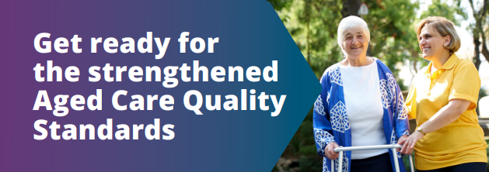
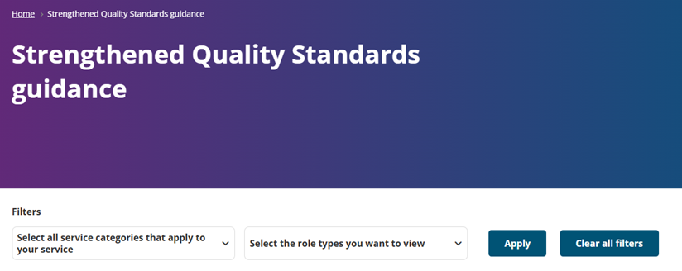

Available digital guidance
Strengthened Quality Standards | resources
Strengthened Quality Standards guidance | Aged Care Quality and Safety Commission
Strengthening the Aged Care Quality Standards | Australian Government Department of Health and Aged Care
Notes:
Facilitator notes:
7 strengthened Quality Standards (SQS) have been implemented
Link 1 = Commission resources page for SQS (show participants how to access the guidance for aged care workers (workers) from here)
Link 2 = SQS guidance. Take participants through a live demonstration to show how they can find information.
Link 3 = Department of Health, Disability and Aged Care where most up-to-date information can be obtained

Slide 8
Reflection opportunity
What have you noticed about the strengthened Quality Standards digital guidance?
How might you be able to use this digital guidance to help in your daily work activities?
How might this digital guidance help when there is an issue?
Notes:
Facilitator notes:
Key messages:
The SQS are more measurable, detailed and comprehensive than the previous Quality Standards.
Outcomes are enforceable, Actions demonstrate how providers may meet that Outcome.

Slide 9



Section 1 - Transitions
9
Notes:
Facilitator notes:
Section 1 is a case study scenario with questions to take participants through when looking at the expectations of the strengthened Quality Standards. The focus of this section is older person transitions from hospital back to residential care. You can work your way through the activity or utilise any element that you think would be helpful in your care setting.
Slides 10 to 12 contain information required to unpack the case study.
Slide 13 is a participant sheet to note their reflections on the issues seen.
Slides 14 and 15 are for participant use when unpacking the Standards relating to transitions
Slide 16 provides specific details from Standard 3 relating to transitions
Slides 17 and 18 are for participant use, noting relevant actions, processes and policies in relation to transitions

Slide 10
The fall
Maria had an unwitnessed fall while she was on her own at Riverview, believed to be because she forgot to use her four-wheeled walker (4WW). A registered nurse (RN) found that maria’s right wrist was swollen and deformed but didn’t identify any other concerns.
Maria was transferred to the hospital emergency department (ED) for review. X-rays showed that Maria had fractured her right wrist.
While in ED, clinical staff noticed a distinct smell to Maria’s urine. A urine sample was collected and sent to pathology, confirming a urinary tract infection (UTI). Maria was admitted to the ward where she was given intravenous (IV) antibiotics to manage her UTI.
Maria was considered fit for discharge back to Riverview 6 days later.
Notes:
Facilitator notes:
This is the information required to set up the context of this section. This information is also available in a video through the ALIS platform at https://learning.agedcarequality.gov.au/view_course/308

Slide 11
Background information about Maria
76 years old and lives at Riverview Aged Care
Has dementia with mild cognitive impairment and osteoarthritis
Requires supervision, support and reminders to do her daily activities
Helen, Maria’s daughter, is her substitute decision maker
Uses a 4WW but often forgets to use it when mobilising
Needs supervision and reminders for personal care
Pain: Reports pain in knees, back, wrists and neck due to osteoarthritis
Medication: workers manage her medications, with a Webster-pak
paracetamol 1g QID (4 times/day)
diclofenac 50mg TDS (3 times/day)
Maria’s hospital discharge summary extract
Right distal radius fracture
review with fracture clinic in weeks 2 and 6. Manage skin integrity to prevent skin damage around the edges of the cast.
UTI
Oral ciprofloxacin 250mg BD (2 times/day) until full 6-day course is finished.
Pressure injury
Developed a stage 2 pressure injury to sacrum during admission
keep wound clean, use adhesive foam dressings, which may be left in place for 5 days if not dirty
New medications on discharge
Oral oxycodone 2.5mg TDS for 3 days for pain. Must be reviewed in 3 days by GP to assess for ongoing pain management
Oral ciprofloxacin 250mg BD for 6 days
Notes:
Facilitator notes:
Basic information for Maria, useful to set the context of who she is for the activities following.

Slide 12
The transition back to Riverview
The hospital called Riverview to tell them Maria was being discharged that day, but no verbal handover was given.
Maria arrived back at Riverview with her discharge summary, but no discharge medications.
The RN provided a handover to the next shift by reading parts of the discharge summary.
A copy of the discharge summary was added in the GP book for the next scheduled visit in 5 days time.
The RN taking over was busy and didn’t review information from Maria’s discharge summary. Maria’s care and services plan was not updated.
Maria was greeted by an RN who told her that if she needed anything, it would be best to wait until the next shift as she was about to finish her shift.
Notes:
Facilitator notes:
Key points of what happened when Maria transitioned back to Riverview following her 6 days in hospital after her fall. She returns to Riverview with a fractured right wrist, a UTI and a sacral pressure injury. Additional medications have been prescribed and noted on her discharge notes, but no medications sent with her.

Slide 13
Reflection opportunity
What issues did you notice relating to Maria’s transition back to Riverview?
Notes:
For facilitator knowledge, issues are:
Handover from hospital included a phone call notification, but no handover information discussed
RN advised Maria to wait for the next shift if she had any questions
the handover to the RN on the next shift only included parts of the discharge summary
Maria’s care and services plan was not updated
Maria returned with handover information but no medications

Slide 14
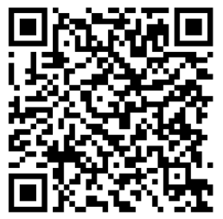
What do the Standards require?
What do the strengthened Quality Standards require when an older person transitions back to residential care from hospital?
Use the following link/QR code to find the information from Standards 3 and 7 on the digital guidance.
Strengthened Quality Standards guidance | Aged Care Quality and Safety Commission
Notes:
Facilitator notes:
Encourage participants to locate the information on the strengthened Quality Standards digital guidance. Point them to look at Standards 3 and 7. Alternatively, print out Standards 3 and 7 from the website for participants to use.

Slide 15
The Standards require: Fill out the missing information below, using the digital guidance to help
Standard 3 requires:
Outcome (s)
Actions
Standard 7 requires:
Outcome(s)
Actions
Notes:
For participant use.
Include key elements from relevant Outcome in Standards 3 and 7. Include any relevant Actions that may support this case study to meet the Outcome.

Slide 16
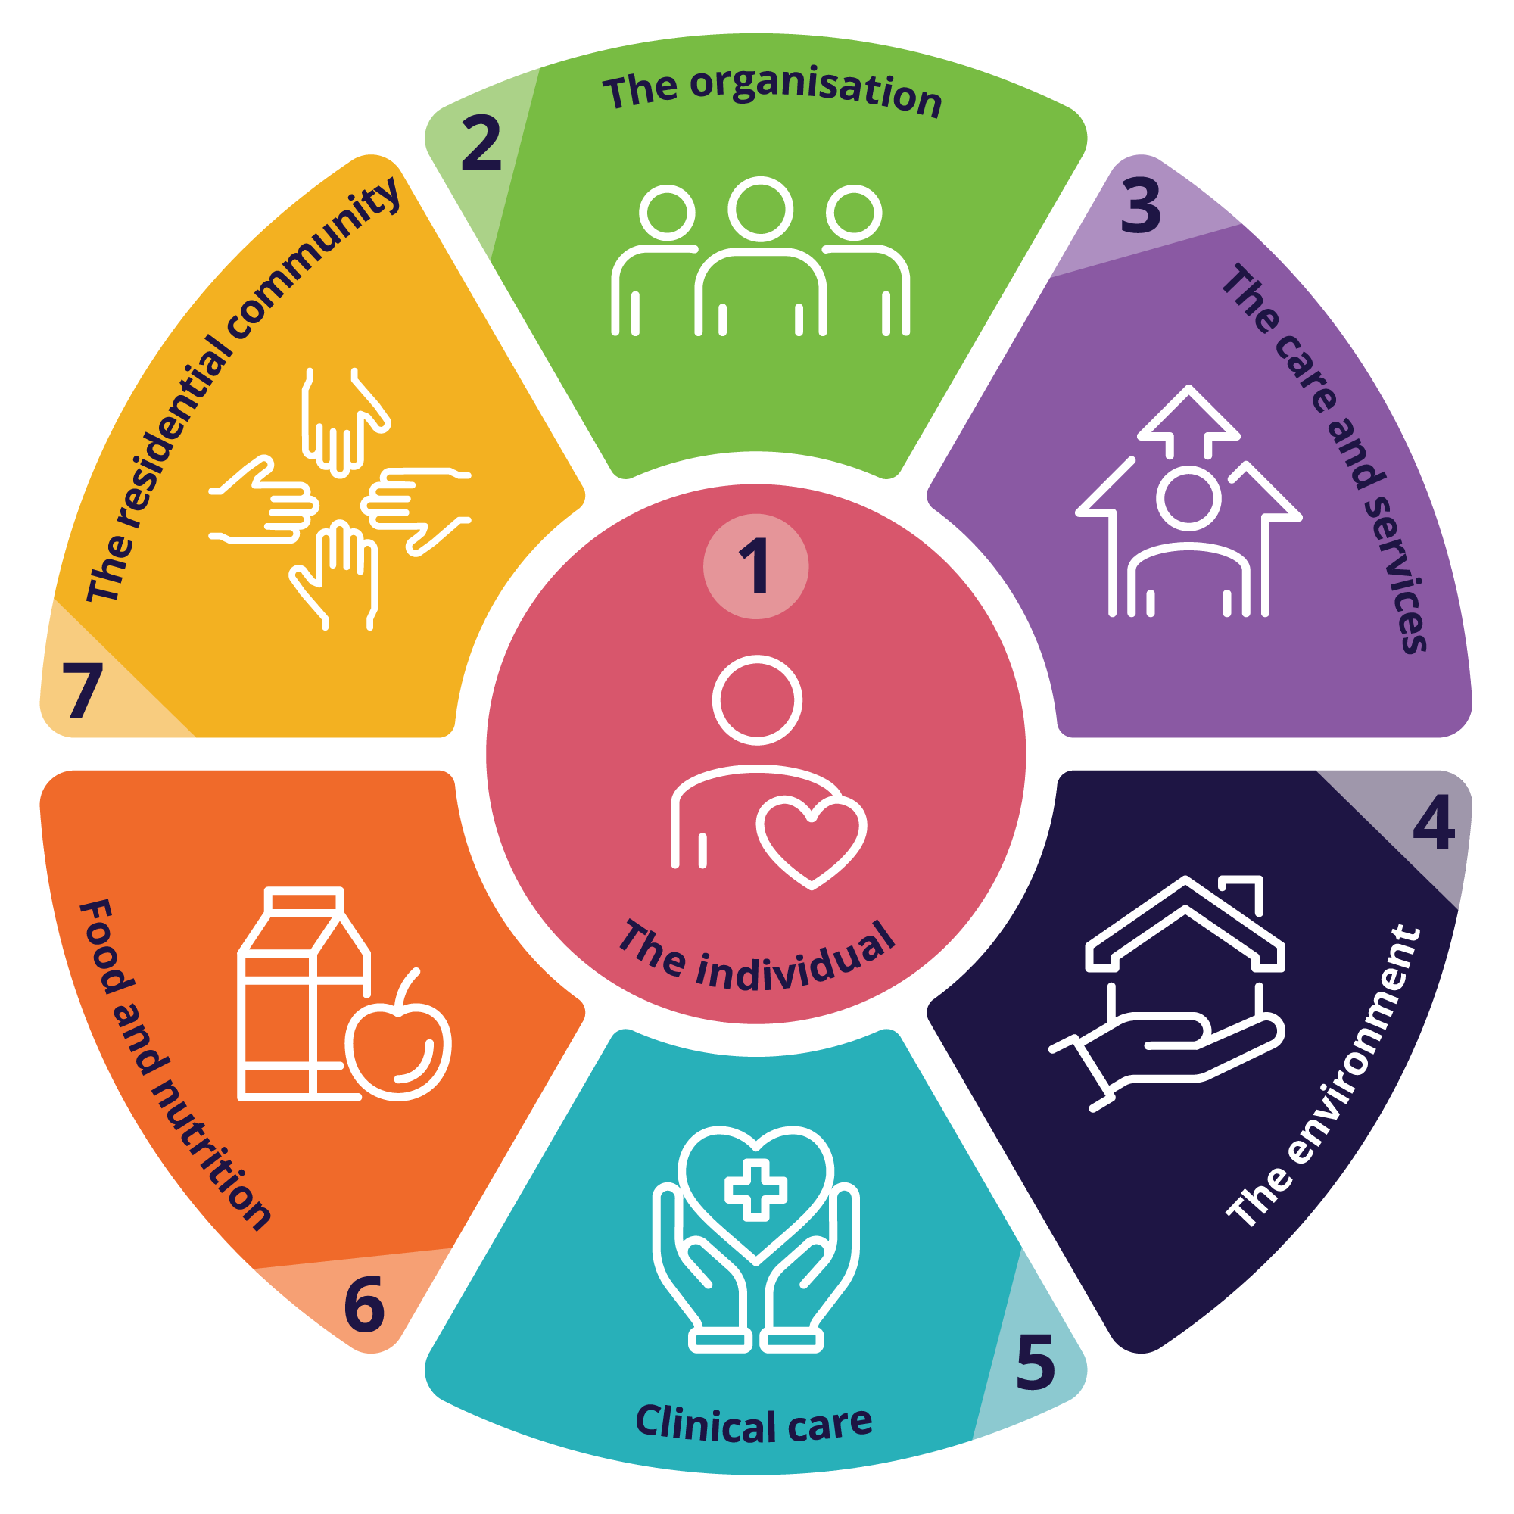
STANDARD 3: THE CARE AND SERVICES
Outcome 3.4 | Action 3.4.3
The provider must ensure that individuals receive funded aged care services that are planned and coordinated, including where multiple health providers and registered providers, supporters of individuals and other persons supporting individuals are involved. | The provider facilitates a planned and coordinated transition to or from the provider in collaboration with the individual and other providers of funded aged care services, and this is documented, communicated and effectively managed.
STANDARD 7: THE RESIDENTIAL COMMUNITY
Outcome 7.2 | Action 7.2.1
The provider must ensure that individuals experience a well-coordinated transition, whether planned or unplanned, to or from a provider. The provider must set out clear responsibility and accountability for the delivery of funded aged care services between aged care workers, registered health practitioners, allied health professionals and across organisations. | The provider has processes for transitioning individuals to and from hospital, other care services and stays in the community, and ensures that: b) there is continuity of care for the individual e) when the individual transitions back to the service, their funded aged care services are reviewed and adjusted as needed.
16
Notes:
Facilitator notes:
Look at the SQS Outcomes from Standards 3 and 7 which specifically relate to transitions and what you as a provider are expected to deliver.
Outcome 3.4
To consider Action 3.4.3, Riverview might have kept in contact with the hospital and Helen during Maria’s stay and then shared information about Maria’s condition and care needs with the people involved in her care during their discharge planning. Riverview could also have contacted Maria’s GP and checked that the hospital had sent them her hospital discharge summary.
Outcome 7.2
To consider Action 7.2.1, Riverview should have had processes to transition Maria back from her hospital stay and included a review and adjustment of her funded aged care services.

Slide 17
Participant responses:
Question | Answer
What could have been done to ensure Maria’s transition back to Riverview was coordinated, planned, and managed effectively to ensure continuity of care?
What processes or systems do we have in our organisation that could ensure a successful transition in alignment with the Standards?
Notes:
Facilitator notes:
Suggestions for response to the first question are:
- Riverview kept in regular contact with Helen and the hospital. Information about Maria’s condition and care needs was shared with people involved with Maria’s care during discharge planning.​
- The RN reviewed the discharge summary and provided a handover of instructions on Maria’s care needs to workers and the RN taking over care.​
- The RN followed Riverview’s processes to start a review of Maria’s care and services plan and reassessments, based on the discharge summary.​
- The RN considered Maria’s changed care needs, such as new medications and wound dressing products, and followed Riverview’s processes to make sure these were readily available.​
- Riverview contacted Maria’s GP and checked that the hospital sent them her hospital discharge summary.

Slide 18
Transitions at
[insert name of your organisation here]
Our policies include:
Our processes for transition are:
Who is responsible for transitions:
What our actions should be if we don’t receive enough information:
Notes:
Facilitator notes:
Would suggest this is run as a group discussion, with information regarding your policies and processes explicitly shared with participants.

Slide 19
Facilitator information
Should you wish to access any further resources related to this case study, all modules are available via ALIS on the following link: https://learning.agedcarequality.gov.au/view_program/11
The ALIS learning includes a series of modules, taking you through the case study in detail, providing additional reflection questions to discuss within your setting.

Slide 20
Section 2
Relating Standards to your own organisation

Slide 21

Working through a case study in our organisation
Add a scenario here for a case study from an issue that happened in your setting.
Notes:
Facilitator notes:
Use a case study from your own setting to encourage participants to consider as you work through the strengthened Quality Standards. This section has been designed for you to cover in any order of your choice and focus on any of the Standards individually, as you choose.
If you don’t have a suitable case study, then use the information already provided for Maria (use the following slides 22, 23 and 24)
It would be useful for participants to look at the digital guidance, specifically at the Outcomes, as these are enforceable under legislation. Looking at Actions that suggest ways in which you might meet the Standard should also be investigated. Within the digital guidance, participants can also select to look at not only the legislation, but the guidance information which includes information on why that outcome is important, key tasks and considerations for additional Outcomes and Standards.
From slide 25 to 45, the intention is you can address each Standard as relevant to your requirements. There are three printable slides for participants to use for each focus Standard.
Slide 1: Includes facilitator notes, to provide some detail on the intent of that Standard
Slide 2: Outcome statements and additional questions to consider
Slide 3: Activity sheet for participants to use
Using your chosen case study, encourage participants to review the Outcome statement detailed on the second slide for each Standard, as this is the enforceable detail of the Standard, apply it to the case study scenario, then look for suggested Actions that could help meet the Outcome.
You could then look at policies and procedures at your setting that apply to this Outcome.

Slide 22
Background information about Maria
76 years old and lives at Riverview Aged Care
Has dementia with mild cognitive impairment and osteoarthritis
Requires supervision, support and reminders to do her daily activities
Helen, Maria’s daughter, is her substitute decision maker
Uses a 4WW but often forgets to use it when mobilising
Needs supervision and reminders for personal care
Pain: Reports pain in knees, back, wrists and neck due to osteoarthritis
Medication: workers manage her medications, with a Webster-pak
paracetamol 1g QID (4 times/day)
diclofenac 50mg TDS (3 times/day)
Maria’s hospital discharge summary extract
Right distal radius fracture
review with fracture clinic in weeks 2 and 6. Manage skin integrity to prevent skin damage around the edges of the cast.
UTI
Oral ciprofloxacin 250mg BD (2 times/day) until full 6-day course is finished.
Pressure injury
Developed a stage 2 pressure injury to sacrum during admission
keep wound clean, use adhesive foam dressings, which may be left in place for 5 days if not dirty
New medications on discharge
Oral oxycodone 2.5mg TDS for 3 days for pain. Must be reviewed in 3 days by GP to assess for ongoing pain management
Oral ciprofloxacin 250mg BD for 6 days
Notes:
Facilitator notes:
This is an optional slide if you wish to use the case study Maria to unpack each Standard.

Slide 23
The transition back to Riverview
The hospital called Riverview to tell them Maria was being discharged that day, but no verbal handover was given.
Maria arrived back at Riverview with her discharge summary, but no discharge medications.
The RN provided a handover to the next shift by reading parts of the discharge summary.
A copy of the discharge summary was added in the GP book for the next scheduled visit in 5 days time.
The RN taking over was busy and didn’t review information from Maria’s discharge summary. Maria’s care and services plan was not updated.
Maria was greeted by an RN who told her that if she needed anything, it would be best to wait until the next shift as she was about to finish her shift.
Notes:
Facilitator notes:
This is an optional slide if you wish to use the case study Maria to unpack each Standard.

Slide 24

Additional considerations…
Maria’s updated medications for her fractured wrist and her UTI were not obtained from the pharmacy for 6 days
Maria developed a sacral pressure injury in hospital, which developed into an unstageable pressure injury with necrotic tissue.
No referrals were made to other registered health practitioners or allied health professionals
Maria’s care and services plan was not updated
Instructions from Maria’s hospital discharge summary were not actioned by Riverview
Notes:
Facilitator notes:
This is an optional slide if you wish to use the case study Maria to unpack each Standard.

Slide 25
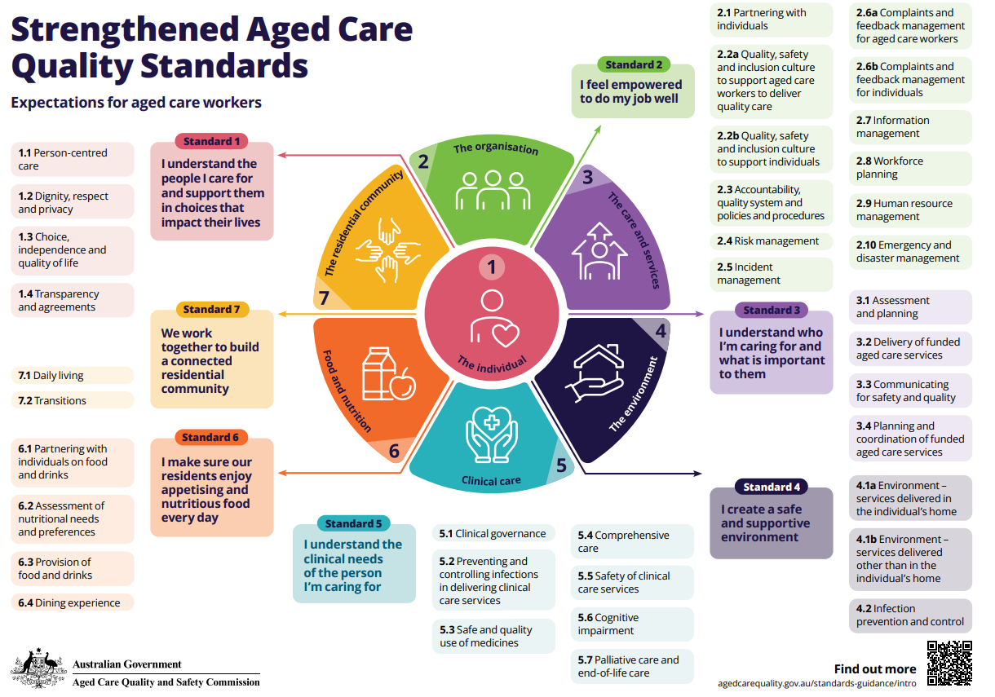
Notes:
Facilitator notes:
If we imagine [insert name of case study focus here] at the centre of the wheel, sitting in Standard 1: The Individual, you can see that all other Standards surround them. This is an intentional image, to remind us that in all circumstances Standard 1 underpins the way that providers are expected to treat older people.
As the image suggests, multiple Standards work in conjunction with one another when considering the funded aged care services of older people.

Slide 26
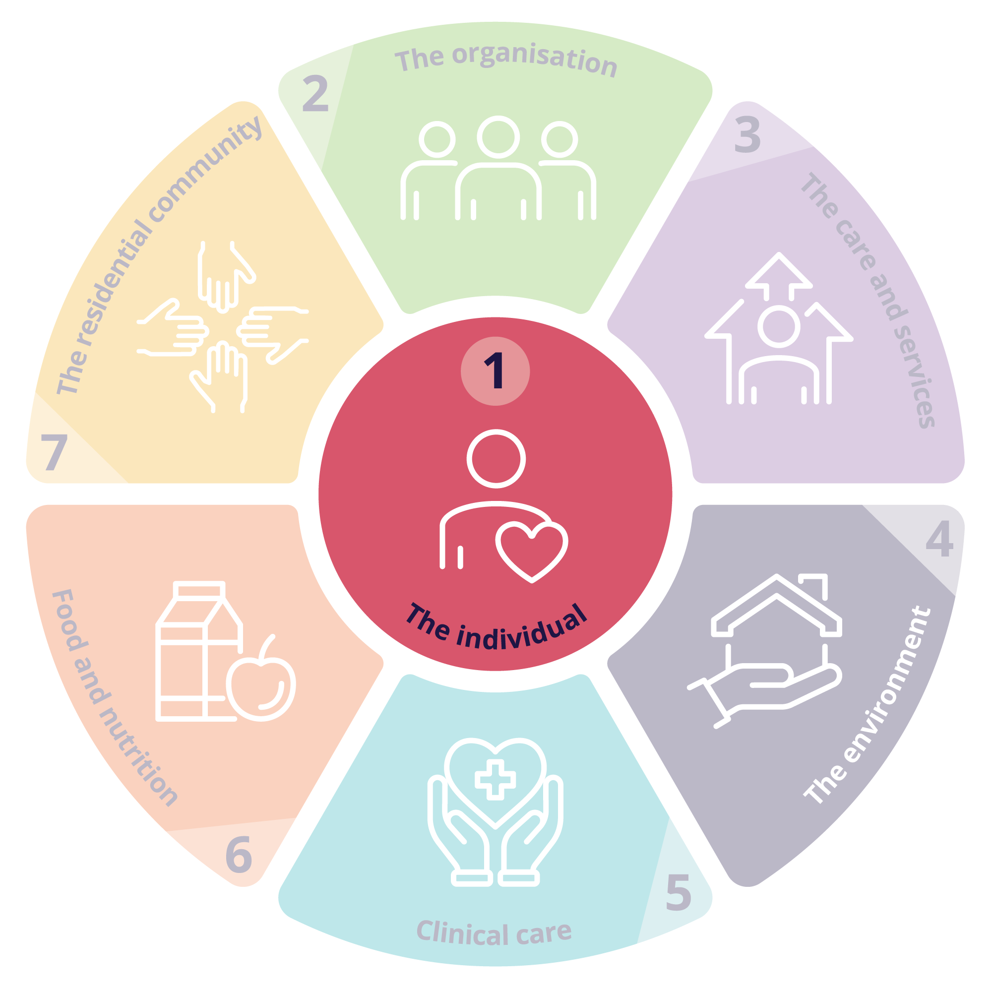
Standard 1: The individual
Outcome 1.1: Person-centred care
The provider demonstrates that the provider understands that the safety, health, wellbeing and quality of life of individuals is the primary consideration in the delivery of funded aged care services.
Outcome 1.2: Dignity, respect and privacy
The provider must deliver funded aged care services to individuals in a way that is free from all forms of discrimination, abuse and neglect, treats individuals with dignity and respect, and respects the personal privacy of individuals.
Outcome 1.3: Choice, independence and quality of life
The provider must support individuals to exercise choice and make decisions about their funded aged care services and provide them with support to exercise choice and make decisions when they want or need it.
Outcome 1.4: Transparency and agreements
Before entering into any agreements with individuals about the delivery of funded aged care services, the provider must provide individuals with the opportunity to exercise autonomy, the time they need to consider the agreement and an opportunity to seek advice.
The provider demonstrates that the provider understands and values individuals, including their identity, culture, ability, diversity, beliefs and life experiences.
The provider demonstrates that the provider develops funded aged care service with, and tailored to, individuals, taking into account their needs, goals and preferences.
The provider demonstrates that the provider understands the rights of individuals under the Statement of Rights. The provider must have practices in place to ensure that the provider acts compatibly with the Statement of Rights, in accordance with subsection 24(2) of the Act (acting compatibly with the Statement of Rights).
The provider must provide individuals with timely, accurate, tailored and sufficient information about their funded aged care services, in a way they understand.
The provider must support individuals to exercise dignity of risk to achieve their goals and maintain independence and quality of life.
The provider must support individuals to understand and make informed decisions about their agreements, fees and invoices.
Notes:
Facilitator notes:
Using your chosen case study, take each Outcome individually for review. Read through the Outcome statement with your staff, discuss meaning and purpose. Allow time for anecdotal examples of how this Outcome might be met for your case study.
Then ask staff to work through the digital guidance to locate suggested Actions that might meet the Outcome expectations for that scenario.
Questions you might ask:
How do we know this action will meet the Outcome?
What barriers to success might be experiences?
How would this action make the older person feel?
Does this suggestion support the policies and procedures already in place?
How might we need to support new staff to follow these practices?
Would our suggested course of action meet more than one Outcome or Standard? If so, which?

Slide 27

Participant Notes – Standard 1
Issue/s identified | Relevant Outcome/s | Suggested Action/s to meet the Outcome
1
2
3
Notes:
Facilitator notes:
QR code will take participants to the strengthened Quality Standards digital guidance on the Commission’s website.

Slide 28
Notes:
Facilitator notes:
The intent of Standard 2 is to set out the expectations of the governing body to meet the requirements of the Quality Standards and deliver quality funded aged care services. A provider’s governance systems and workforce are critical to the delivery of safe, quality, effective and rights-based, person-centred care for every older person, and continuous improvement of funded aged care services.
Print this slide out for staff members to use / display for reference when looking at Standard 2.
You may find it appropriate depending on your chosen case study to discuss the connections to Outcome 5.1: Clinical governance.

Slide 29
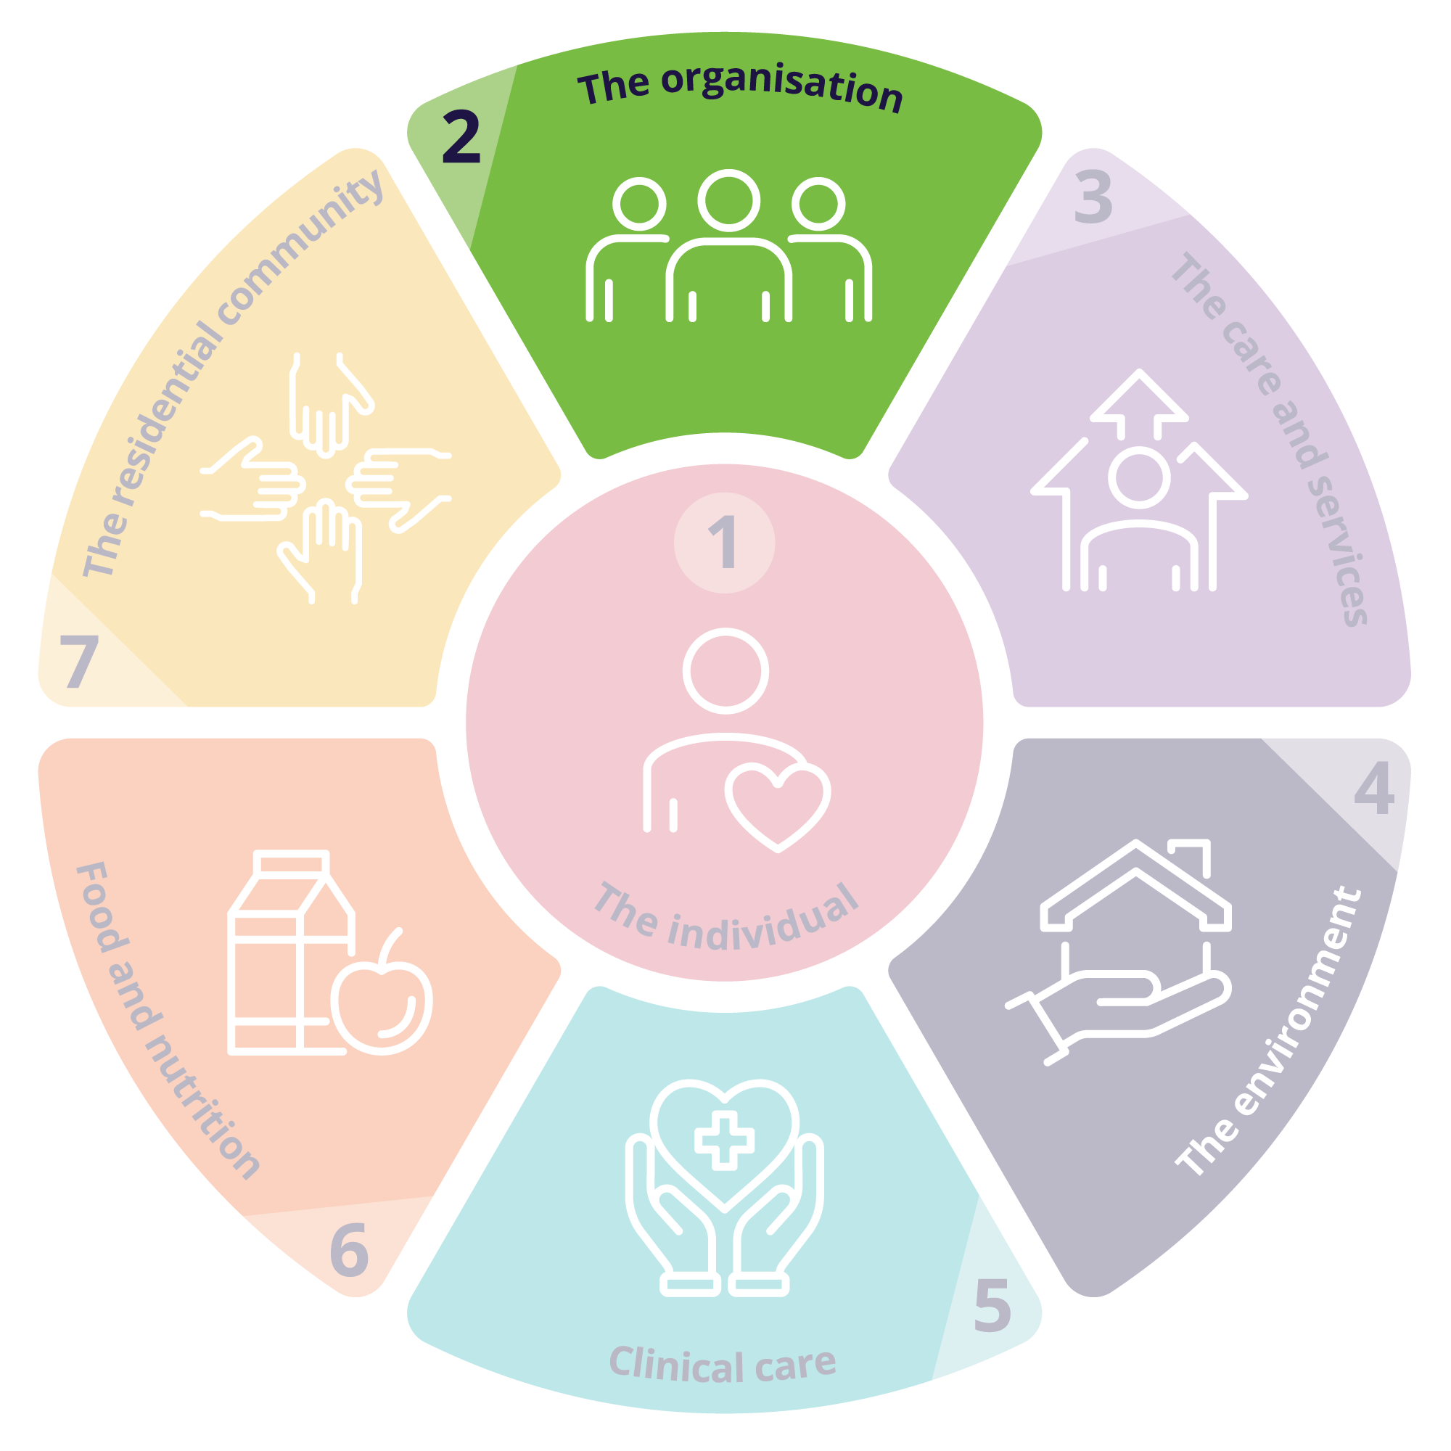
Standard 2: The organisation
Expectation statement for older people: | The organisation is well run. I can contribute to improvements to care and services. My provider and aged care workers listen and respond to my feedback and concerns. I receive funded aged care services from aged care workers who are knowledgeable, competent, capable and caring.
Outcome 2.1: Partnering with individuals | Outcome 2.2a: Quality, safety and inclusion culture to support workers to deliver quality care. | Outcome 2.2b: Quality, safety and inclusion culture to support individuals | Outcome 2.3: Accountability, quality system and policies and procedures | Outcome 2.4: Risk management | Outcome 2.5: Incident management
Outcome 2.6a: Complaints and feedback management for workers | Outcome 2.6b: Complaints and feedback management for individuals | Outcome 2.7: Information management | Outcome 2.8: Workforce planning | Outcome 2.9: Human resource management | Outcome 2.10: Emergency and disaster management
Notes:
Facilitator notes:
Select a relevant Outcome for staff to review. Use the information in your case study and read the Outcome statement, then look for Actions that might support meeting the expectations of the Outcome. Relate these Actions to relevant, practical actions that may be initiated in response to the situation being considered.
Questions you might consider:
What role do each of us play within this Standard?
How do I ensure I am aware of the policies and procedures related to this Outcome?
When things go wrong, what part can I play to prevent it from happening again?
How can I tell if this is an isolated incident, or something systemic?
How does Open Disclosure fit into this Standard?
What are my obligations when there is an incident?
What is a safety culture and how can I support this?

Slide 30

Participant Notes – Standard 2
Issue/s identified | Relevant Outcome/s | Suggested Action/s to meet the Outcome
1
2
3
Notes:
Facilitator notes:
QR code will take participants to the strengthened Quality Standards digital guidance on the Commission’s website.

Slide 31
Notes:
Facilitator notes:
Standard 3 describes the way providers must deliver funded aged care services for all types of services being delivered (noting that other Standards describe requirements relevant to specific service types).
In delivering funded aged care services, providers and workers must draw on all relevant standards, with particular reference to Standard 1, including to ensure care is tailored to the older person and what’s important to them.
Print out for staff members use / display for reference when looking at Standard 3

Slide 32
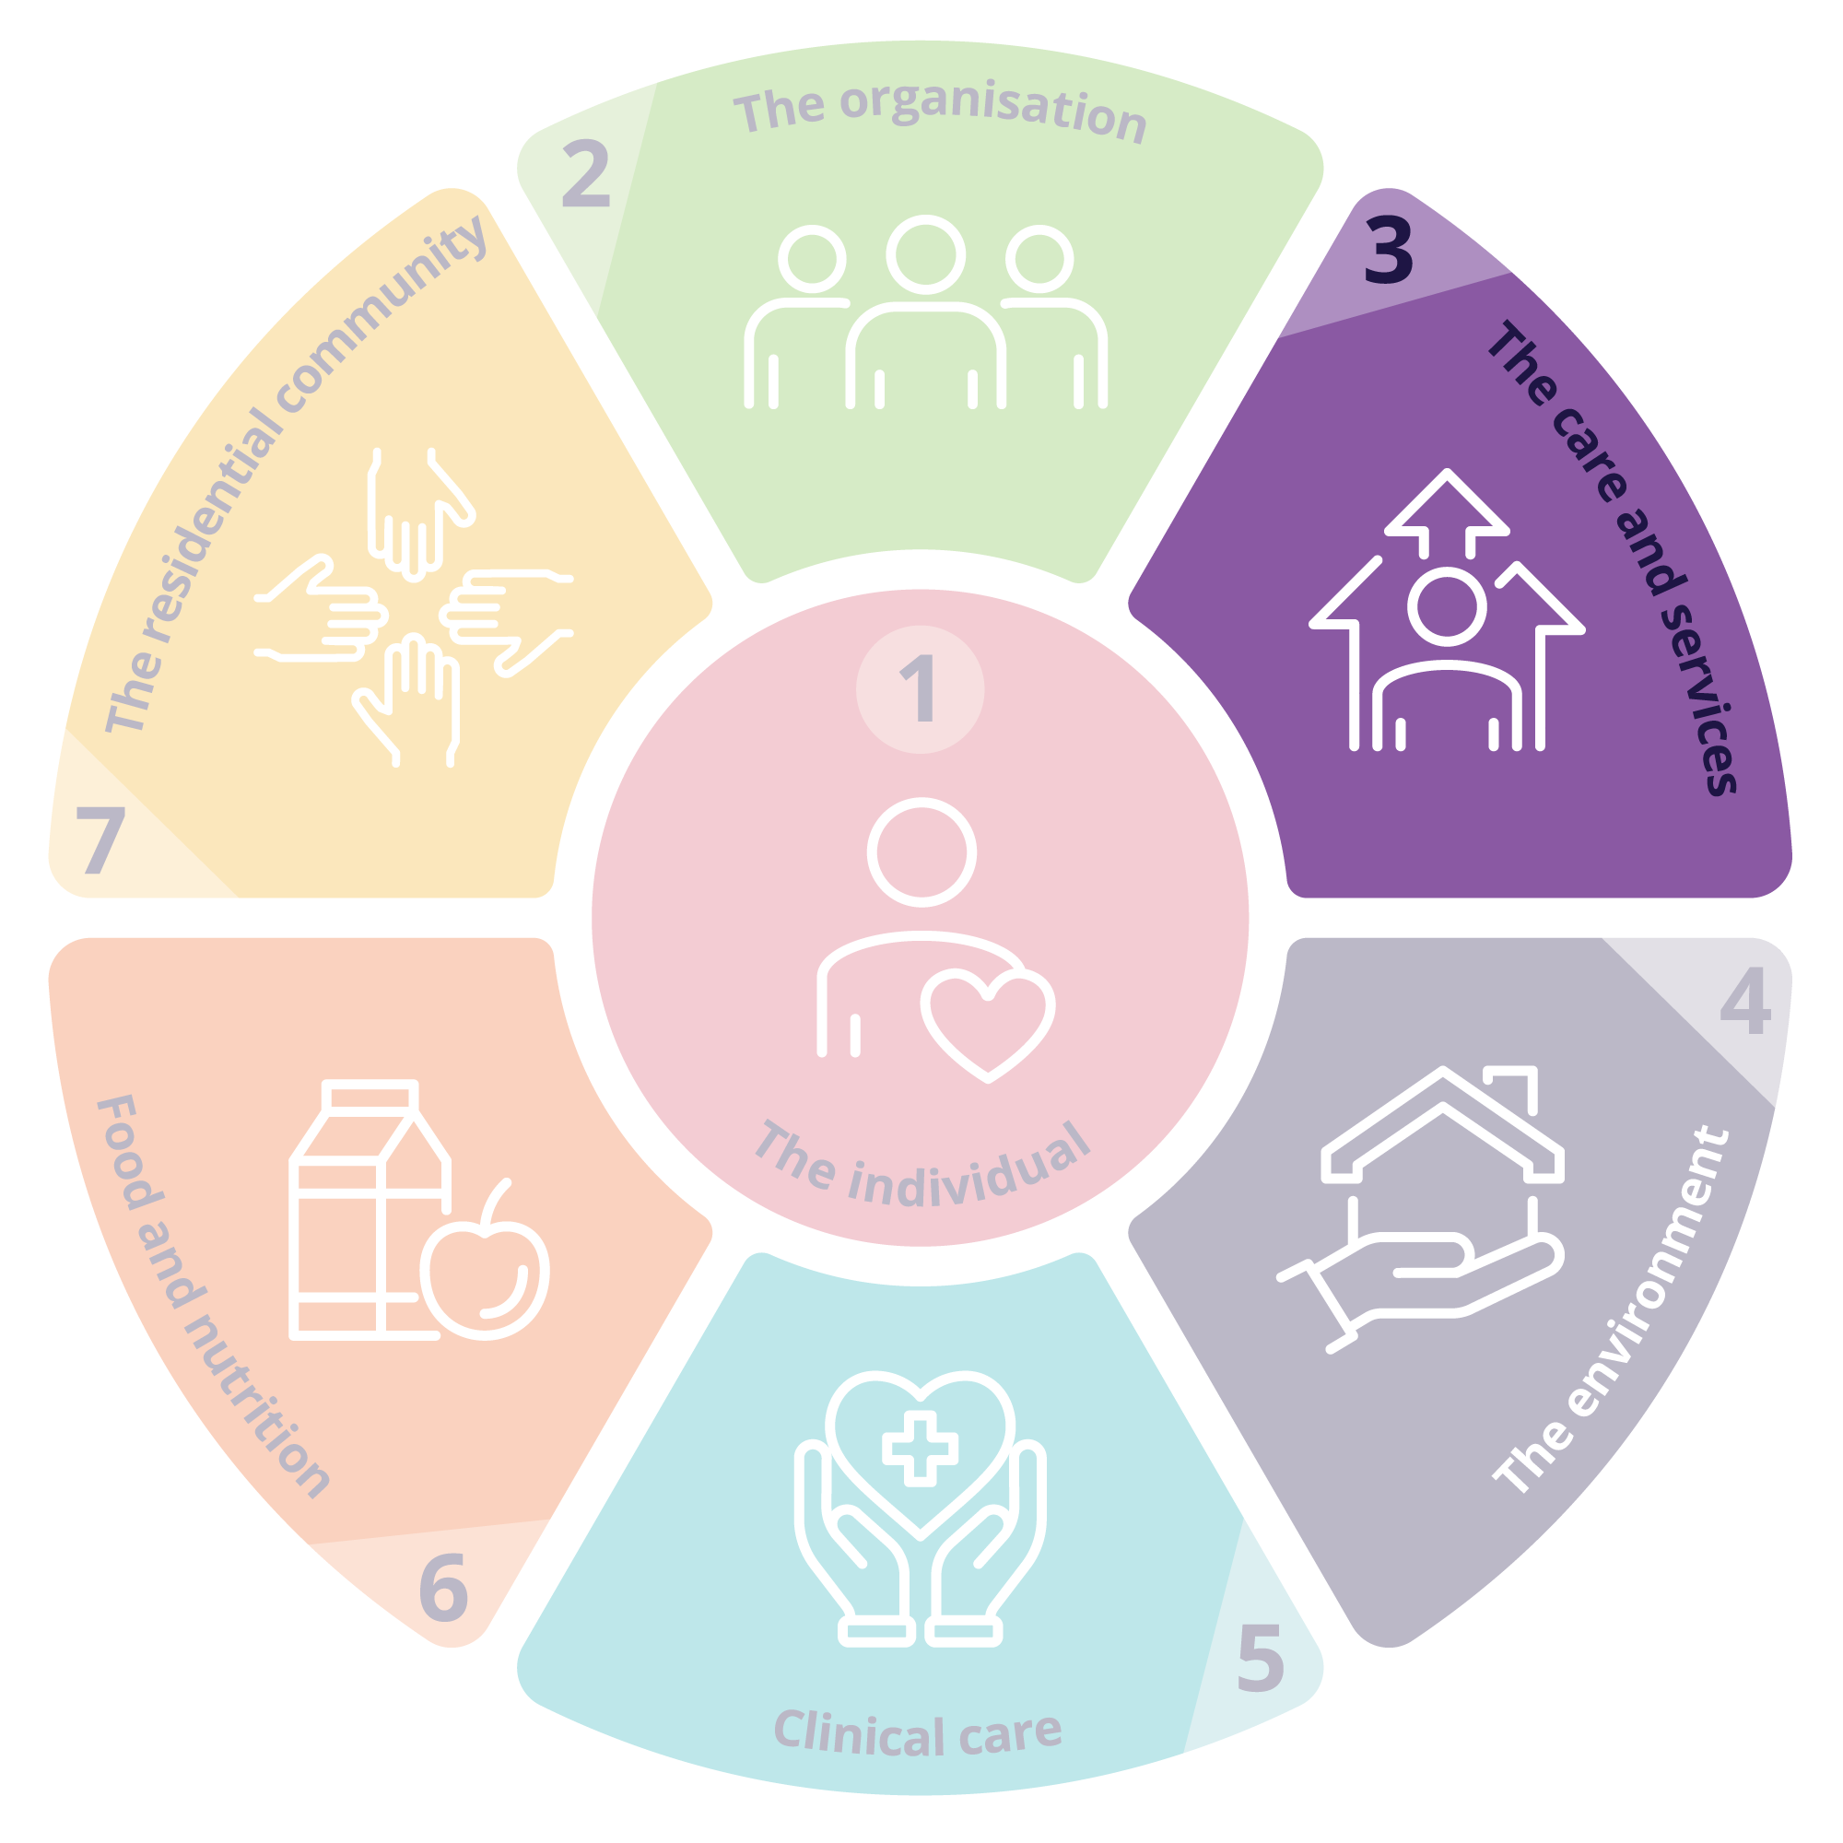
Standard 3: The care and services
Outcome 3.1: Assessment and planning
The provider must actively engage with individuals to whom the provider delivers funded aged care services, supporters of individuals (if any) and any other persons involved in the care of individuals in developing and reviewing the individual’s care and services plans through ongoing communication.
Outcome 3.2: Delivery of funded aged care services
The provider must ensure that individuals receive quality funded aged care services that meet their needs, goals and preferences and optimise their quality of life, reablement and maintenance of function.
Outcome 3.3: Communicating for safety and quality
The provider must ensure that critical information relevant to the delivery of funded aged care services to individuals is communicated effectively to the individuals, between aged care workers delivering the services, with supporters of the individuals and other persons supporting the individuals and with registered health practitioners, allied health professionals, allied health assistants and others involved in the individual’s care.
Outcome 3.4: Planning and coordination of funded aged care services
The provider must ensure that individuals receive funded aged care services that are planned and coordinated, including where multiple health providers and registered providers, supporters of individuals and other persons supporting individuals are involved.
Care and services plans must describe the current needs, goals and preferences of individuals and include strategies for risk management and preventative care.
The provider must ensure that care and services plans are regularly reviewed and are used by aged care workers to guide the delivery of funded aged care services.
The provider must ensure that funded aged care services are delivered in a way that is culturally safe and culturally appropriate for individuals with specific needs and diverse backgrounds.
The provider must ensure that risks to individuals, and changes and deterioration in the condition of individuals are escalated and communicated as appropriate.
Notes:
Facilitator notes:
Using your chosen case study, take each Outcome individually for review. Read through the Outcome statement with your staff, discuss meaning and purpose. Allow time for anecdotal examples of how this Outcome might be met for your case study.
Then ask staff to work through the digital guidance to locate suggested Actions that might meet the Outcome expectations for that scenario.
Questions you might ask:
How do we know this action will meet the Outcome?
What barriers to success might be experiences?
How would this action make the older person feel?
Does this suggestion support the policies and procedures already in place?
How might we need to support new staff to follow these practices?
Would our suggested course of action meet more than one Outcome or Standard? If so, which?
Which other Standards would we need to consider alongside this Standard?
What do the key tasks include that apply to this case study?

Slide 33

Participant Notes – Standard 3
Issue/s identified | Relevant Outcome/s | Suggested Action/s to meet the Outcome
1
2
3
Notes:
Facilitator notes:
QR code will take participants to the strengthened Quality Standards digital guidance on the Commission’s website.

Slide 34
Notes:
Facilitator notes:
The intent of Standard 4 is to ensure that older people receive funded aged care services in a physical environment that is safe, supportive and meets their needs. Effective infection prevention and control measures are a core component of service delivery to protect older people, their supporters and workers.
Print out for staff members use / display for reference when looking at Standard 4

Slide 35
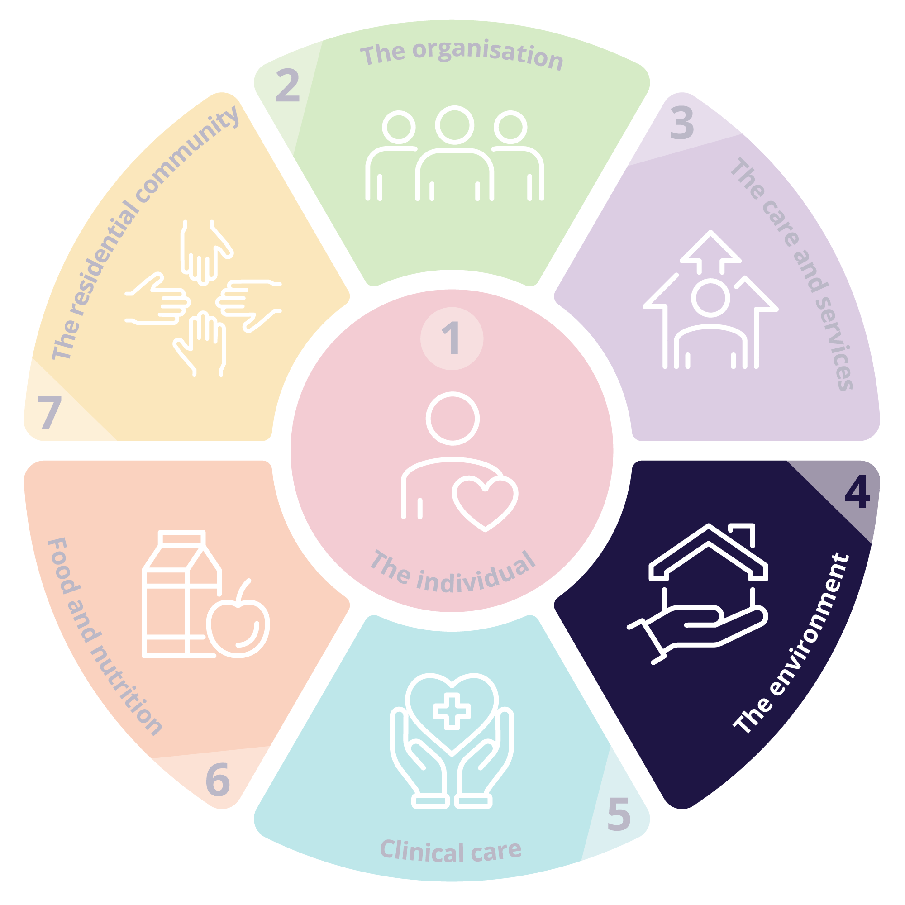
Standard 4: The environment
Outcome 4.1a: Environment – services delivered in the individual's home
When delivering funded aged care services to individuals in their homes, the provider must support the individuals to mitigate environmental risks relevant to the services.
Outcome 4.1b: Environment – services delivered other than in the individual's home
Where the provider delivers funded aged care services to individuals other than in their homes, the provider must ensure that individuals are able to access funded aged care services in a clean, safe and comfortable environment that optimises their sense of belonging, interaction and function.
Outcome 4.2: Infection prevention and control
The provider must have an appropriate infection prevention and control system.
Where the provider uses equipment in the delivery of any funded aged care services to individuals, or providers equipment to individuals, the equipment must be safe and must meet the needs of the individuals.
Where the provider uses equipment in the delivery of any funded aged care services to individuals, or provides equipment to individuals, the equipment must be safe and must meet the needs of the individuals.
The provider must ensure that aged care workers use hygienic practices and take appropriate infection prevention and control precautions when delivering funded aged care services.
Notes:
Facilitator notes:
Using your chosen case study, take each Outcome individually for review. Read through the Outcome statement with your staff, discuss meaning and purpose. Allow time for anecdotal examples of how this Outcome might be met for your case study.
Then ask staff to work through the digital guidance to locate suggested Actions that might meet the Outcome expectations for that scenario.
Questions you might ask:
How do we know this action will meet the Outcome?
What barriers to success might be experienced?
Does this suggestion support the policies and procedures already in place?
How might we need to support new staff to follow these practices?
How do we ensure any equipment used is fit for purpose?
How do we know any equipment used is meeting the needs of the older person?
How do we ensure all workers understand our hygienic practices at [insert name of your organisation here]
Would our suggested course of action meet more than one Outcome or Standard? If so, which?

Slide 36

Participant Notes – Standard 4
Issue/s identified | Relevant Outcome/s | Suggested Action/s to meet the Outcome
1
2
3
Notes:
Facilitator notes:
QR code will take participants to the strengthened Quality Standards digital guidance on the Commission’s website.

Slide 37
Notes:
Facilitator notes:
Extract from Standard 5 intent statement
The Clinical care Standard describes the responsibilities of providers to deliver safe and quality clinical care services to older people.
At all times, clinical care services provided should be rights-based, person-centred, inclusive, safe, effective and coordinated. It should be planned and delivered in partnership with the older person, involving their supporters and others in line with the older person’s needs and preferences. Delivering safe, quality clinical care services requires a multidisciplinary approach with a skilled workforce with clear accountabilities that are supported to deliver contemporary, evidence-based care.
Effective implementation of Standard 5 is reliant on the systems and processes from Standards 1-7.
Print out for staff members use / display for reference when looking at Standard 5

Slide 38
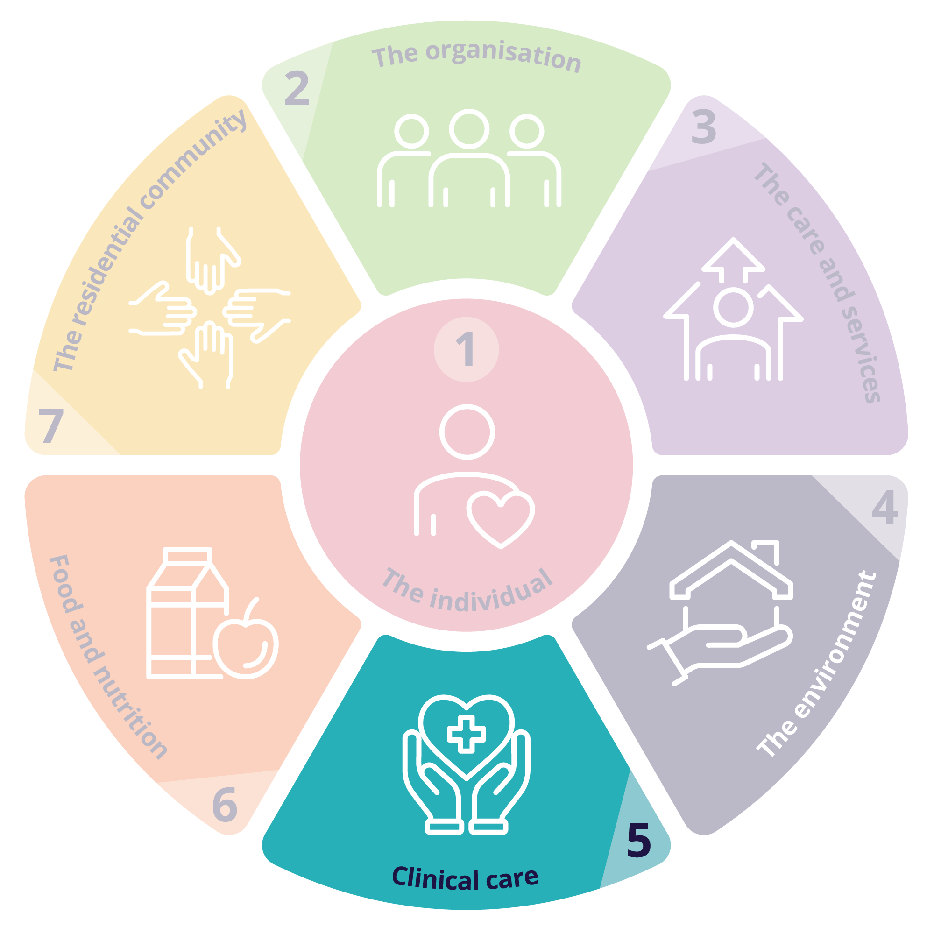
Standard 5: Clinical care
Expectation statement for older people:
I receive person-centred, evidence-based, safe, effective, and coordinated clinical care services by registered health practitioners, allied health professionals, allied health assistants and competent aged care workers that meets my changing clinical needs and is in line with my goals and preferences.
Outcome 5.1 Clinical governance
Outcome 5.2 Preventing and controlling infections in delivering clinical care services
Outcome 5.3 Safe and quality use of medicines
Outcome 5.4 Comprehensive care
Outcome 5.5 Safety of clinical care services
Outcome 5.6 Cognitive impairment
Outcome 5.7 Palliative care and end-of-life
Notes:
Facilitator notes:
Using your chosen case study, take each Outcome individually for review. Read through the Outcome statement (found on the digital guidance) with your staff, discuss meaning and purpose. Allow time for anecdotal examples of how this Outcome might be met for your case study.
Then ask staff to work through the digital guidance to locate suggested Actions that might meet the Outcome expectations for that scenario.
Questions you might ask:
How do we know this action will meet the Outcome?
What barriers to success might be experiences?
Does this suggestion support the policies and procedures already in place?
How do we consider an older person’s supporters when meeting this Standard?
How do we most effectively coordinate clinical care when there are multiple clinical staff involved in an older person’s care?
How do we effectively monitor an older person’s needs to identify any changes?
How do we meet an older person’s clinical needs in line with their goals and preferences?

Slide 39

Participant Notes – Standard 5
Issue/s identified | Relevant Outcome/s | Suggested Action/s to meet the Outcome
1
2
3
Notes:
Facilitator notes:
QR code will take participants to the strengthened Quality Standards digital guidance on the Commission’s website.

Slide 40
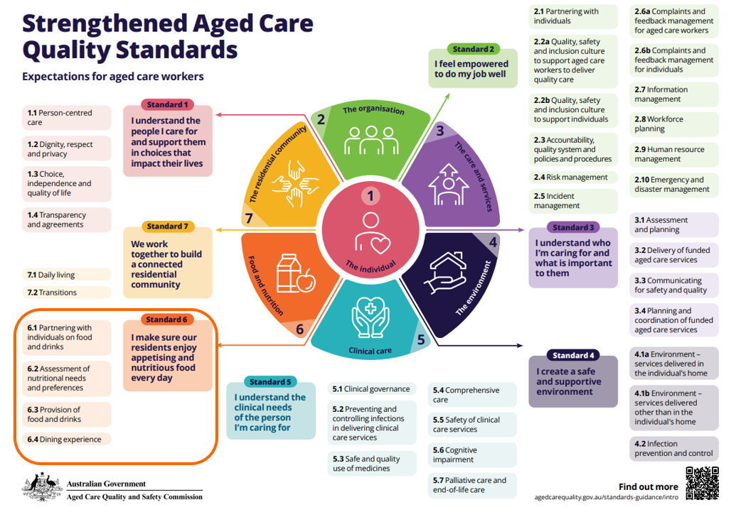
Notes:
Facilitator notes:
Extract of intent statement for Standard 6:
Standard 6 is intended to apply only to residential care homes.
It is important that providers engage with older people about what they like to eat and drink, deliver choice and meals that are full of flavour, appetising and nutritious (including for older people with texture modified diets), and support older people to consume as much as they want and exercise dignity of risk.
Providers must draw on Standard 3 in delivering food services to ensure this is informed by robust assessment and planning and funded aged care services are delivered in line with the needs, goals and preferences of older people. It is critical for providers to monitor older people for malnutrition and dehydration and respond appropriately where concerns are identified – this is addressed as part of Standard 5.
Print out for staff members use / display for reference when looking at Standard 6

Slide 41
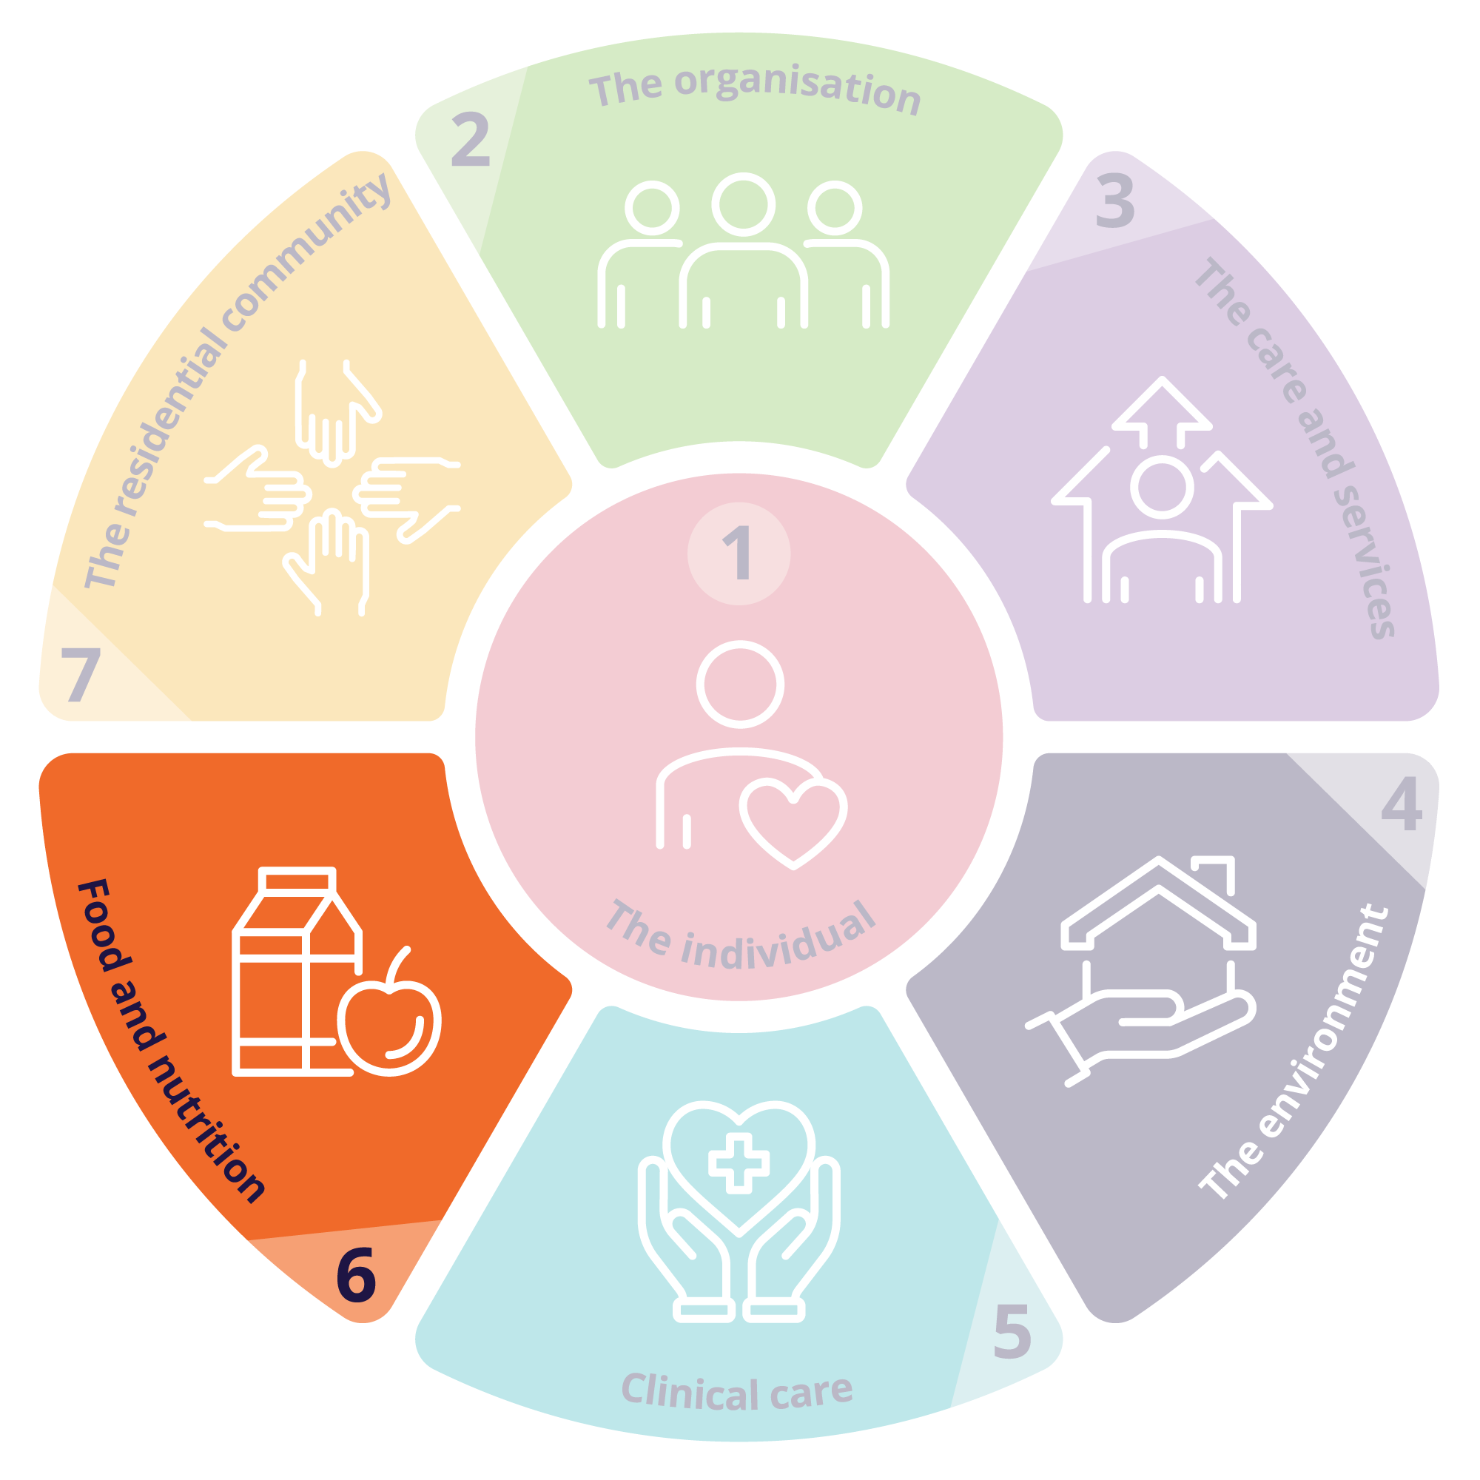
Standard 6: Food and nutrition
Outcome 6.1: Partnering with individuals on food and drinks
The provider must partner with individuals to deliver a quality meal and refreshment service that incudes appealing and varied food and drinks and an enjoyable dining experience.
Outcome 6.2: Assessment of nutritional needs and preferences
The provider must demonstrate that the provider understands the specific nutritional needs of individuals and assesses the current needs, abilities and preferences of individuals in relation to what and how they eat and drink.
Outcome 6.3: Provision of food and drinks
The provider must provide individuals with food and drinks that meet their nutritional needs and are appetising and flavoursome, have variation and choice about what they eat and drink and choice about how much they eat and drink.
Outcome 6.4: Dining experience
The provider must support individuals to eat and drink.
The provider must ensure that the dining experience meets the needs and preferences of individuals to support social engagement, function and quality of life.
Notes:
Facilitator notes:
Using your chosen case study, take each Outcome individually for review. Read through the Outcome statement with your staff, discuss meaning and purpose. Allow time for anecdotal examples of how this Outcome might be met for your case study.
Then ask staff to work through the digital guidance to locate suggested Actions that might meet the Outcome expectations for that scenario.
Questions you might ask:
How do we know this action will meet the Outcome?
What barriers to success might be experiences?
Does this suggestion support the policies and procedures already in place?
How do we provide choice within food and nutrition?
What monitoring procedures do we have in place regarding food and nutrition?
How do we include older people in the design of our menu and dining experience?
How do we make texture modified foods appealing?
What support do we offer to older people when eating and drinking?

Slide 42

Participant Notes – Standard 6
Issue/s identified | Relevant Outcome/s | Suggested Action/s to meet the Outcome
1
2
3
Notes:
Facilitator notes:
QR code will take participants to the strengthened Quality Standards digital guidance on the Commission’s website.

Slide 43
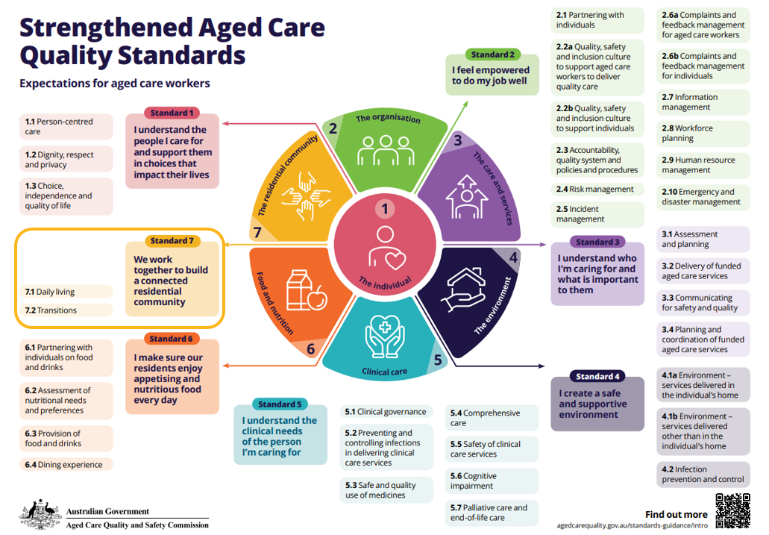
Notes:
Facilitator notes:
Standard 7 is intended to apply only to residential care homes.
Extracts from the Intent of Standard 7 [the full Intent statement can be accessed on the digital guidance]
It is critical that older people feel safe and at home in the residential community, have opportunities to do things that are meaningful to them and are supported to maintain connections with people important to them.
Given the scope of responsibility in residential care homes, providers also have increased requirements to ensure that older people have access to other services and to coordinate a planned transition to or from the organisation to maximise continuity of care for older people.
Print out for staff members use / display for reference when looking at Standard 7

Slide 44
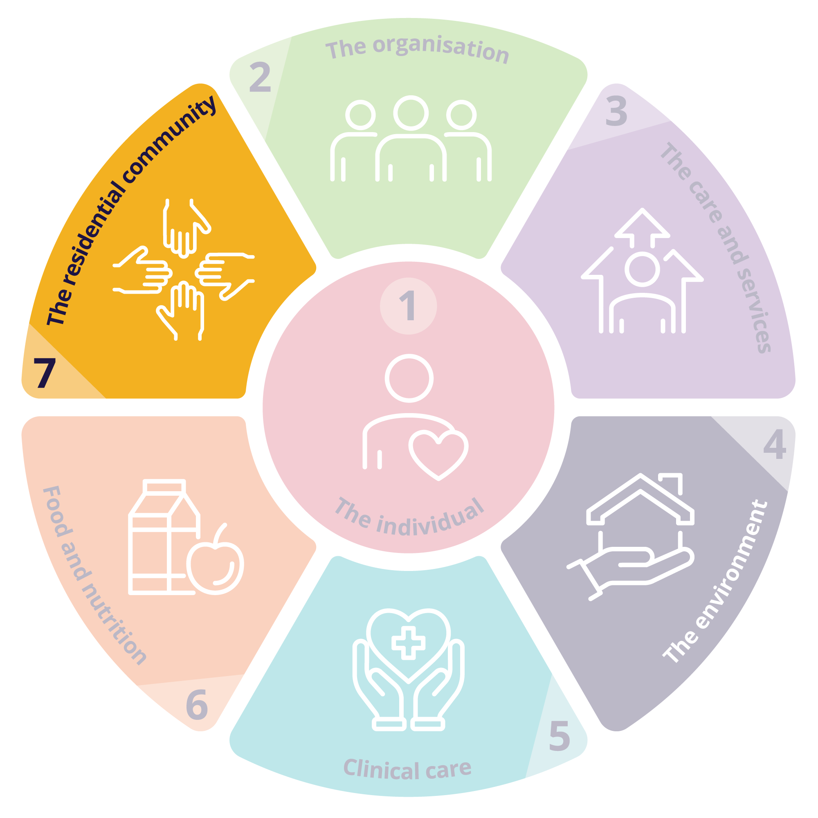
Standard 7: The residential community
7.1: Daily living | 7.2: Transitions
The provider must ensure that individuals receive funded aged care services that optimise their quality of life, promote use of their skills and strengths and enable them to do the things they want to do. | The provider must ensure that individuals experience a well-coordinated transition, whether planned or unplanned, to or from a provider. The provider must set out clear responsibility and accountability for the delivery of funded aged care services between aged care workers, registered health practitioners, allied health professionals, allied health assistants and across organisations.
Notes:
Facilitator notes:
Using your chosen case study, take each Outcome individually for review. Read through the Outcome statement with your staff, discuss meaning and purpose. Allow time for anecdotal examples of how this Outcome might be met for your case study.
Then ask staff to work through the digital guidance to locate suggested Actions that might meet the Outcome expectations for that scenario.
Questions you might ask:
How do we know this action will meet the Outcome?
What barriers to success might be experiences?
Does this suggestion support the policies and procedures already in place?
How do we engage older people in a balance of lifestyle activities?
How do we manage the balance between an older person’s privacy and care?
How do we support older people to feel welcome?
How do we support continuity of care for an older person when they transition to our care?
How do we enable older people to engage in intimate relationships of their choice?

Slide 45

Participant Notes – Standard 7
Issue/s identified | Relevant Outcome/s | Suggested Action/s to meet the Outcome
1
2
3
Notes:
Facilitator notes:
QR code will take participants to the strengthened Quality Standards digital guidance on the Commission’s website.

