Slide 1

Strengthening provider governance

Slide 2

Acknowledgement of Country

Slide 3



Key topics we’ll cover today:
an overview of the provider governance reforms
implementation dates
who they apply to
the determinations process for providers
that are currently not able to meet the requirements
  how the Governing for Reform in Aged Care program can support your organisation to lift their clinical and organisational governance capability

Slide 4

Context and background
The right mix of people in any organisation is a key factor in driving continuous improvement
Our role is to help organisations meet the provider governance requirements through support and resources

Slide 5


Louise Macleod
Complaints Commissioner
Overview of the provider governance reforms

Slide 6

From 1 December 2022
All providers are required to:
assess the suitability of each of your key personnel at least once a year
tell us when you make material changes to your organisation and changes to your key personnel, including key personnel suitability within 14 days
submit provider operations reports annually

Slide 7

From 1 December 2023
All providers are required to:
meet governing body membership requirements
establish a quality care advisory body
offer to establish a consumer advisory body
ensure your people are skilled and build their capability
prioritise older Australians (not the holding company) if the organisation is a wholly owned subsidiary

Slide 8

Providers approved after
1 December 2022
Providers approved after 1 December 2022 are required to meet all provider governance requirements from date
of approval.

Slide 9


Notifications – material and key personnel changes
    Tell us:
      about organisational changes such as ABN, business name, sale of a service, full or partial sale of your business, mergers and acquisitions
      when you add or cease key personnel – including when you sell or transfer your service to another provider (even when they are under the same business structure)
      when a key personnel is no longer suitable - including why
    Keep records about decisions made regarding key personnel suitability.
    Provide a full Nationally Coordinated Criminal History check (extracts are not accepted) or an NDIS Worker screening check.
    Keep your information, and your key personnel’s information, secure at all times.
    Progressing a Notification will be delayed if forms are incomplete, documents are missing or are incorrect.
Organisation changes
Key personnel changes
Key personnel suitability

Slide 10

Government Provider Management System (GPMS)
GPMS will:
allow aged care providers to self-manage, view, and maintain their records with the government
support provider reporting requirements
improve information sharing between the aged care and healthcare systems
provide a master source of aged care provider information for collection and sharing with relevant stakeholders

Slide 11


Governing body composition
Unless exempt, the governing body must have: ​
a majority of independent non-executive members, and
at least one member with experience in the provision of clinical care
does not apply to all providers
Fewer than 5 members and provides aged care (through one or more services) to fewer than 40 care recipients
Aboriginal Community Controlled Organisation
State, Territory or Local Government

Slide 12

What is a determination?
A determination is the outcome of a Commission decision affirming that either one or both of the governing body requirements do not apply.
The maximum length of a determination is 12 months.
Determination decisions DO NOT remove an approved provider’s other obligations under the Aged Care Act 1997.

Slide 13


Request a determination
Providers can apply to the Commission for a ‘determination’ that one or both of the provider governance requirements do not apply.
Scan the QR code
Go to our website www.agedcarequality.gov.au
Enter ‘request determination’ in the search bar at the top right of our home page

Slide 14
The assessment process
Apply for a determination
What we consider
the number and location of the aged care services that the provider has
The determination
the maximum determination period is 12 months
check that all required fields are completed, the form is signed and you have included all supporting documents
use the approved form available on our website
the number of care recipients
measures taken by the provider to meet the requirements in other ways
will be made within 60 days of receiving a complete application
will take longer if we need further information
the determination will be given to you in writing
records held by the Commission

Slide 15

Determination timeframes
Complete application
Incomplete application
Determination period
60 days
more than 60 days
up to
12 months

Slide 16

Scenarios

Slide 17
Scenarios
Scenario 1
Provider A is an organisation with only 3 people on the Board, however it provides care to more than 50 aged care clients. Do they need to comply with the governing body requirements or are they exempt?
Scenario 2
Provider B is a small organisation operating a single service which is located in a rural/remote area. This has made it difficult for Provider B to find people locally to satisfy the governing body requirements. Do they need to meet the requirements? What other options are available to assist Provider B?
Scenario 3
Provider C is a home care provider that doesn’t deliver clinical care. Why do they need to have someone with clinical experience on their governing body?

Slide 18

Pam Christie
Executive Director – Strategic Projects
Governing for Reform in Aged Care Program

Slide 19

Provider governance
“We considered provider governance extensively, and we have made a series of recommendations for improvements which reinforce the need for boards and executives to:
to act responsibly and appropriately;
to lead their services with the interests
of older people at heart; and
to be more open and transparent about
the quality performance of their services.”
Source: Royal Commission into Aged Care Quality and Safety, Final Report, Volume 1

Slide 20



Critical behavioural shifts
From
To
Operational, financial and performance focus
Substandard care at inexcusably high levels
Minimum acceptable standard
No clear statement of responsibility
Some directors act in the best interest of
wholly owned subsidiary companies
Boards and leaders are disconnected from
the day-to-day practices in their services
Board members deny knowledge of problems
when they occur
Inappropriate board skills and composition
Deficiencies in leadership
Reactive
Values and behaviours are poor
The safety, health, wellbeing and interests of people who receive aged care
must inform the governance processes of approved providers
The community expects dignity, respect, control, choice and good quality of life
Consistent delivery of high-quality care
Universal, shared understanding of high-quality care in Australia and clarity
around the roles and duties of the board and C-suite in discharging
Board members have a duty to act in good faith in the best interest
of an organisation
Supporting committees monitor and ensure accountability for the
quality of care
Transparency in systems, processes and response. Board members attest
that they are satisfied these will deliver safe and high-quality care outcomes
Members of governing bodies with the mix of skills, experience and knowledge
of governance responsibilities to provide safe and high-quality care combined
with curiosity and ambition for care improvement
Clinical governance expertise
Professional knowledge of the aged care sector
Urgent need for innovation, collaboration and transformation
Client-centred strategies driven by boards
Values and behaviours of those in senior positions align with the mission
and purpose of the aged care system
Older Australians
at the Centre of Care
Obligations and Accountabilities
Knowledge, Skills
and Experience
Leadership
and Culture

Slide 21




Program activity overview
Older Australians
at the Centre of Care
Obligations and Accountabilities
Knowledge, Skills
and Experience
Leadership
and Culture
Online
Learning modules and resources
17 Online learning modules and
flip guides
A toolkit with
topic guides and practical tools
Webinars
Monthly webinars for program participants involving panel discussions on key topics
Podcasts
A series of podcasts with conversations with sector leaders
Action
Learning Groups
Participants can join their peers
to explore areas
of interest
Leadership Sprints and Coaching
Leadership sprints target large providers and coach for small, rural
and remote providers
Workshops
Participants can join workshops to consolidate their learning

Slide 22
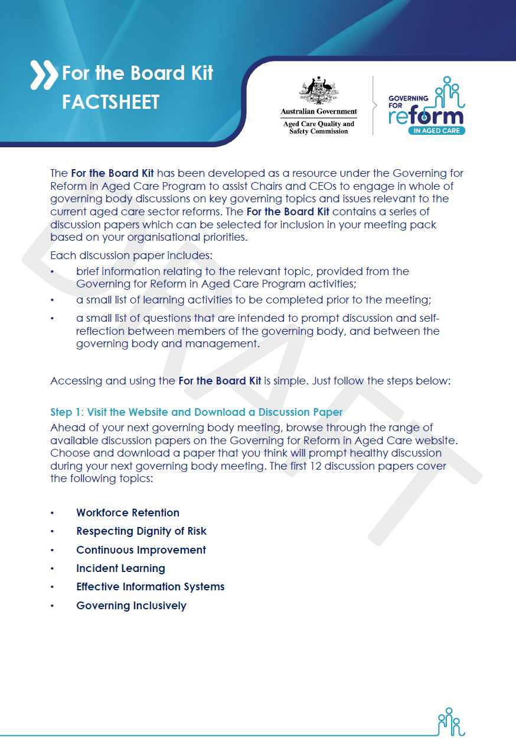

For the Board Kit
Workforce Retention
Effective Information Systems
Data Driven Decision Making
Respecting
Dignity of Risk
Governing Inclusively
Skills and Composition
Continuous Improvement
Compliance
with Clinical Governance Obligations
Setting Tone
from the Top
Incident
Learning
Consumers
at the Centre
Planning for
the Future

Slide 23
Program enrolments
Number of providers with at least one enrolled participant
Number of providers in the aged care sector
Representation by care type
Number of providers
6,036
Program enrolments
919
Providers enrolled
Source: Governing for Reform in Aged Care data 29/8/23

Slide 24

https://gfr.agedcarequality.gov.au/
Any questions?

