Slide 1

Strengthening provider governance
A regulatory perspective

Slide 2
Janet Anderson PSM Commissioner
Welcome
Aged Care Quality and Safety Commission

Slide 3

Acknowledgment of Country

Slide 4

Key topics we’ll cover today:
an overview of the provider governance reforms
regulatory guidance for the reforms
how to demonstrate compliance with the reforms
overview of the Governing for Reform in Aged Care Program.

Slide 5
Emma Jobson Executive Director Regulatory Policy and Intelligence
Overview of the provider governance reforms

Slide 6


Scope of the provider governance reforms
Residential Aged Care
Short-term Restorative Care in Residential Aged Care settings
Home Care Package
Short-term Restorative Care at home
Multi-Purpose Services Program
Transition Care Program services
Commonwealth Home Support Program
National Aboriginal and Torres Strait Islander Flexible Aged Care Program

Slide 7

Provider governance obligations – existing providers – 1 December 2022
From 1 December 2022, existing approved providers must:
assess the suitability of their key personnel at least once a year
submit material changes, including key personnel notifications, within 14 days
report annually on their operations.

Slide 8

Provider governance obligations – existing providers – 1 December 2023
From 1 December 2023, existing approved providers must also:
ensure their governing body is mostly made up of independent non-executive members that have the mix of skills and experience to deliver safe and high-quality care, and that at least one member has experience in providing clinical care
set up and continue a quality care advisory body
offer to set-up at least one consumer advisory body.

Slide 9
Provider governance obligations – new providers from 1 December 2022
Providers approved on or after 1 December 2022 will need to meet all requirements from the date of approval.
For applications for approved provider status made before 1 December 2022, and where a decision on that application is still pending, the new governing and advisory body responsibilities will not apply until 1 December 2023.

Slide 10
Governing body composition
Under subsection 63-1D(2) of the Act, unless exempt, the governing body must have:
a majority of independent non-executive members, and
at least one member with experience in the provision of clinical care

Slide 11
When the governing body composition responsibilities do not apply
governing body with fewer than 5 members AND provide aged care to less than 40 care recipients
State or Territory body
State or Territory authority
local government authority
Aboriginal Community Controlled Organisation.

Slide 12
Ann Wunsch Executive Director Approvals, Compliance and Investigations
Regulatory guidance

Slide 13
Material changes and key personnel notification
Within 14 days:
a person who is key personnel must tell the approved provider when they experience a change in circumstances that relates to their suitability.
approved providers must advise us at the Commission when they employ a new key personnel; or one of their key personnel leaves or is no longer a key personnel for the approved provider; or a key personnel is no longer suitable to hold a key personnel position.

Slide 14

Suitability of key personnel
key personnel registrations – such as AHPRA
key personnel insolvency checks undertaken by an approved provider
NDIS Banning order checks
police certificates evidencing that an individual has not been convicted of an indictable offence.

Slide 15
Lisa Peterson PSM Assistant Commissioner Sector Capability
Governing for Reform in Aged Care Program

Slide 16

Governing For Reform
A free program for Executive Leaders and Governing Body Members of aged care service providers

Slide 17
What the research told us

Slide 18
Executive leaders and/or governing body members hold a mix of responsibilities, governance and training experience within and outside the sector
Current job title
Role outside the sector
Time in the sector
Time in current role
Role within the sector
CEO | Board Member | Chair of the Board | General manager
Other roles: Director of Nursing, CFO, Risk and Compliance Officer, Regional manager, Clinical director. Director / Head of HR, Director / Head of Risk
NET Held/ hold role as governing body or executive leader outside sector: 69%
Industries worked in
Top industries worked for across professional career:
Qualification areas
Governance training experience
Health care | Profession services | Government agency | Education / teaching | Social assistance | Financial / insurance
Top qualification areas:
A1. What is your role within an aged care provider? A2a. How long have you been a member of a governing body within the aged care sector? Base n=370/656 A2b. How long have you been an executive leader within the aged care sector? A7. In your professional career, have you worked in any industries other than Aged Care? A3. Do you hold, or have you ever held, a role as a member of the governing body or an executive leader outside of the aged care sector A4. Which best describes your role within the aged care provider you are associated with? A5. And how long have you been in this role? Base n=656
Business | Nursing | Accounting | Health / public policy

Slide 19
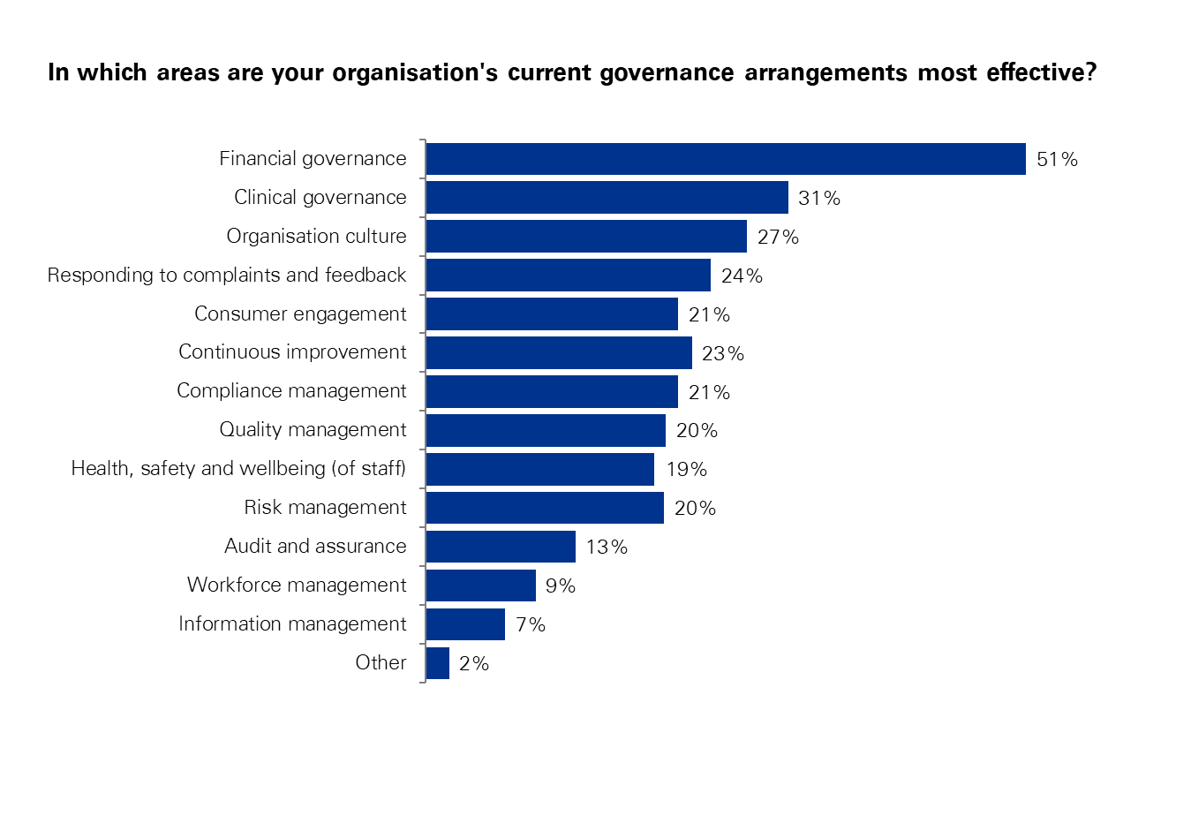
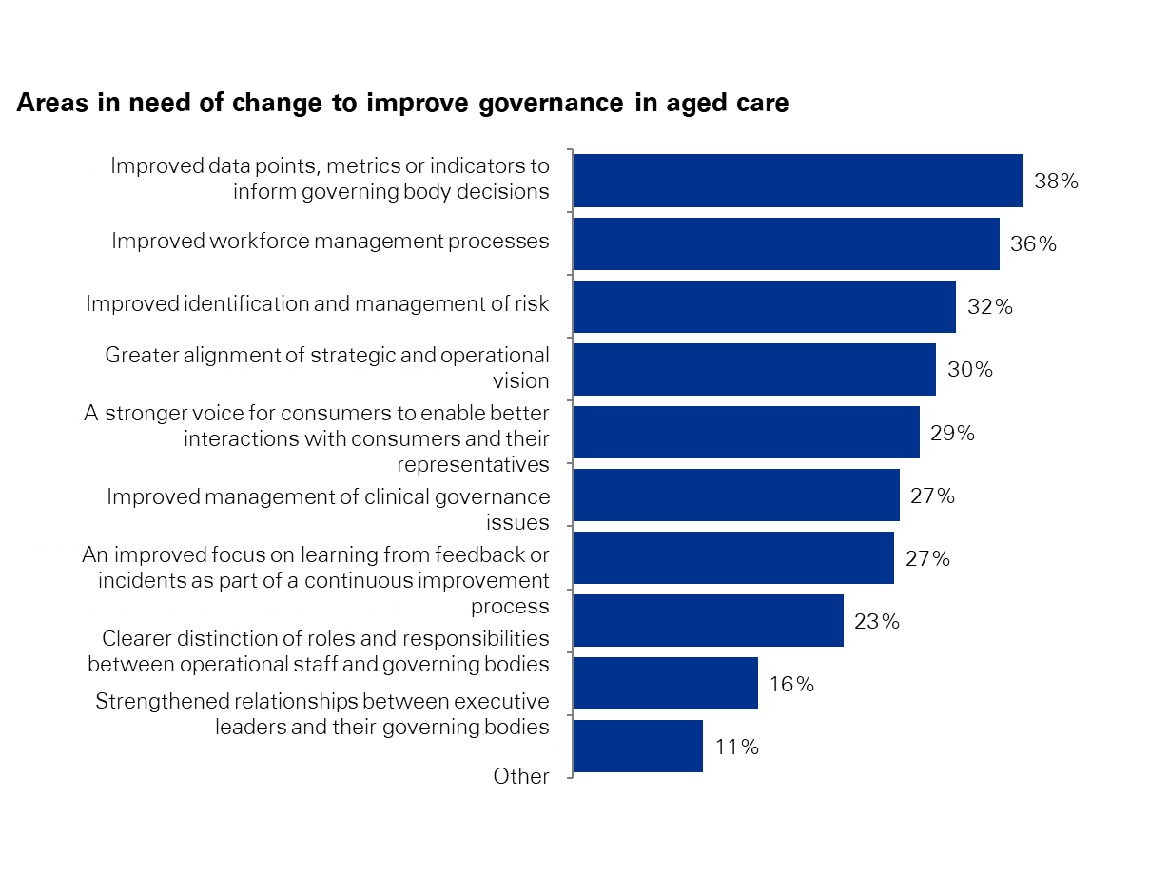
Effective vs non effective governance areas
Financial governance is seen as the most effective area of governance, while workforce management and access to data and information are see as areas in need of change
In which areas are your organisation’s current governance arrangements most effective?
Areas in need of change to improve governance in aged care

Slide 20

Capability Framework

Slide 21
Online learning modules
There are 15 modules currently available, with a module centred around the Aged Care Reform Agenda due for release in December. The existing modules are:
Core Module: Consumers at the Centre of Care
Core Module: Obligations & Accountabilities
Core Module: Effective Governance
Core Module: Leading the Transformation
Clinical Governance
Continuous Improvement
Data Driven Decision Making
Governance within the Home Care Context
Incident Learning
Inclusive & Culturally Safe Governance
Information Management
Partnering with People Living with Dementia
Restrictive Practices
Rethinking Risk
Workforce

Slide 22







Podcasts series - “Conversations to Transform Aged Care”
Season 1 of the Governing for Reform podcast series “Conversations to Transform Aged Care” is now available as part of the Program, as well as publicly available.

Slide 23
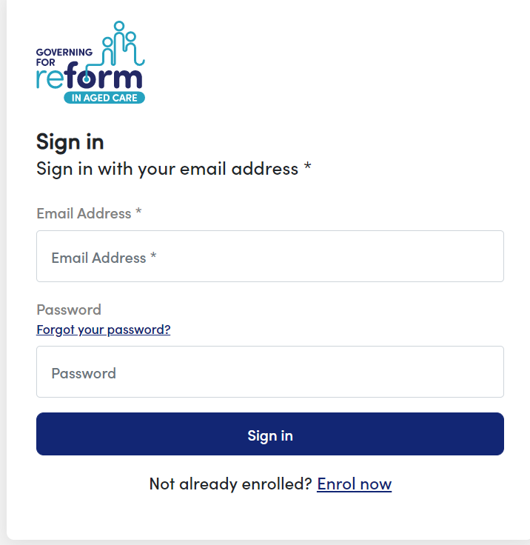

How to enrol in the Governing for Reform Program
Scan the QR code below and tap ‘Enrol Now’
Eligible participants can enrol in the Program via: https://gfr.agedcarequality.gov.au/

Slide 24
Any questions?
Email us at:
GoverningForReform@agedcarequality.gov.au

Slide 25
Q&A
Questions?

Slide 26
More information
Commission:
Aged care reforms webpage
agedcarequality.gov.au/reforms
Department of Health and Aged Care
Aged Care Engagement Hub:
agedcareengagement.health.gov.au

Slide 27
Thank you for participating
Please complete the post webinar survey

